Slide 1

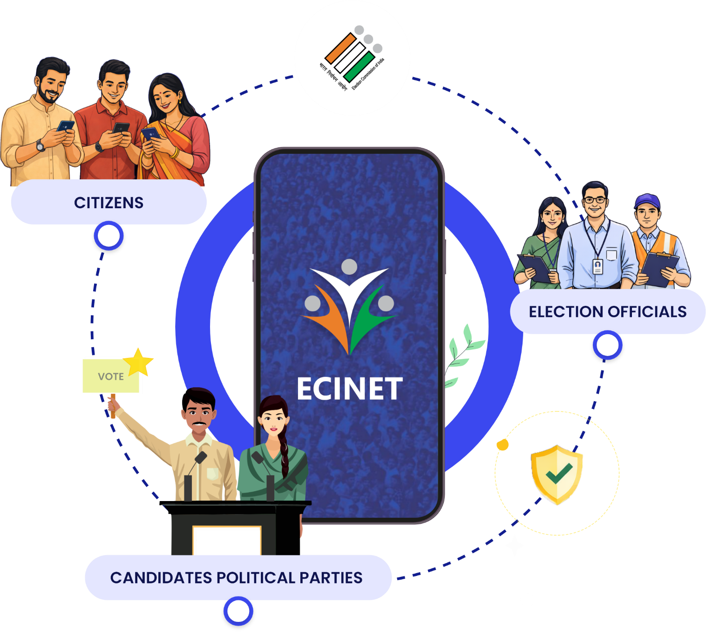



ECINET
Mobile App
FOR
Presiding Officers
Download Mobile App from

Slide 2



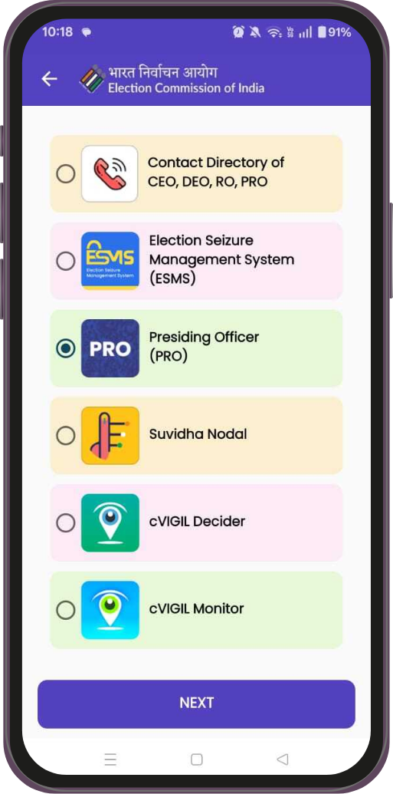
PRO Module
of
ECINET App

Slide 3

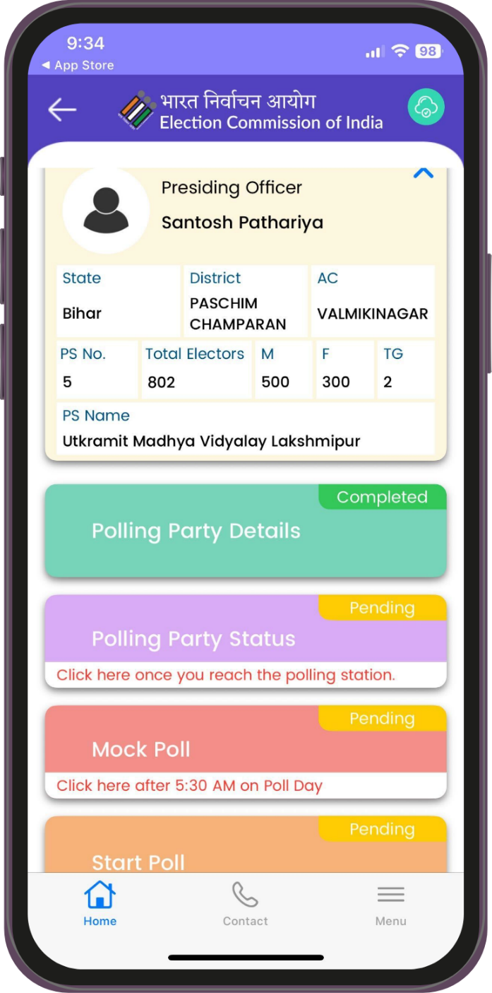
What is PRO Module?
A Designed for ease — a simple and intuitive app that ensures Poll Day activities are completed with minimal effort (Polling Party arrival status, Mock Poll, Start Poll, Polling Trends and Close of Poll) on P-1 and Poll Day.

Slide 4

Prerequisites/आवश्यक शर्तें
Smart Phone with Android or iPhone
  Minimum Android Version : 8.0
  Minimum iOS Version : 15.6
PRO mobile number should be registered and mapped with PS
Valid recharge if Pre-paid with Mobile data and SMS Pack

Slide 5


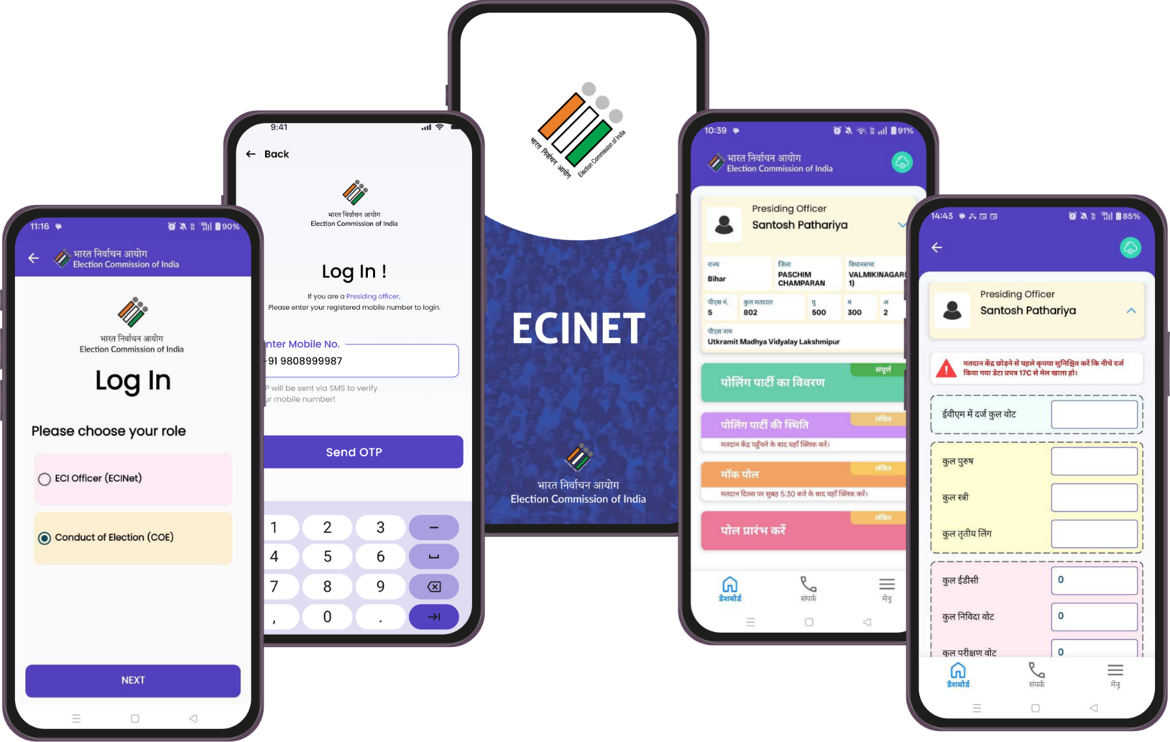
Action items/ कार्य बिंदु
App for PROs to input Polling party arrival status, Mock Poll activity,
Start Poll, Two hourly Polling Trends and Close of Poll

Slide 6

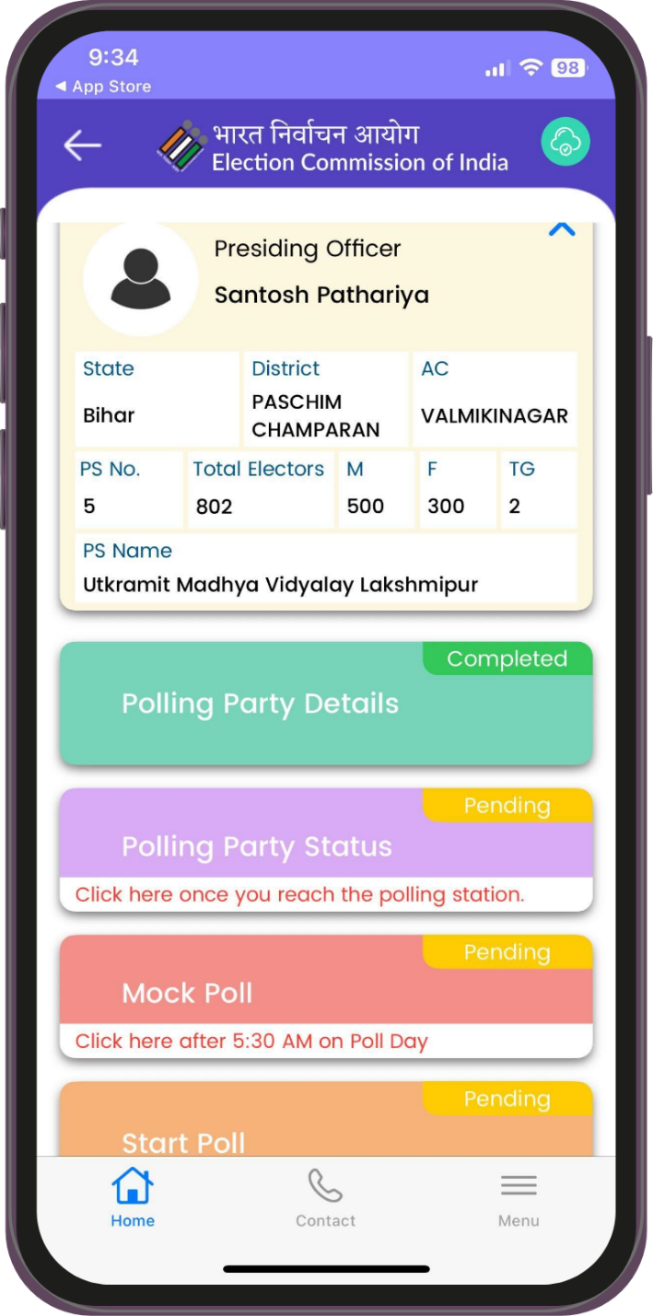
Steps to use/ प्रयोग की विधि
Download & Install ECINET Mobile App from Google Play Store or Apple App Store only
Login with registered mobile number and OTP
After login, verify your details from Dashboard Name, PS Name, PS Number, AC Name
Verify Elector Count (M,F and TG)
Perform activity step by step

Slide 7
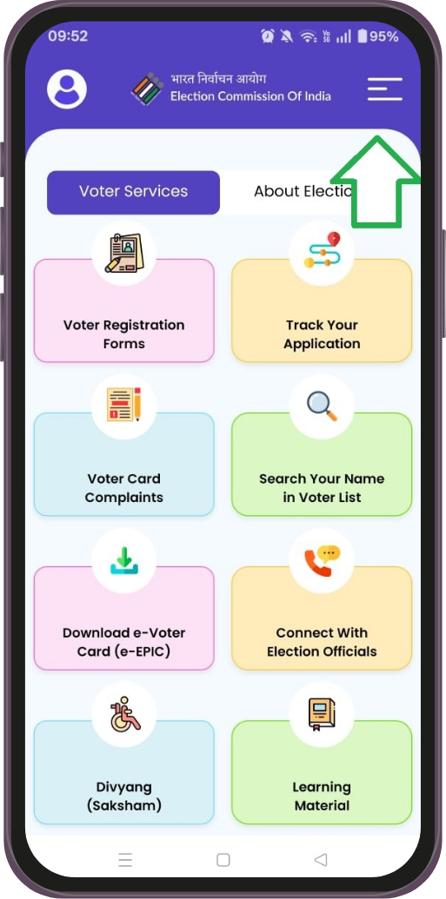
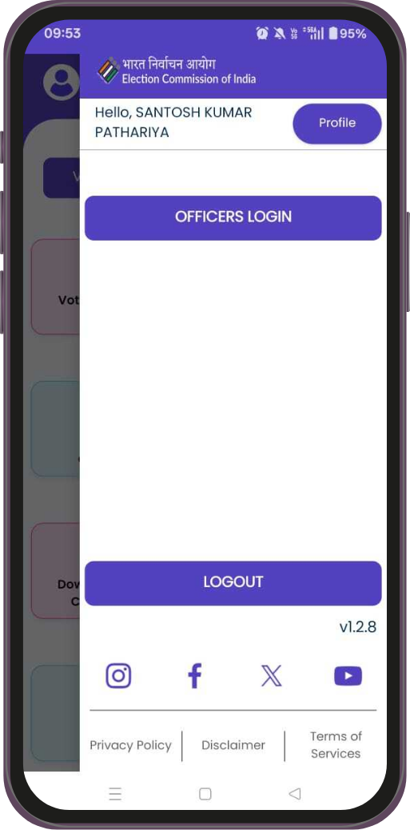

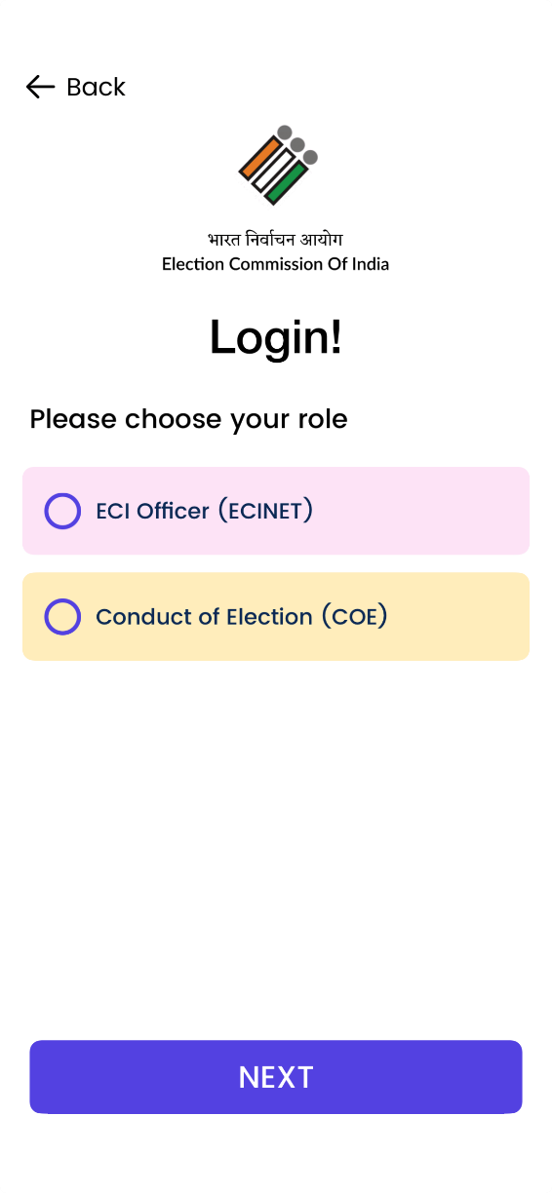
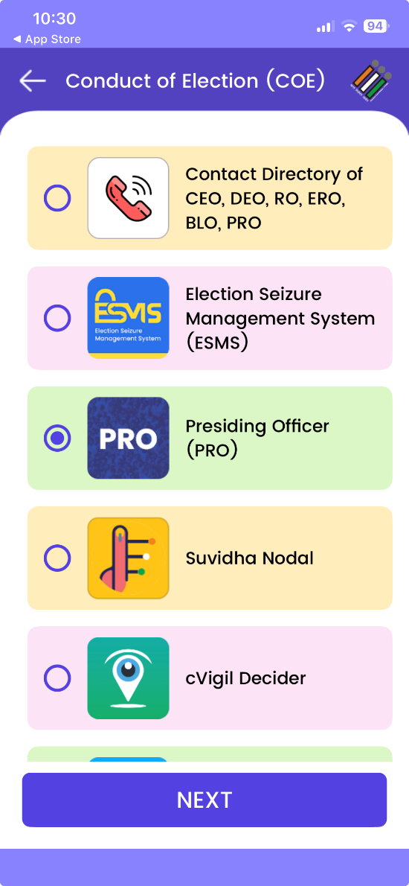
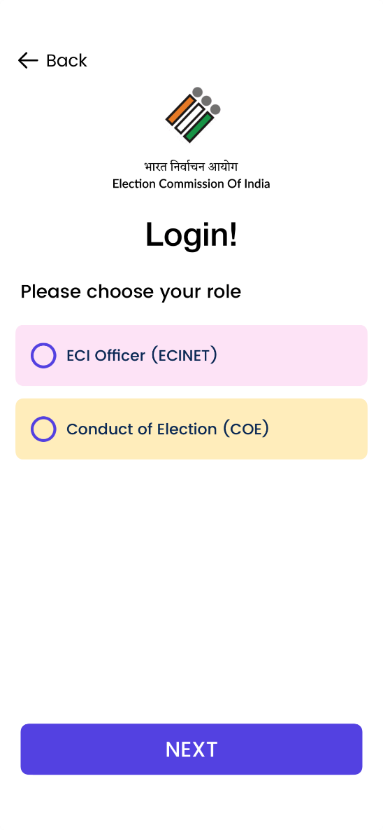
STEPS TO LOGIN

Slide 8
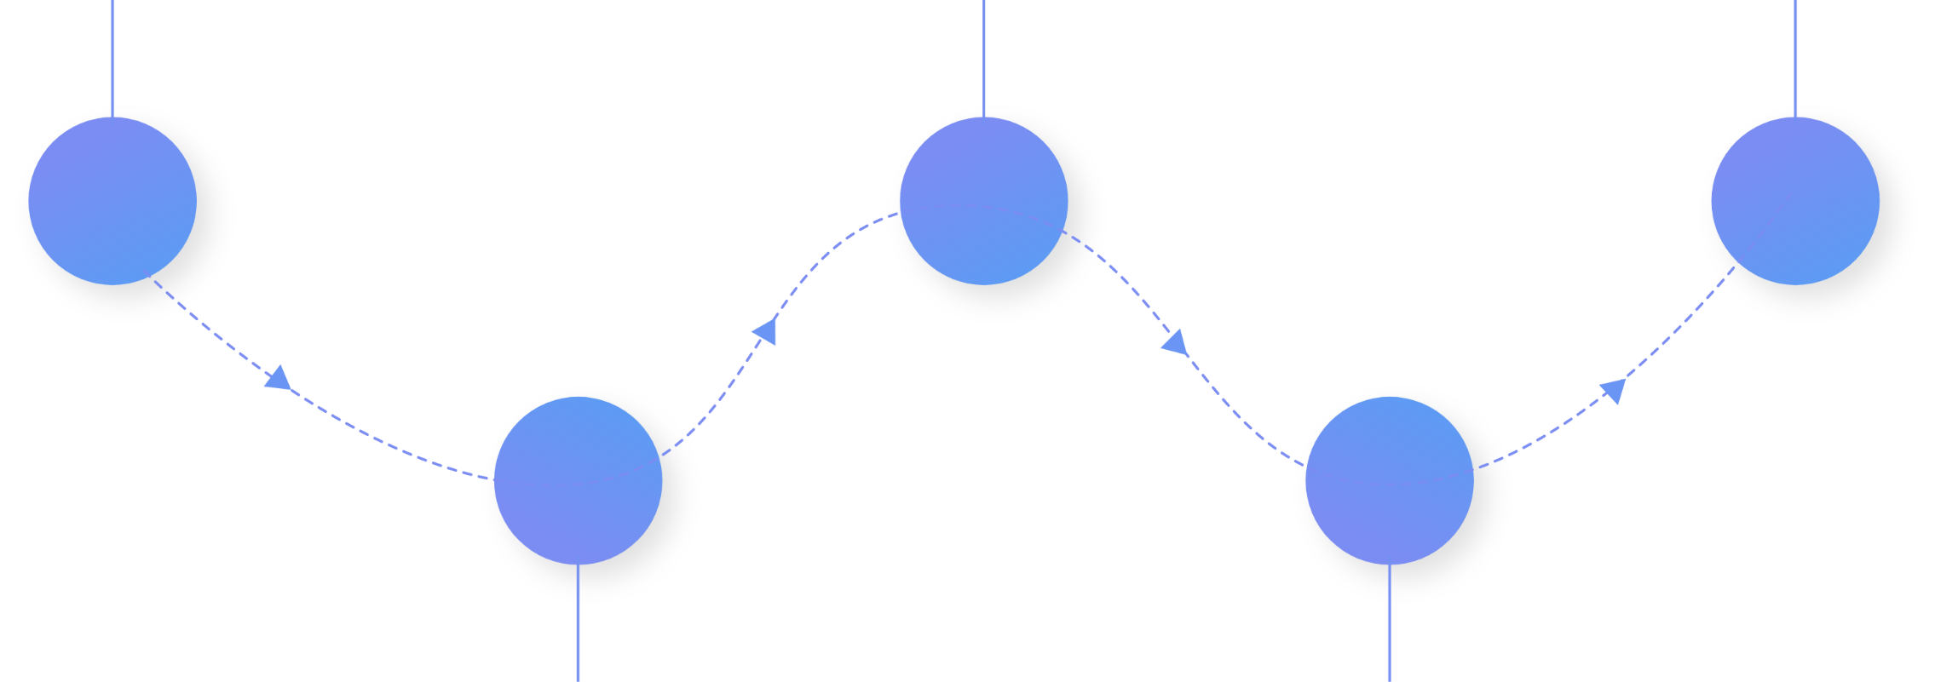





Role of Presiding Officer On P-1 & Poll Day
1
Polling Party
arrival status
3
Poll Start
Marking
5
Close of Poll
Perform Mock Poll
Activity
2
4
Polling Trends
(Voter Turnout)

Slide 9


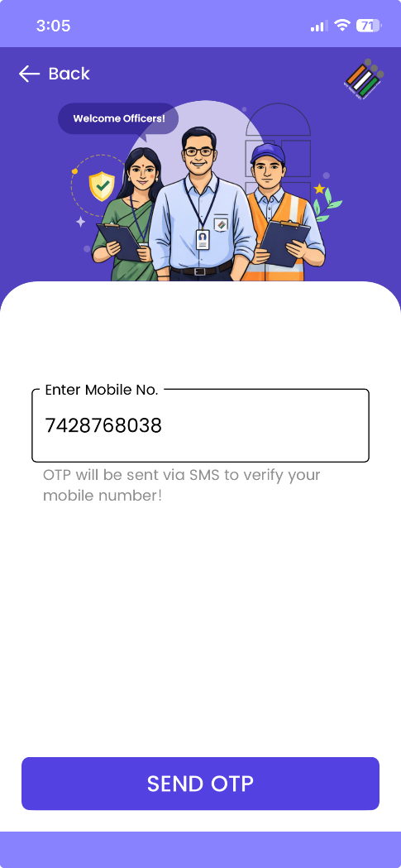
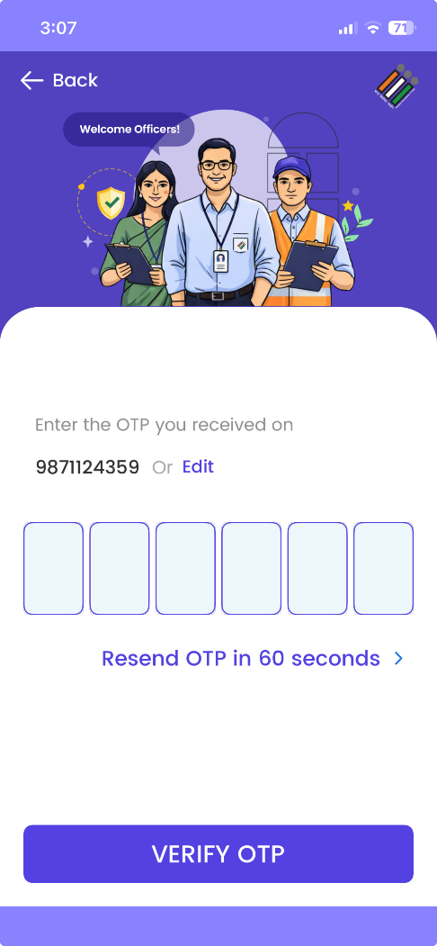
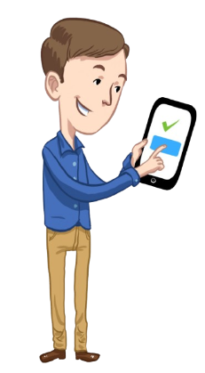
Secure Log In

Slide 10
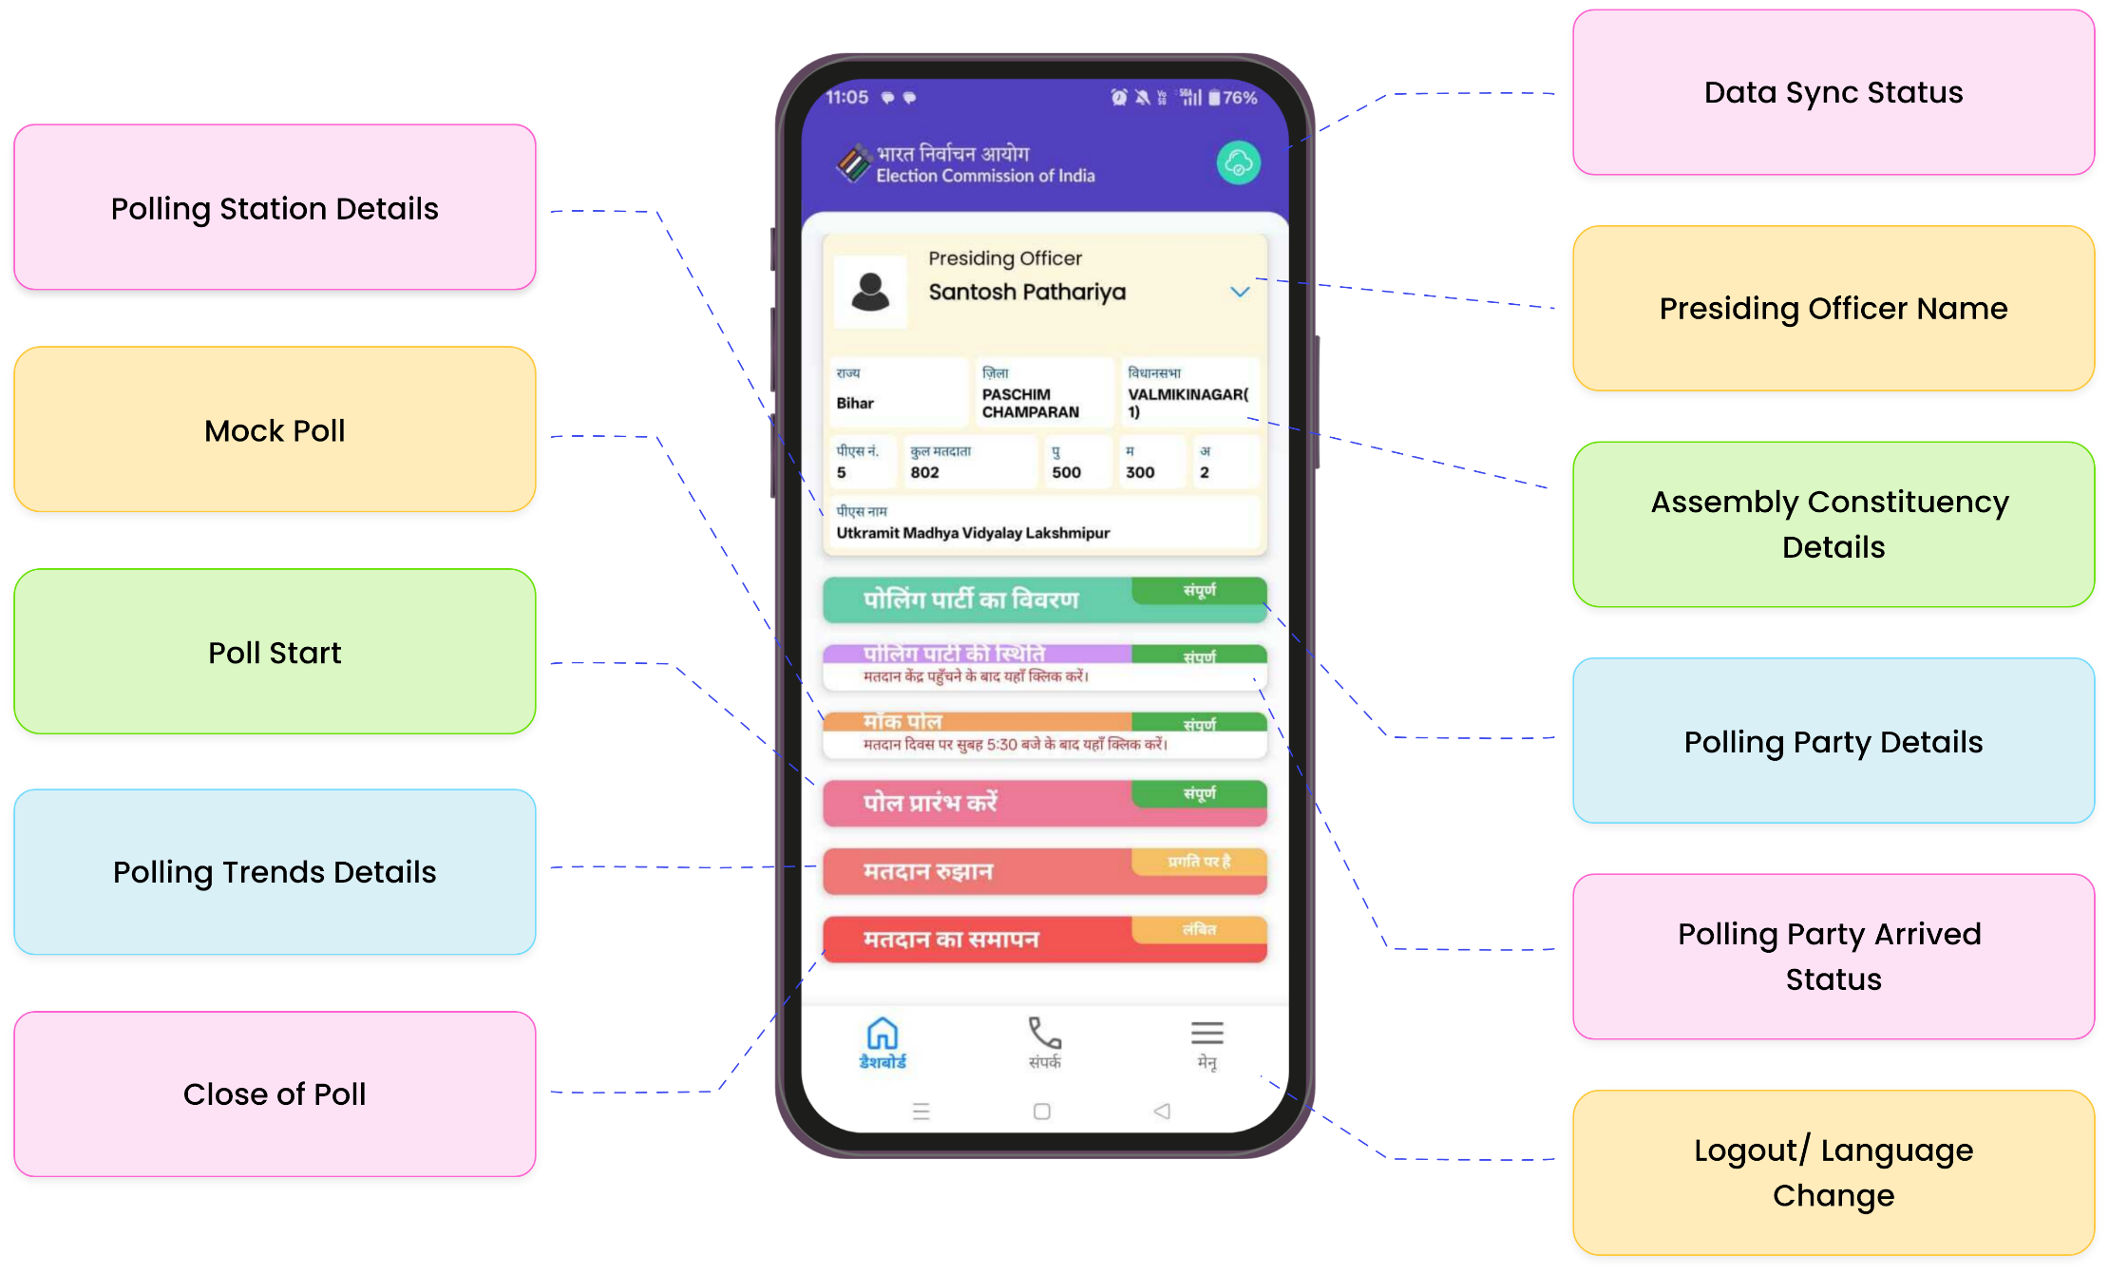
PRO Dashboard Screen

Slide 11
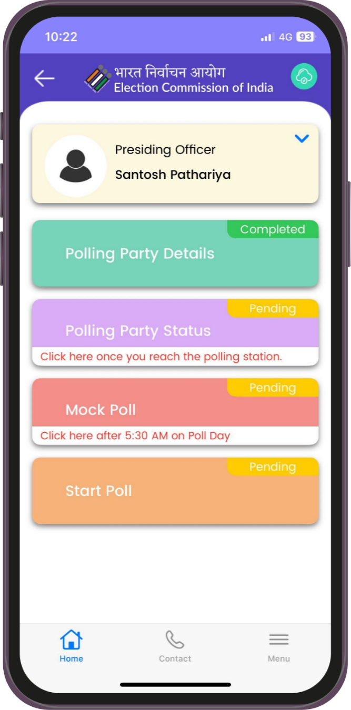
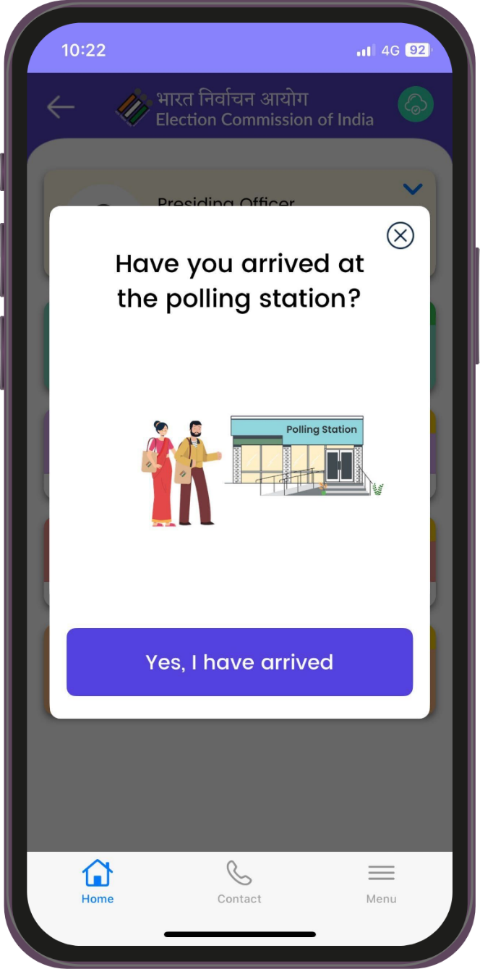
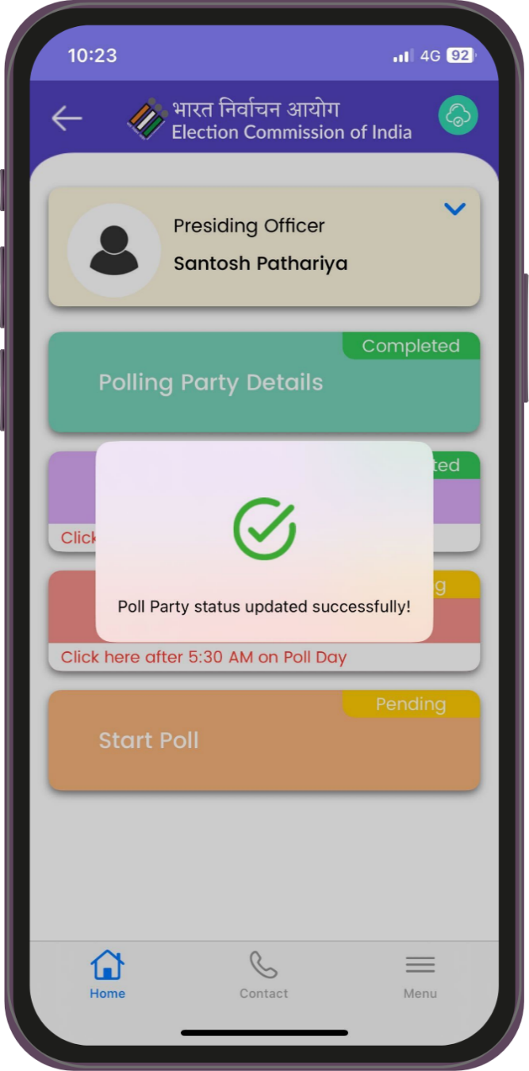
Polling party Arrival Status

Slide 12
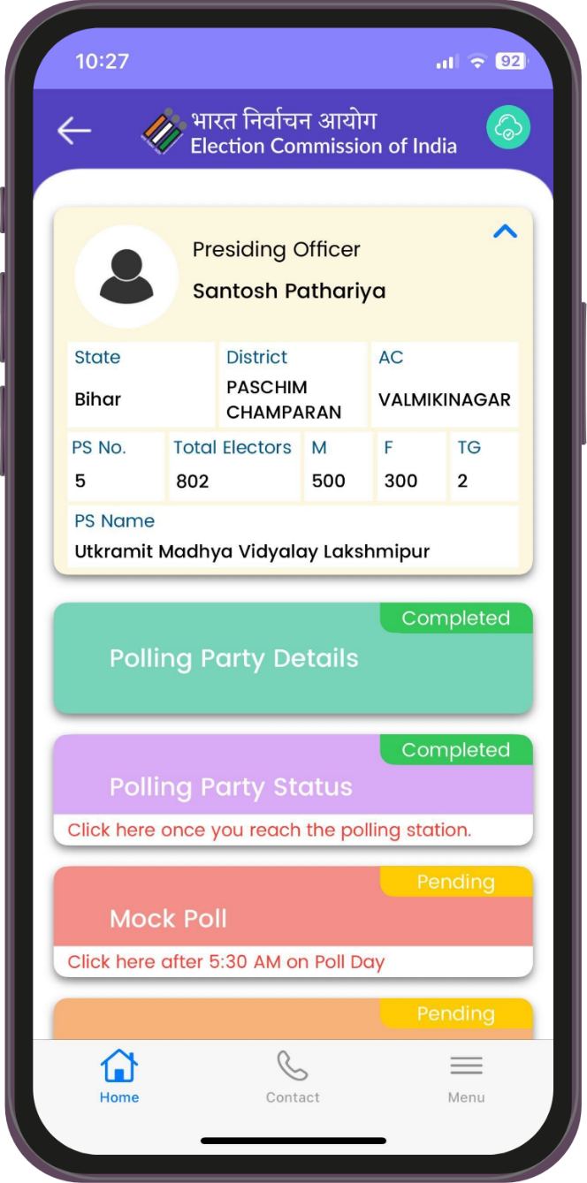
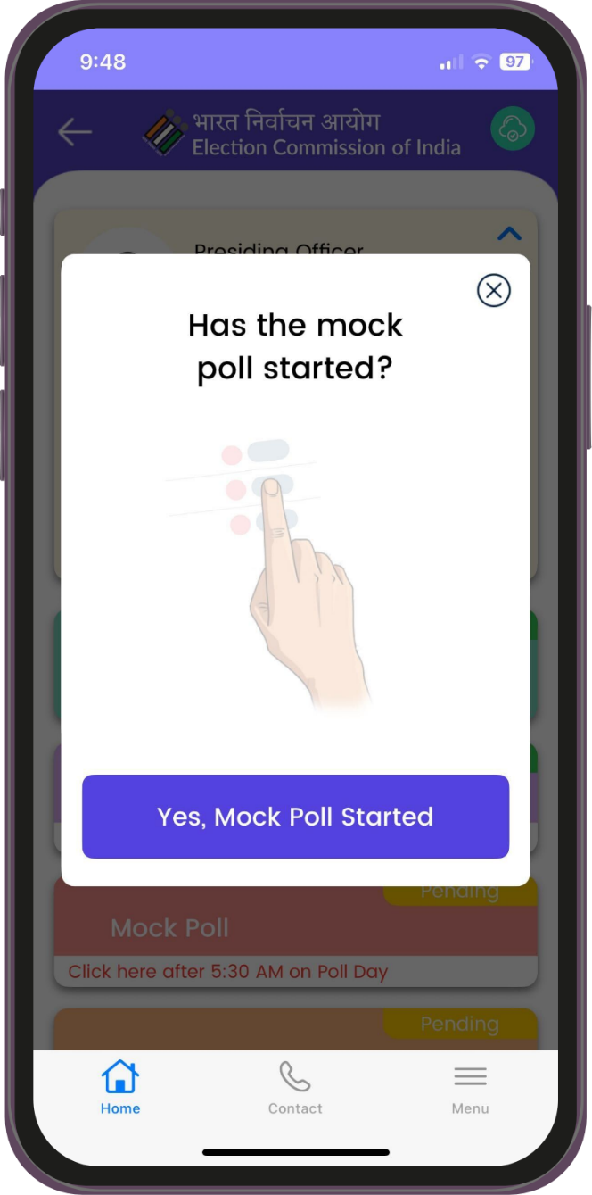
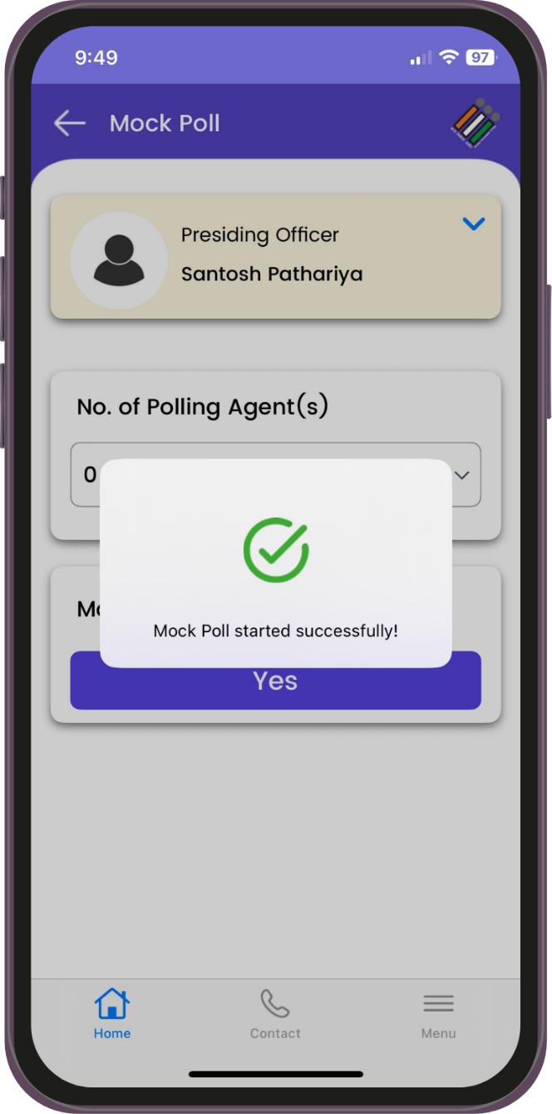
Mock Poll Activity Part-1

Slide 13
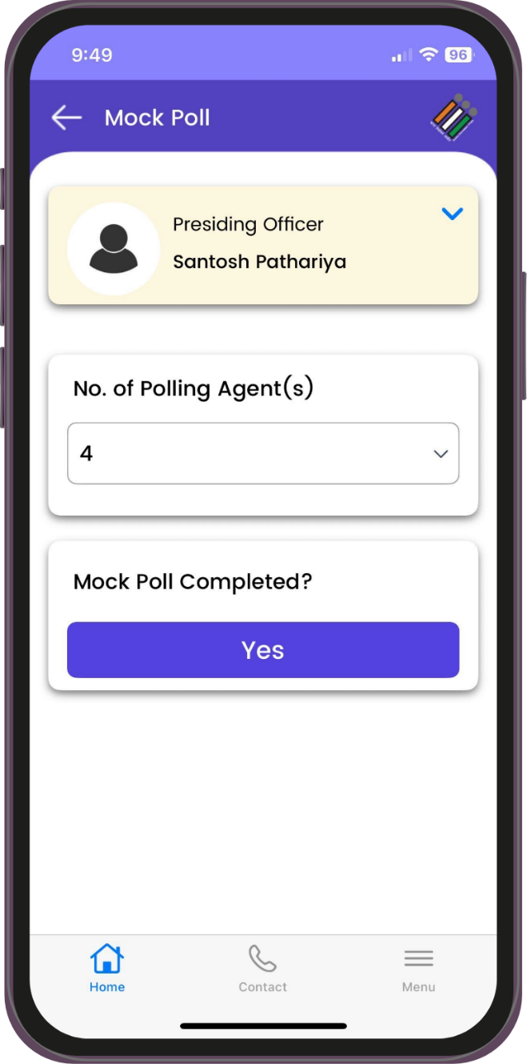
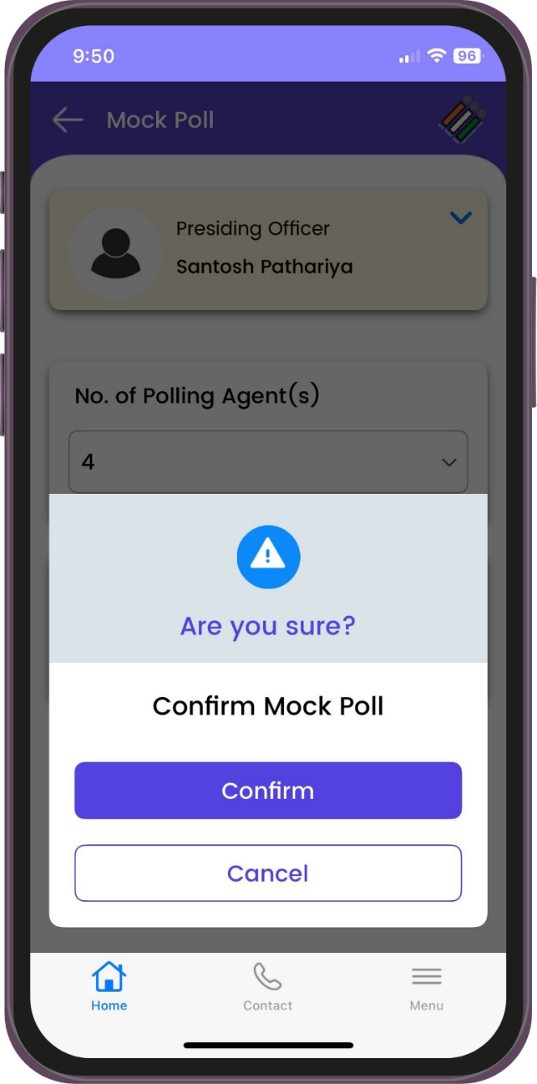
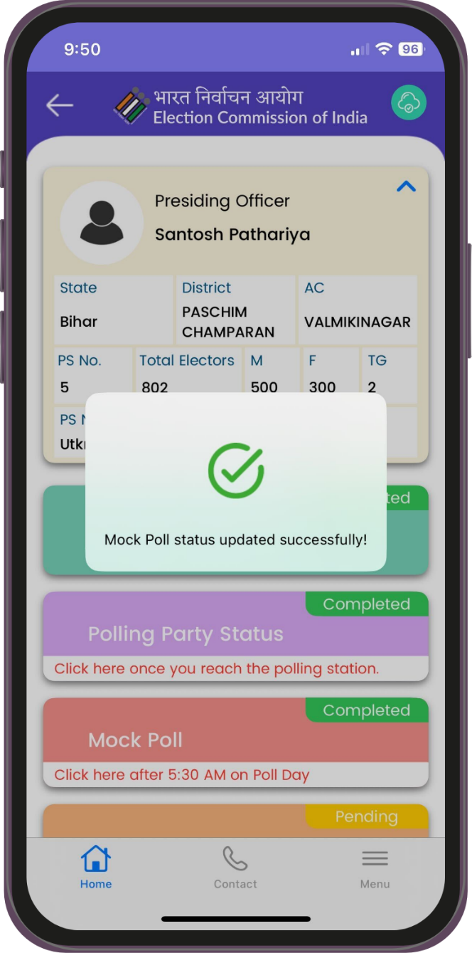
Mock Poll Activity Part-2

Slide 14
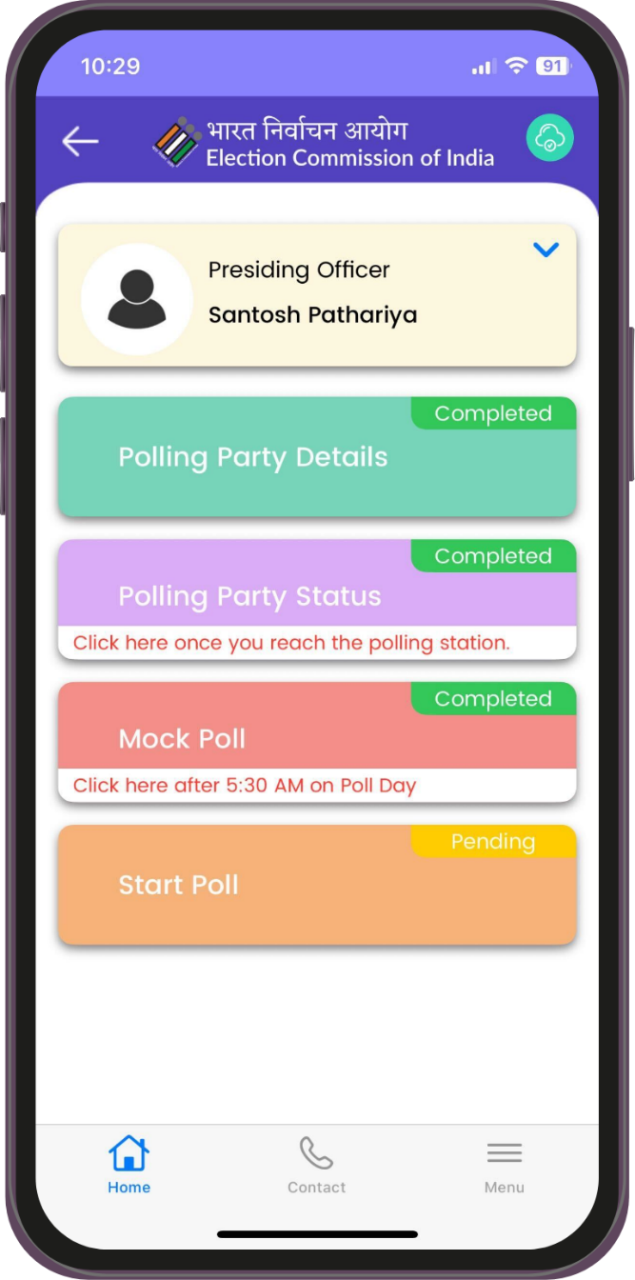
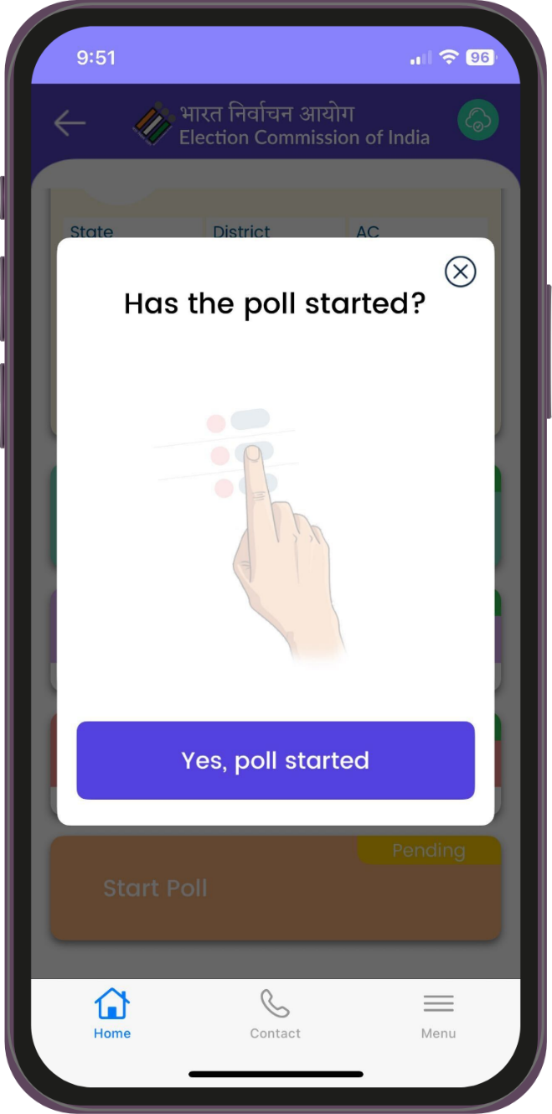
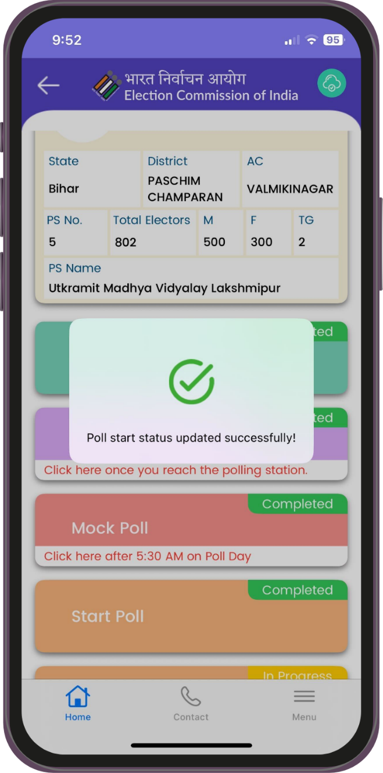
Poll Start Activity

Slide 15

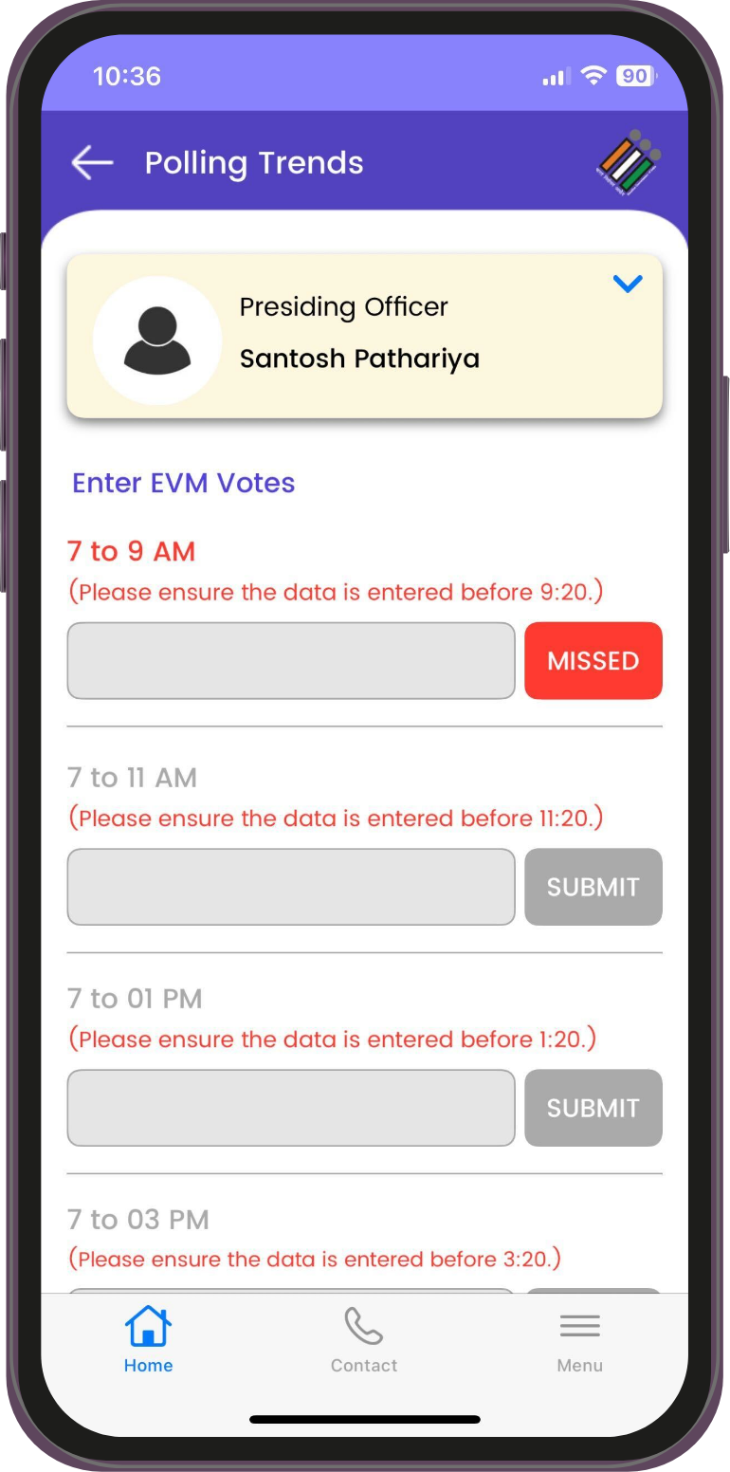
Submit
Polling Trends
                PRO can start data entry for turnout from 09:00 AM
                PRO can update/edit data as many times as he wishes till 09:20 AM
                Data entered in subsequent slot should be more than previous slot

Slide 16

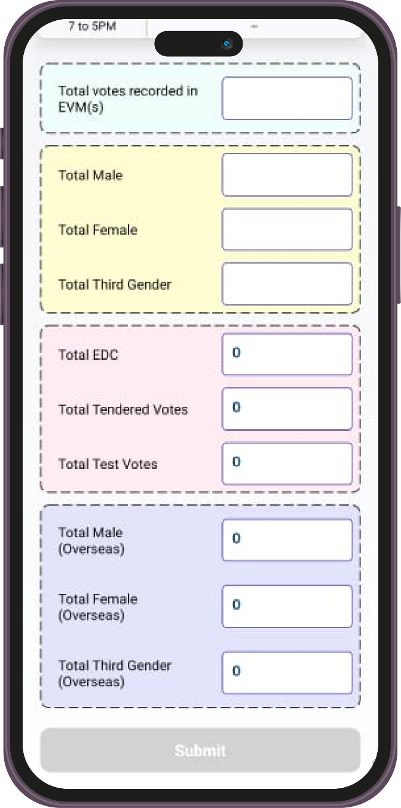
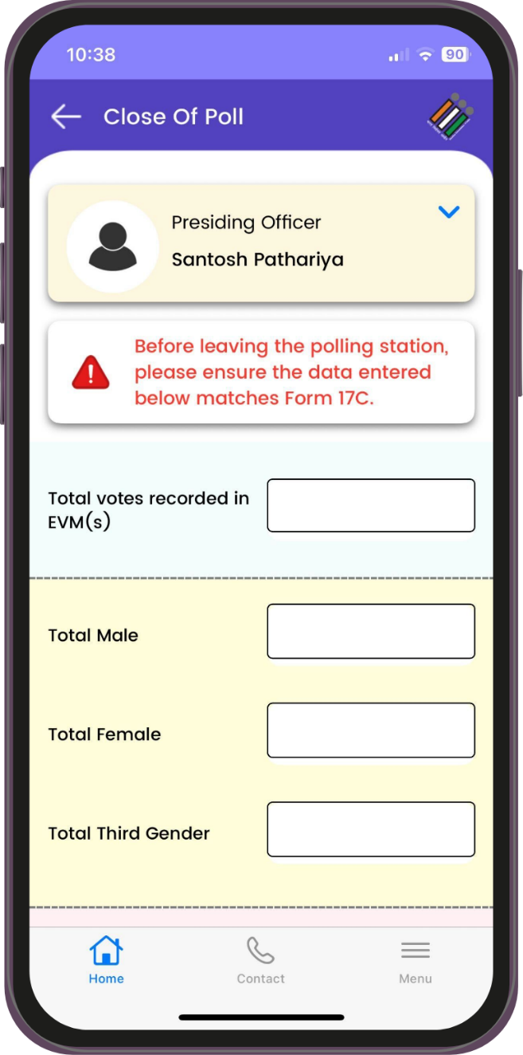
Close of Poll
Close of Poll button will be enabled after 5:30 PM Only
Few PS are allowed close of Poll after 3:30 PM
This data is very critical and should be same as 17C
Will generate the Index card using the data submitted on this screen

Slide 17

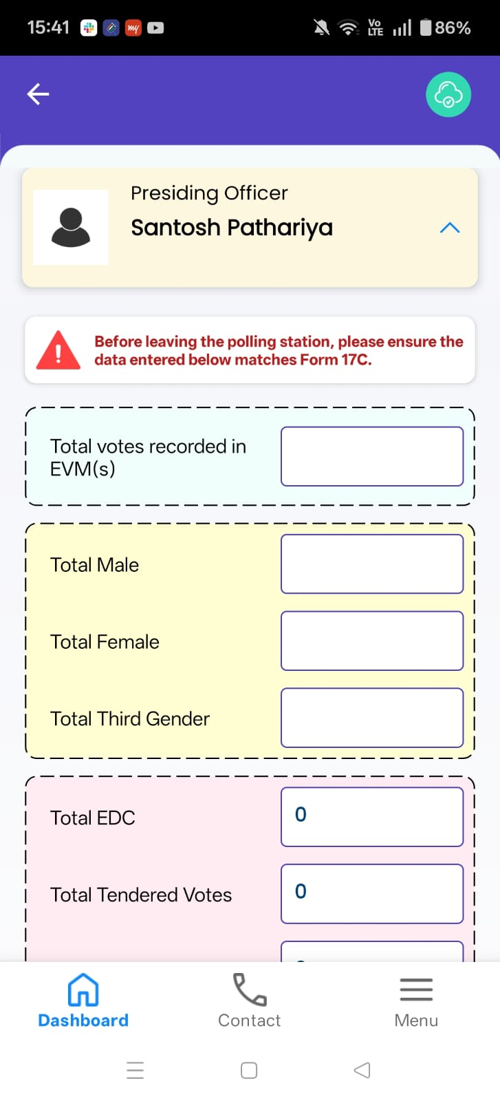
Close of Poll Correction
Presiding Officer may edit the Close of Poll entries multiple times between 5:30 PM and 12:00 midnight
No corrections are permitted after 12:00 midnight on Poll Day in Close of Poll entries
After 12 AM midnight PRO may see Close of Poll data in read only mode

Slide 18
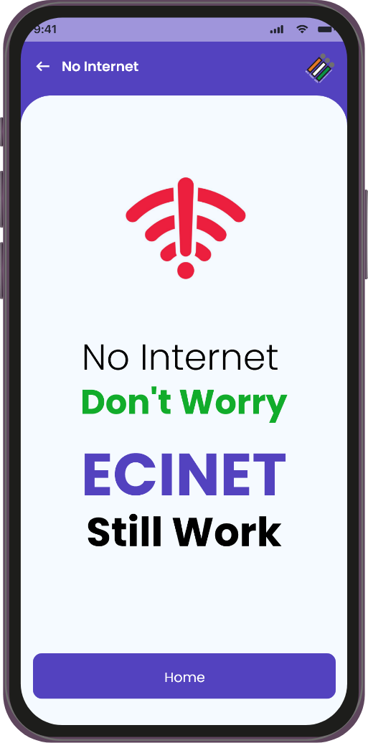
Offline Mode Support
PRO App will work in offline mode as well
Data stored offline will be sync to server
Data stored offline will be transmitted to server through SMS

Slide 19
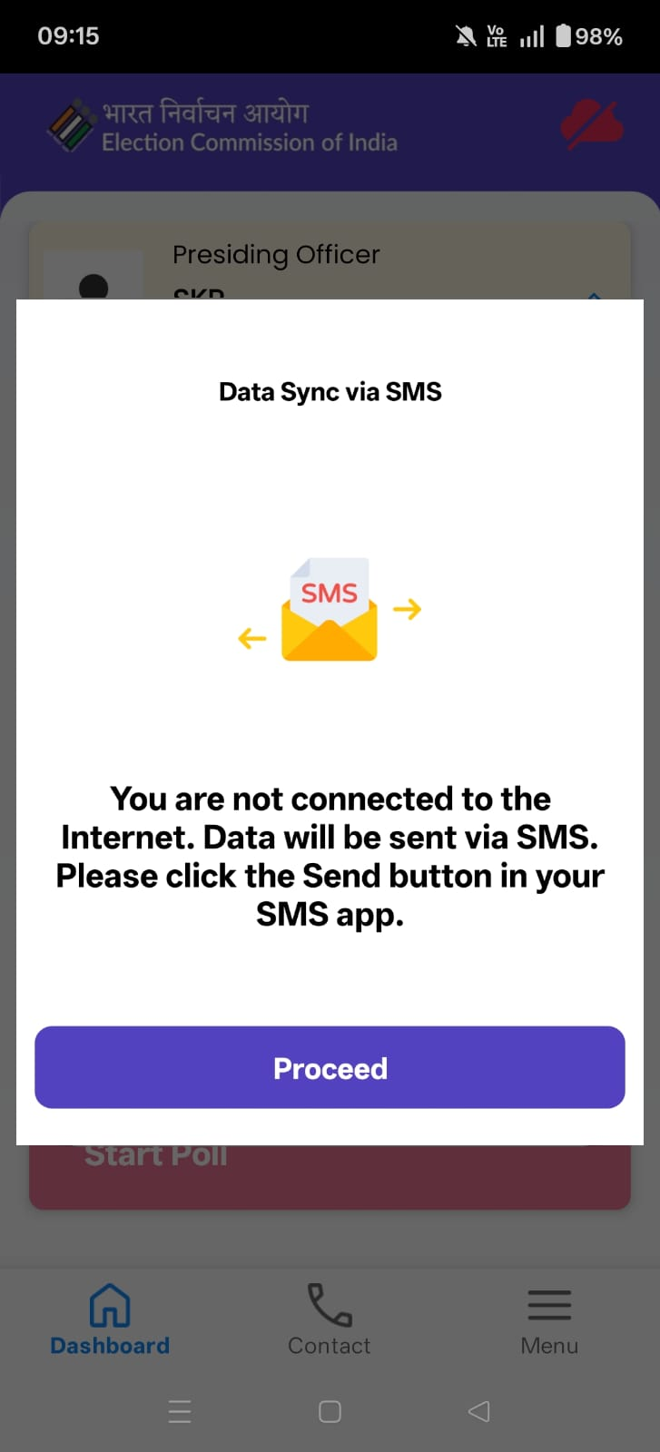
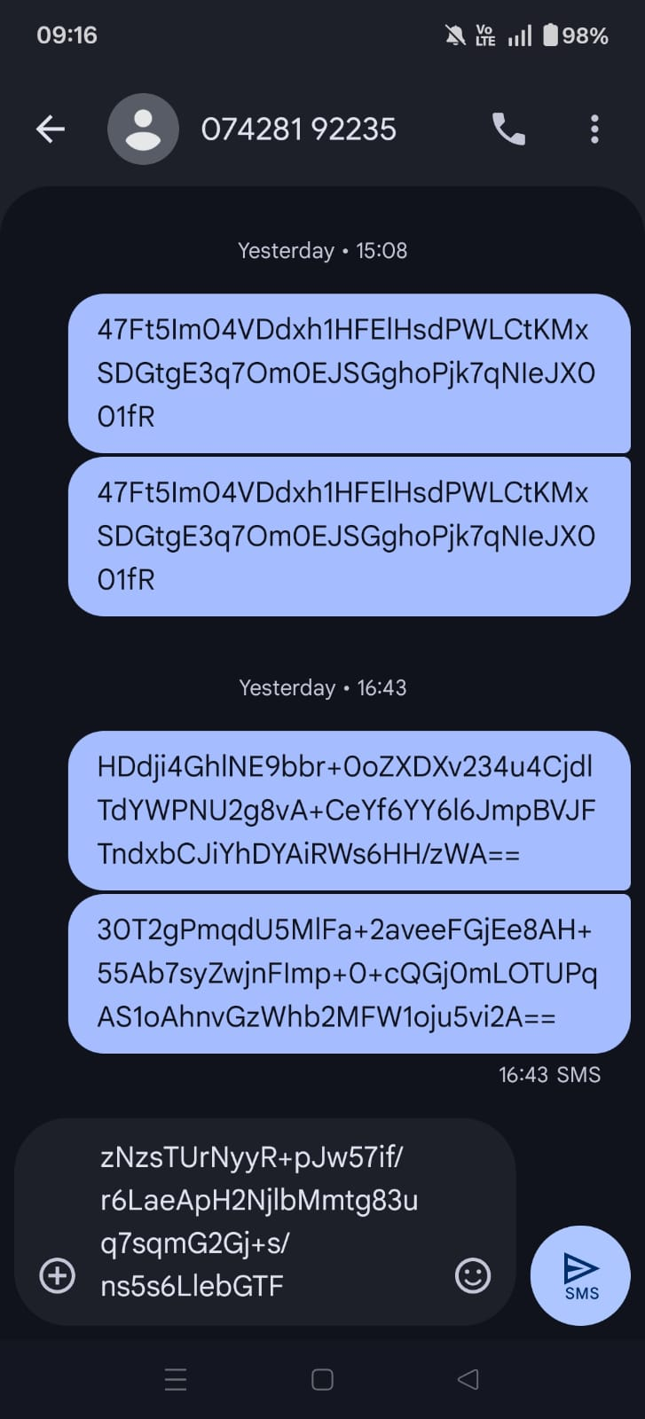
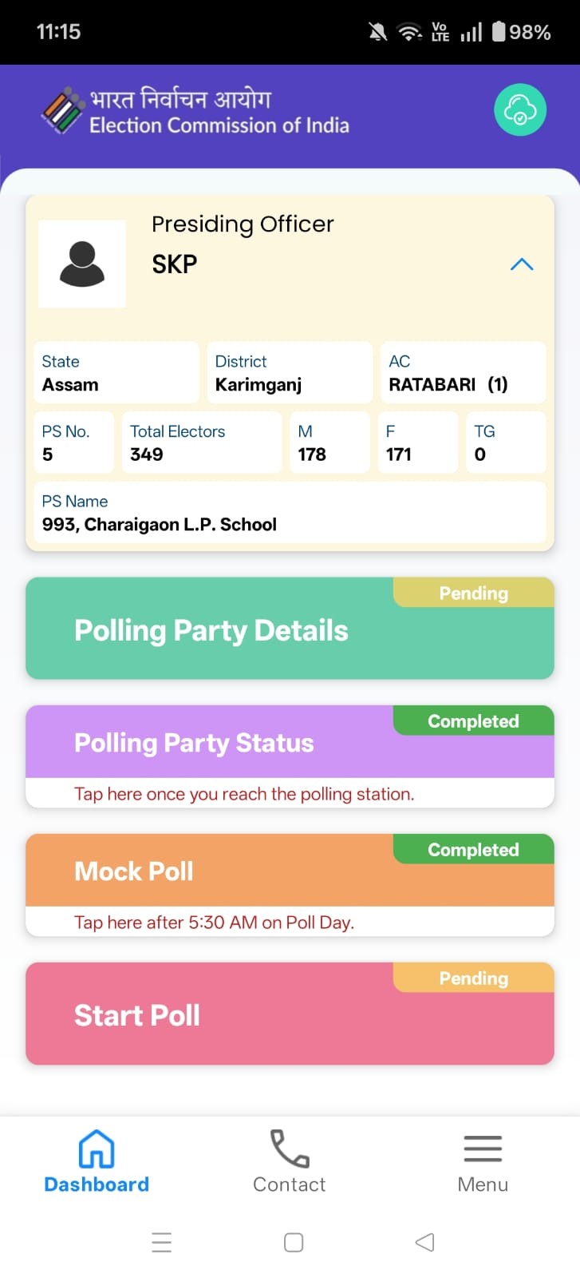
Offline Mode Support

Slide 20


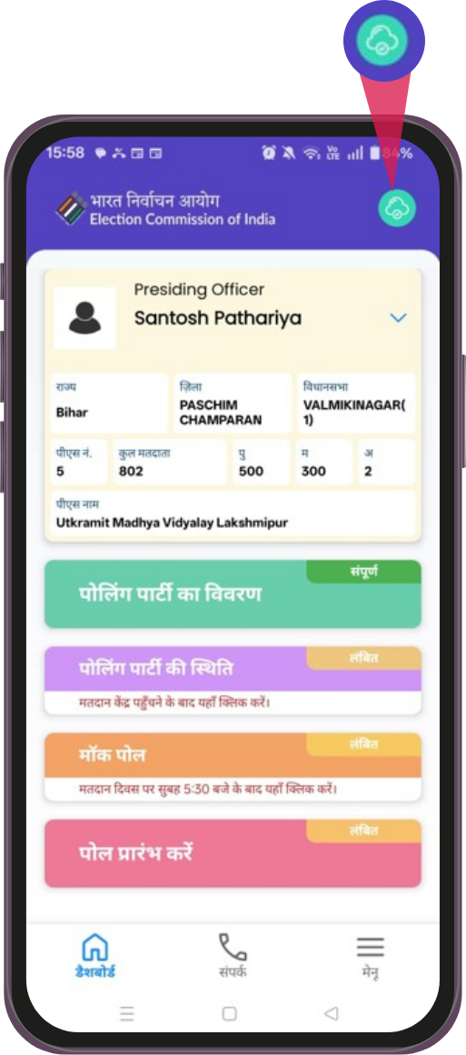
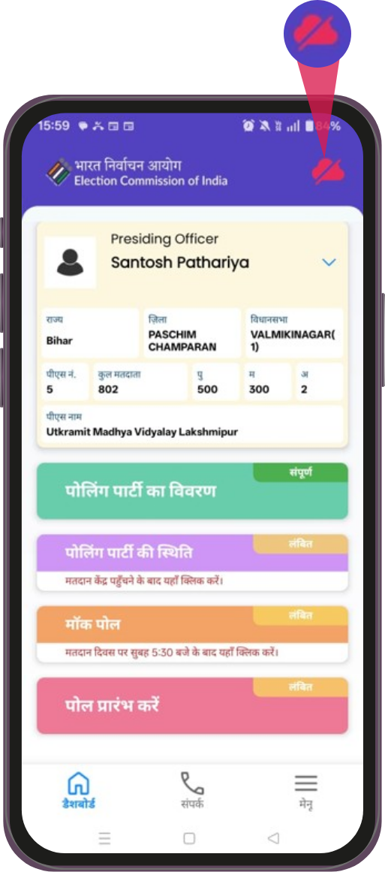
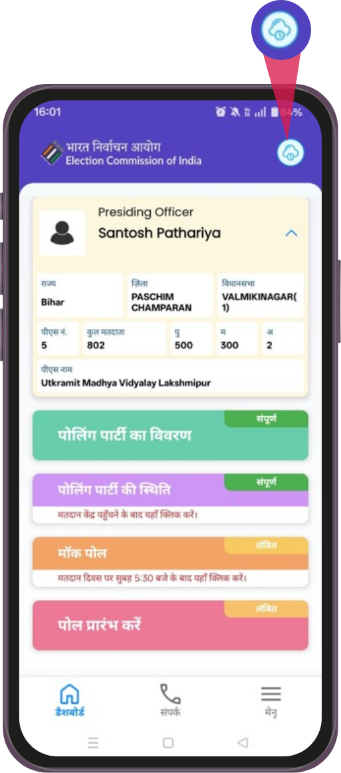
Offline Mode Support
Data Synced
Offline
Pending data Sync

Slide 21
User Onboarding Steps
RO (Returning Officer) will register all PROs from ENCORE
PRO Name, Mobile number and PS Number is mandatory
RO may bulk import through excel sheet in one shot
PRO Mobile number is unique in System
RO may also edit any details of PROs if required
Only registered PROs will be able to login in App
RO should add Poll party details SO(s) and PO(s)

Slide 22
Index Card
Index card will be published with in 72 hours of Counting
Index card will be e-signed by RO
Data should be accurate
Compare the data with 17C

Slide 23

Validation Rules (COP)
1
Total Votes
recorded in EVM
=
Total Male + Total Female +
Total TG + Total Test Vote
Close of Poll M+F+TG should be greater than or equal to Maximum data entered in any of the slots.
2

Slide 24
Important Note
It is compulsory for the PRO to use the ECINET App on Poll Day.
The data entered by PRO in the App must be accurate.
Ensure that all data is filled in during the allotted time window.
Data entered in the app at the close of poll must exactly match the details in Form 17C

Slide 25
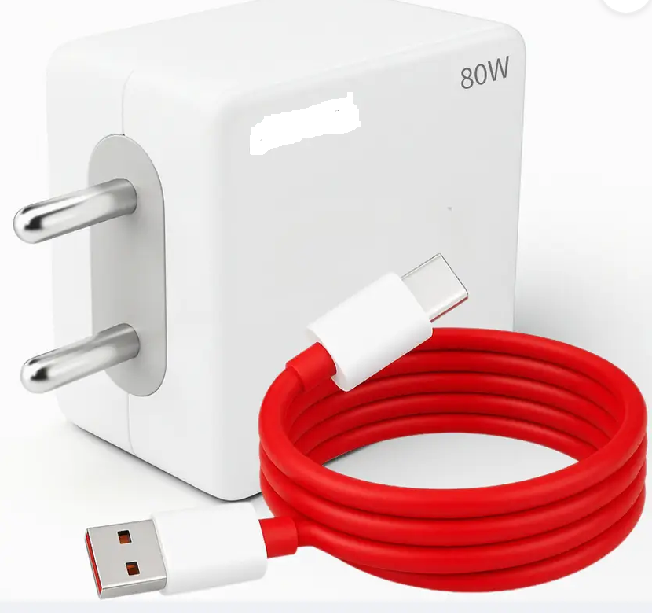
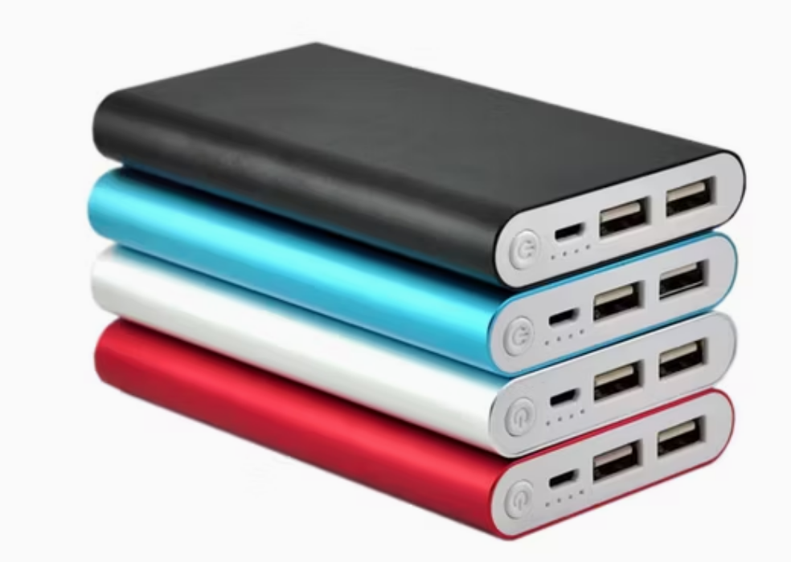
Reminder
Please carry Mobile phone charger on Poll Day
If possible please bring power bank for Poll Day

Slide 26
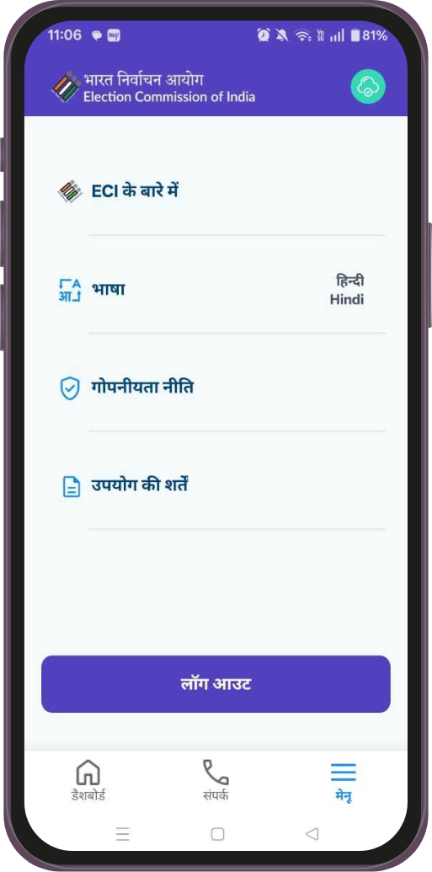
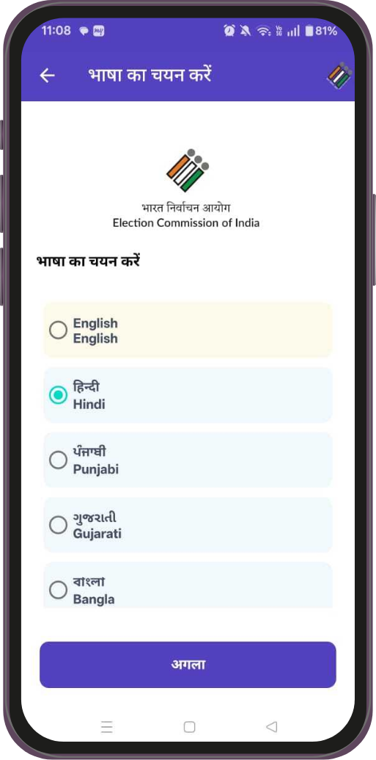
Vernacular Language Support
Available in Vernacular languages
Select language as per your convenience!

Slide 27
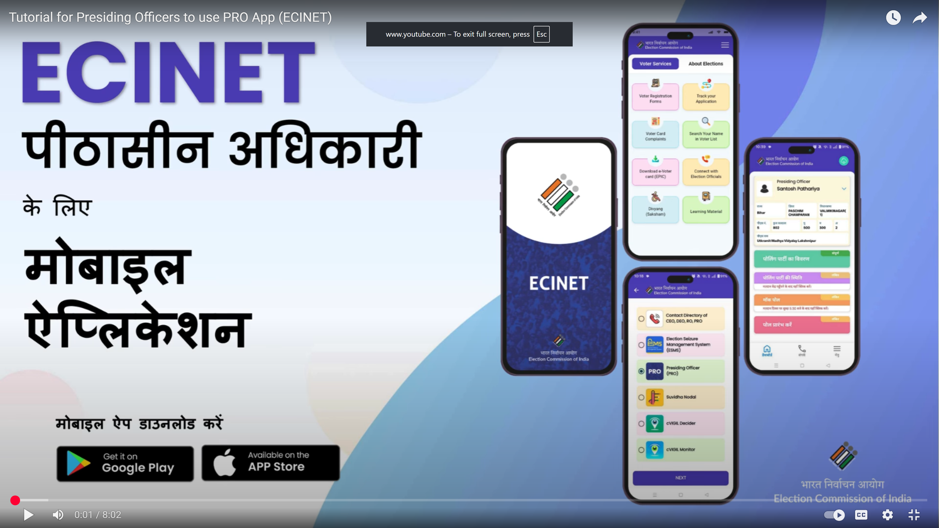
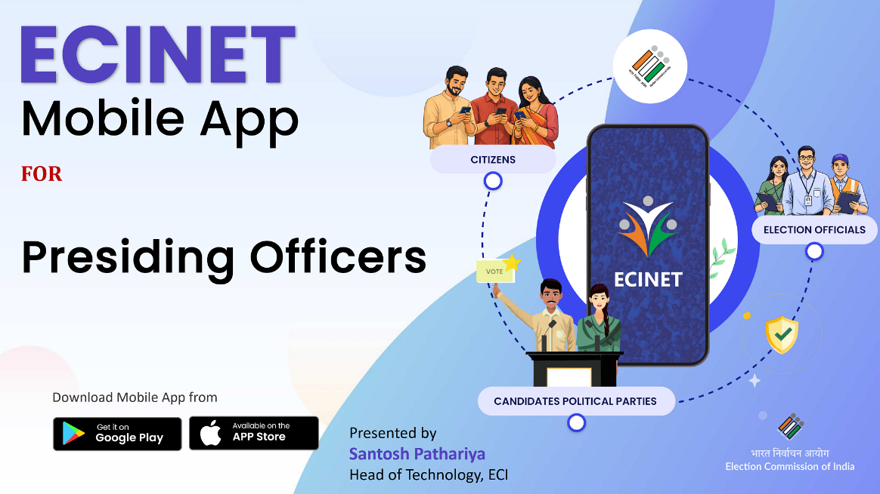
Video Tutorial
https://www.youtube.com/watch?v=do_jMFvXPUE
https://youtu.be/pX1AZ0c7V70
Hindi
English

Slide 28
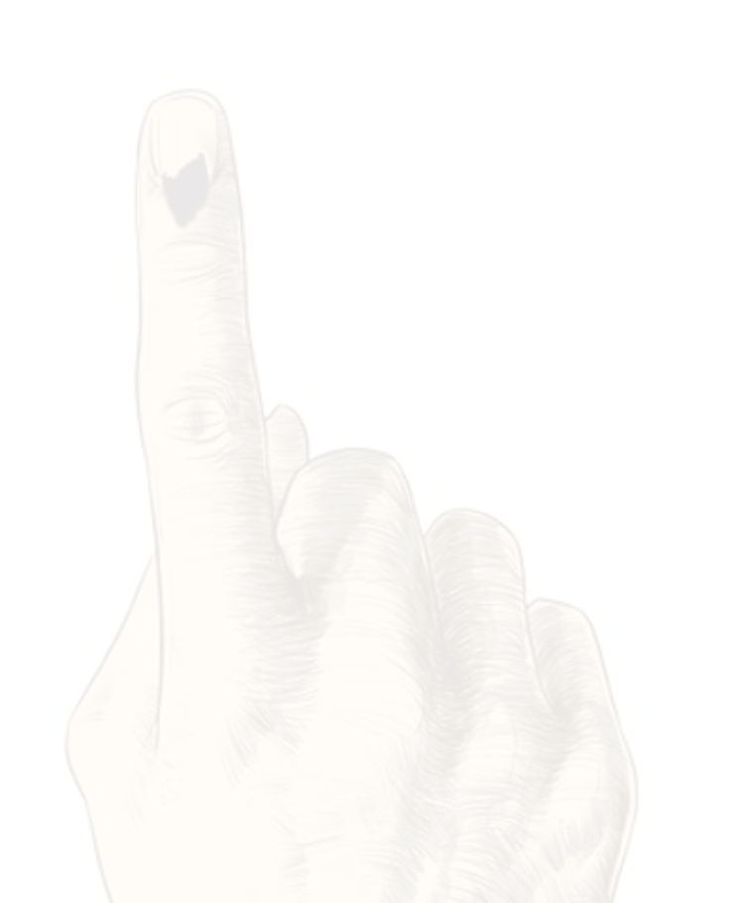
Thank You
Design and Developed
by ECI IT Team.

