Slide 1


Slide 2
Learning Points
Sl | Subject | Sub-topics
1 | Pre counting Arrangements | Legal issues, Counting centre & Hall, Counting personnel & Agent, Materials issue
2 | Counting of votes | ETPBS, PB counting, EVM counting, VVPAT counting, Special situations
3 | Post Counting Arrangements | Declaration of result, Sealing, Misc
4 | Report return | Statutory reports, Non statutory reports, Post counting matters

Slide 3
  Total No of candidates
Candidates | Phase 1 | Phase 2
Male | 1,311 | 1,228
Female | 167 | 220
Others | - | -
Total | 1,478 | 1,448
  No. and Name of AC with Maximum and Minimum Number of Candidates
 | Phase 1 | Phase 2
No & Name of Assembly Constituency with Maximum number of candidates | 15 Candidates (4-Coochbehar Dakshin, 32-Karandighi, 36-Itahar) | 19 Candidates (148-Bhangar)
No & Name of Assembly Constituency with Minimum number of candidates | 5 Candidates (232-Chandrokona) | 5 Candidates (201-Goghat)

Slide 4
Whats new
SLU to be stored till C+ 45 days
VVPAT to be released after 10 days of counting is over, VVPAT slips to be preserved
More nos. of PB counting due to inclusion of new categories of absentee voters
Option of TV placement for display of round wise result in counting hall
ETPB nos. reduced from 40 digits to 16 digits
Close button not pressing guideline is changed
Guideline on Non CRC /non removal of mock poll slips is changed
Guideline on counting of machines having discrepancy with 17C is changed
Poster on counting to be displayed
Guideline on Recording of CCTV, videography is streamlined
VVPAT mock drill at training venue only
PB 13A attestation by Group A/Group B
Postal Ballot counting arrangement changed
Penultimate round counting guideline changed
The CCTV data, webcasting data and photography of election processes at various stages shall be preserved for a period of 45 days.
C&V
Encore:
Table wise data entry of EVM votes at ARO level in PC Election.
Pre-finalization of EVM Votes in PC Counting
Generation of Form – 20 from ENCORE
De-finalization of EVM Votes by ROPC
De-finalization of Postal Ballot at state level
Bulk download of Form – 20 at CEO level
ECINET

Slide 5

1.Pre counting Arrangements
i. Major legal provisions related to counting
ii. Infrastructure and security arrangements at counting centre
iii.Appointment of counting staffs and counting agents

Slide 6
i. Major Legal Provisions
R.P. ACT 1951
Sec 64: Counting of Votes
Sec 64A: Destruction, loss etc. of ballot papers at the time of counting
Sec 65: Equality of Votes
Sec 66: Declaration of Results
Sec 67: Report of the Result
Sec 128: Maintenance of secrecy of voting
Sec 129: Officers, etc. at elections not to act for candidates or to influence voting
Sec 136: Other offences and penalties thereof [Sub sections to (1)-(4)]
CONDUCT OF ELECTIONS RULES, 1961
Rule 66A: Use of EVM
Rule 51: Time and place for counting
Rule 52 : Appointment of Counting Agents
Rule 53: Admission to the place of counting
Rule 54: Secrecy of voting
Rule 55C: Scrutiny and inspection of EVMs before counting
Rule 56C: Actual counting
Rule 57C: EVMs after counting.
Rule 56D: Scrutiny of paper trail
Rules 60 provides for continuous counting
Rule 61 provides for re-commencement of counting after fresh poll
Rule 63 provides for recount of votes
Rule 64 provides for declaration of result of election
Rule 65 provides for counting at 2 or more places for one constituency
Rule 66 provides for grant of certificate of election to returned candidate

Slide 7
R.P. ACT 1951
Sec 64: Counting of Votes
Sec 64A: Destruction, loss etc. of ballot papers at the time of counting
Counting under supervision and direction of the Returning Officer
Contesting candidate /election agent/ /counting agents have a right to be present.
Or if satisfied the result of election will not get materially affected, may allow counting to be completed.
RO shall immediately report the matter to ECI who may direct the counting to be stopped.
ECI may further declare poll to be void, order re-poll for that polling station.
Sec 65: Equality of Votes
  Result to be decided by draw of lot by RO.

Slide 8
Sec 66: Declaration of Results
In the absence of any direction to the contrary from ECI, RO to declare the result on completion of counting.
Sec 67: Report of the Result
RO to report result to ECI & to Appropriate Authority (i.e. Secretary State Legislature/ Parliament, who shall get it published in official Gazette immediately.
Sec 128: Maintenance of secrecy of voting
Applicable to officer/clerk/agent/person performing duty in connection to Election ( during poll or counting).
RO/ARO should take an oath to maintain secrecy of voting & read it out aloud before the commencement of counting of votes.
Violation punishable with 3 months imprisonment or fine or with both.
Sec 129: Officers, etc. at elections not to act for candidates or to influence voting
Applicable to DEO/RO/AROs/Polling staff.
Imprisonment up to 6 months /fine/both .
Sec 136: Other offences and penalties thereof [Sub sections to (1)-(4)]
  Guilty of electoral offence: tampering with EVM/ballot box or ballot paper /nomination paper etc fraudulently
  Imprisonment up to 6 months or 2 years /fine /both

Slide 9
CONDUCT OF ELECTIONS RULES, 1961
Rule 66A: In relation to counting of votes where EVMs are used, the provisions of Rules 50-54 have been made applicable. And in lieu of Rule 55, 56 and 57, Rules 55C, 56D and 57C have been made applicable.
Rule 51: Time and place for counting
  To be fixed by RO at least one week before date of poll
  Notice to be given in writing to each candidate/his election agent
Rule 52 : Appointment of Counting Agents
  Subject to ECI directions, a candidate may appoint counting agents which shall not exceed 16 for each place of counting
  Appointment to be made in FORM 18, in duplicate. One copy for RO for record and other copy to agent for production before RO, not later than one hour before the time fixed for counting
  No entry in counting hall unless second copy of FORM 18 is given to RO after signing the declaration
  Revocation in FORM 19
Rule 53: Admission to the place of counting
  No body else except RO/ARO, counting staff, candidates, their election agents and counting agents public servants on duty, persons authorized by ECI
  Whosoever misconducts himself or fails to obey lawful direction of RO shall be removed from the counting hall.

Slide 10
Rule 55C: Scrutiny and inspection of EVMs before counting
Counting staff and counting agents to inspect and ensure that the CU is not tampered and all seals are intact. In case not, report matter to ECI
Rule 56C: Actual counting
1. Press the result button and see the display of votes count.
2. Note down the same in part-II of form 17C. Counting supervisor to sign on it along with candidates or their election agents or counting agents
Corresponding entries to be made in form-20
Rule 57C: EVMs after counting.
After result is recorded in part-II of form 17C, the CU is to be sealed with the seals of the RO and candidates/ counting agents.
Rule 56D : Scrutiny of paper trail –
(1) Where printer for paper trail is used, after the entries made in the result sheet are announced, any candidate, or in his absence, his election agent or any of his counting agents may apply in writing to the returning officer to count the printed paper slips in the drop box of the printer in respected of any polling station or polling stations.
(2) On such application being made, the returning officer shall, subject to such general or special guidelines, as may be issued by the Election Commission decide the matter and may allow the application in whole or in part or may reject in whole, if it appears to him to be frivolous or unreasonable.
(3) Every decision of the returning officer under sub-rule(2) shall be in writing and shall contain the reasons therefor.

Slide 11
ii. Infrastructure and security arrangements
    Strong room inspection
    Counting centre arrangement
    Counting hall arrangement
    Management inside counting hall
    Media management
    Design of VCB
    Security arrangement

Slide 12
Strong room Arrangement
RO should visit the storage campus (upto inner perimeter only) everyday in the morning and evening.
If the strong room is located in district head quarter the DEO should do the same.
If the strong room is located outside district head quarter the DEO should visit the same atleast once in 3-4 days.
Certificate in Annex 1 by DEO has to be submitted.
One control room operated by Gazetted officer along with police officer should be operative round the clock for monitoring security arrangements of strong rooms having polled machines.
The candidates should be intimated in writing to depute their representatives to keep close watch on security arrangement of strong room.

Slide 13



Counting Centre Arrangements (Rooms)
Communication: Table/chair, telephone, STD, fax, computer, printer, scanner and internet connection
Observer- Table/chair, TV, telephone, STD, fax, computer, printer, scanner and internet connection
Mobile Room- For storage/safe keeping of mobile by Candidate/ Agents etc.
Various rooms required for each AC : RO, Observer, EVM counting, Strong room, ETPBS, Postal Ballot, Compilation, Sealing, Room for statutory Papers
Colour coding of Identity cards may be adopted.

Slide 14
Arrangements at counting centre for RO:
  A hotline with CEO
  One more STD telephone to keep in touch with CEO & ECI
  Fax and photocopy machine at counting centre
  Computer centre with power backup with facility for online transmission through Encore.
  RO hand book, EVM/VVPAT manual (Dec, 2023), All counting instructions.
  Deployed engineers will be reporting him on C-1 day.
  NOTE :only ECI observers is allowed to use mobile phone inside the counting hall.
  Public Communication Room-
  From here candidates and their agents can use their mobile. Suitable arrangements to keep mobile phones .

Slide 15
RO needs to forward the proposal of counting centres in consultation with the observer in Annexure 32 of HB of RO to ECI through CEO for approval at the earliest after last date for withdrawal of candidature.
After ECI has approved the same, a mandatory notice to candidates has to be given in Annexure 33 or 34 of Hand Book of RO on P-3 day.
If, for any unavoidable reasons, the RO is unable to conduct counting on notified date /time, he should postpone counting to another date and time after obtaining approval of ECI.
The counting should not be done in a temporary structure.
In case 2 halls are approved, allot in advance the PS to be counted in each hall. Intimate candidates accordingly
For Each AC or assembly segment there should be a strong room and a spacious counting hall with separate entry and exit.
Each counting centre to have distinct number and each hall to be distinctly numbered.

Slide 16
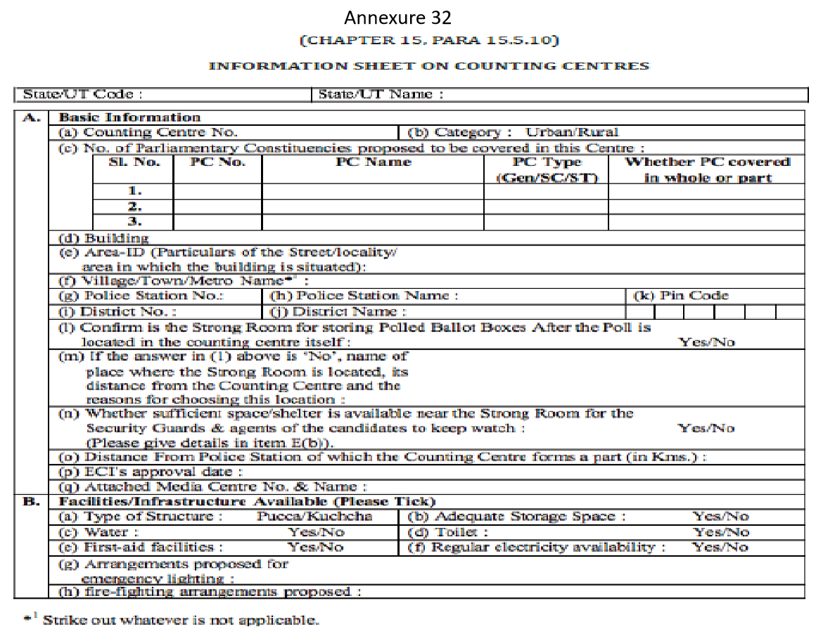

Slide 17
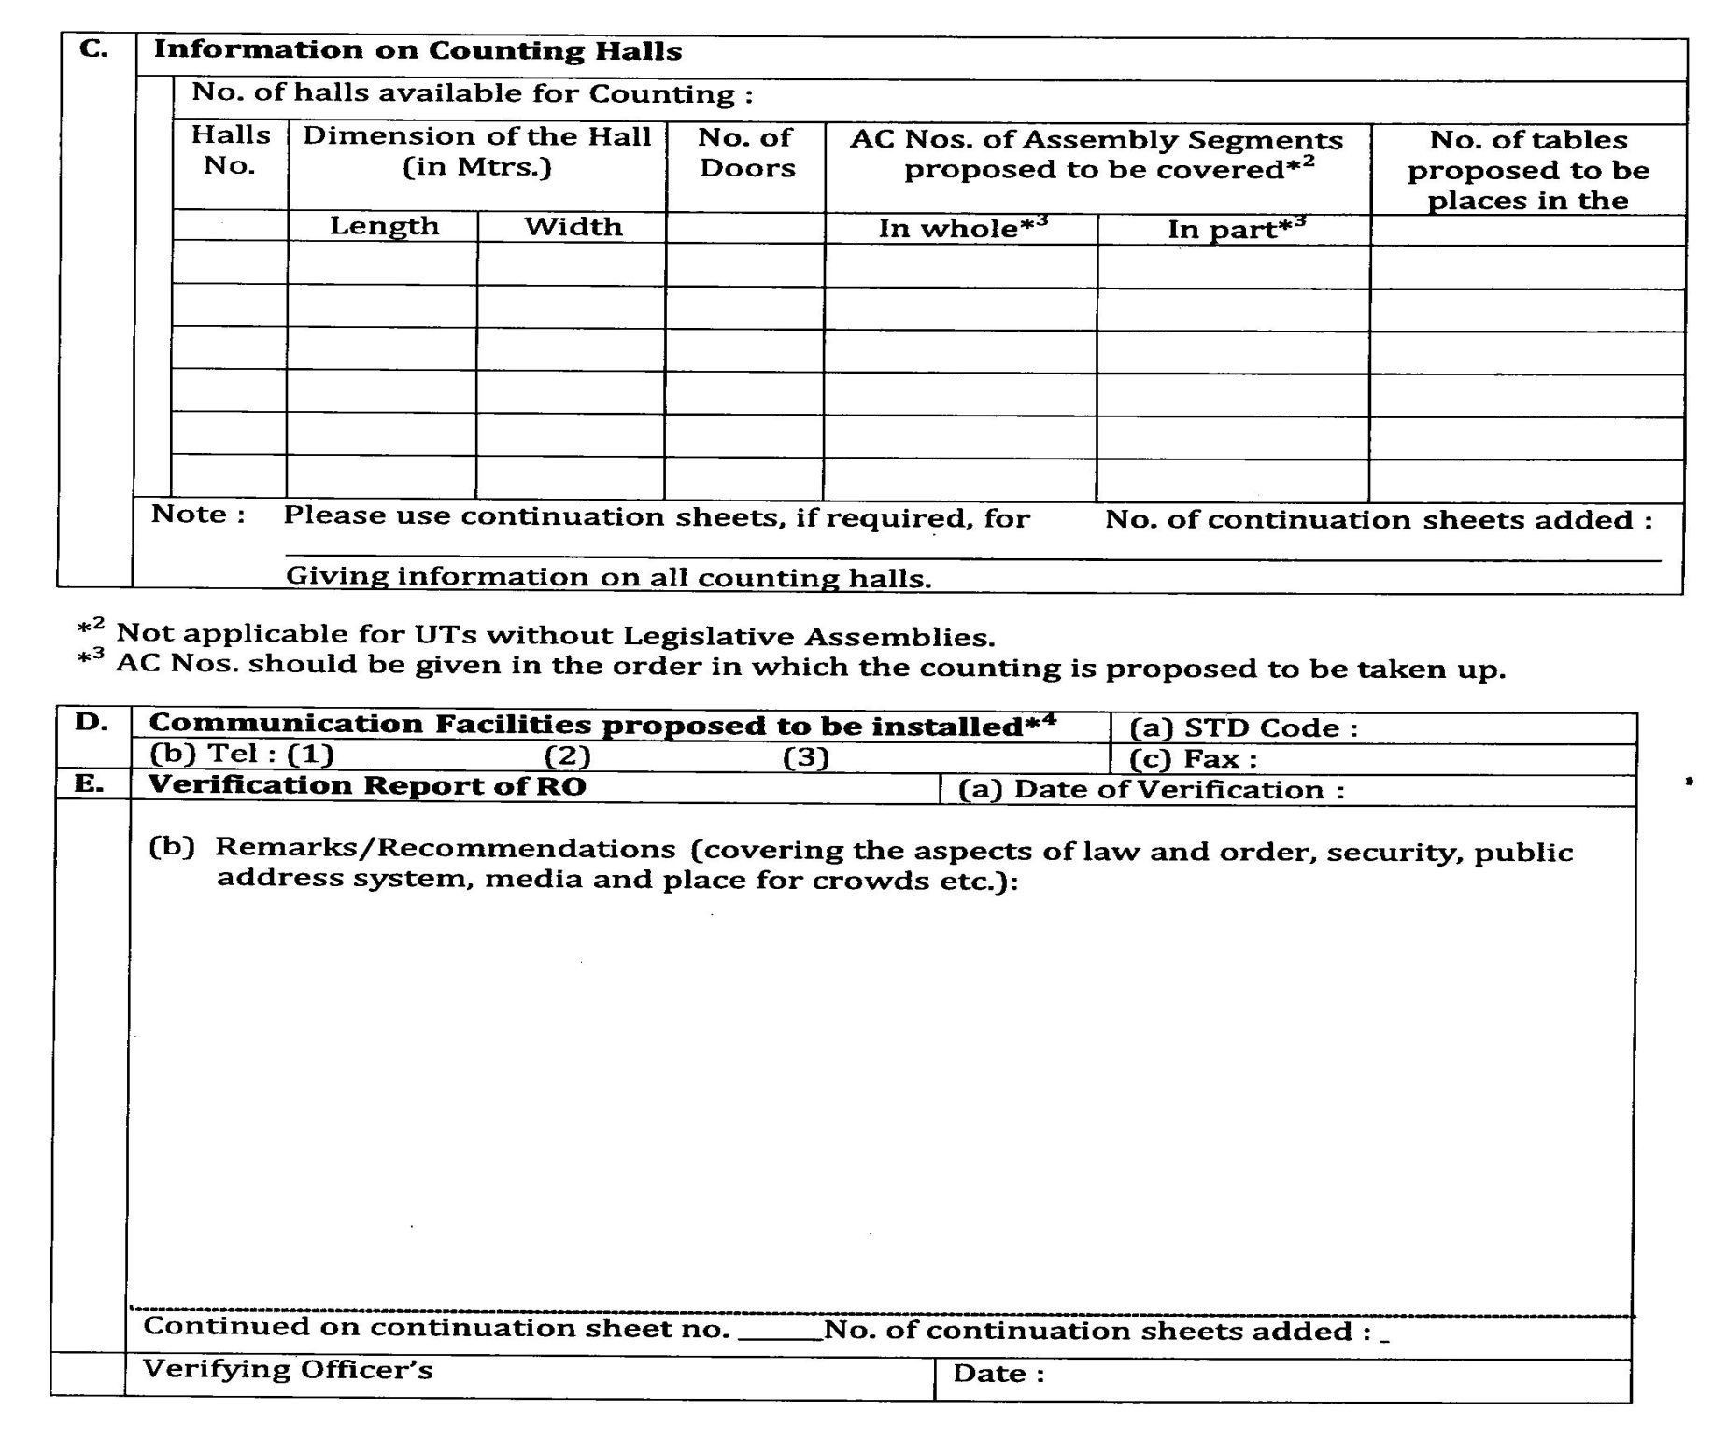
19

Slide 18
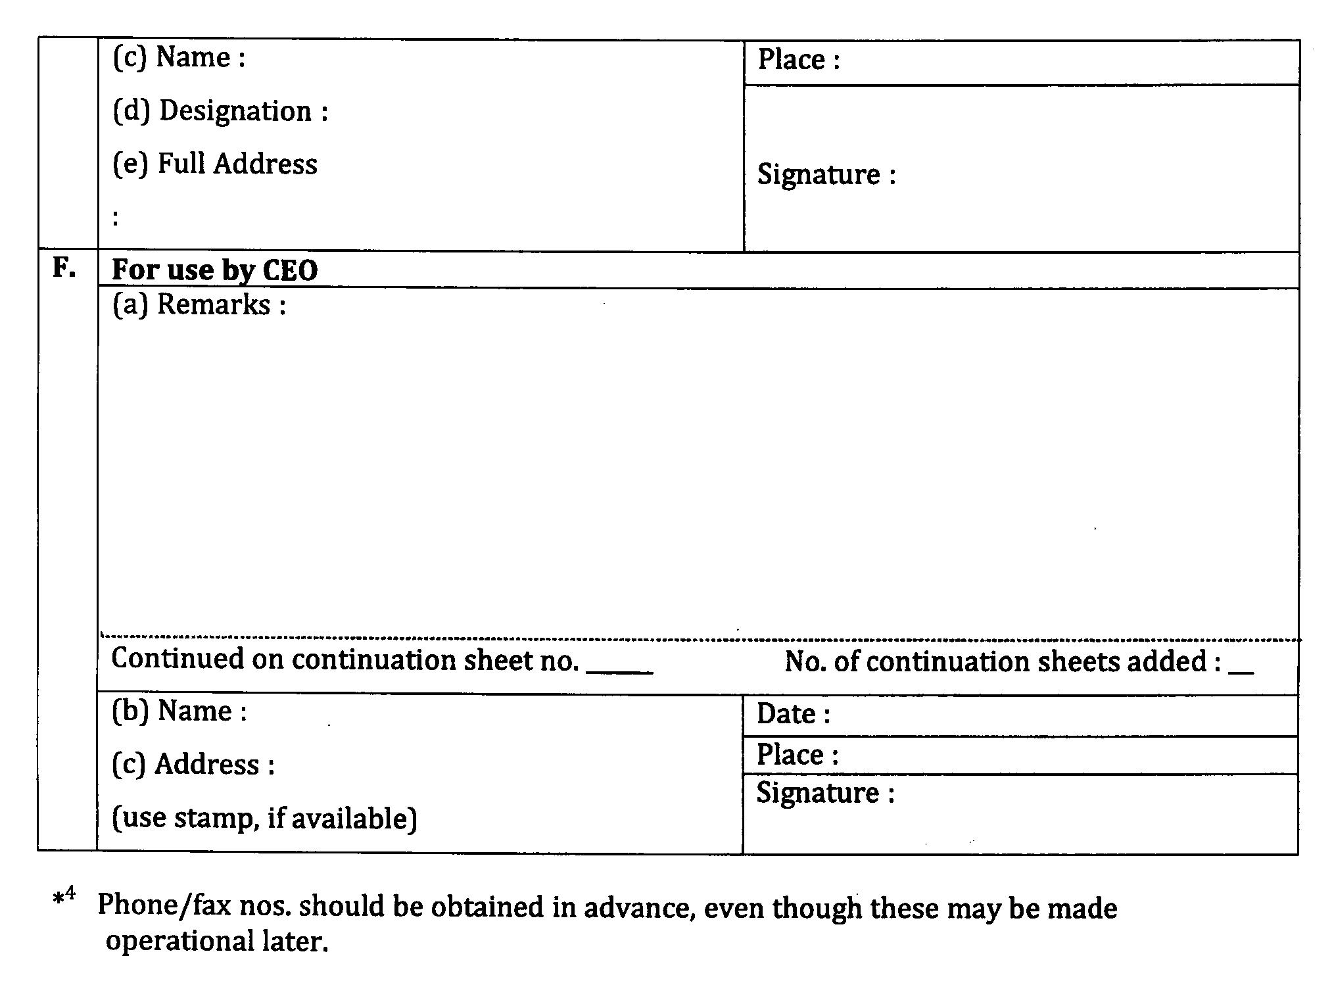
20

Slide 19
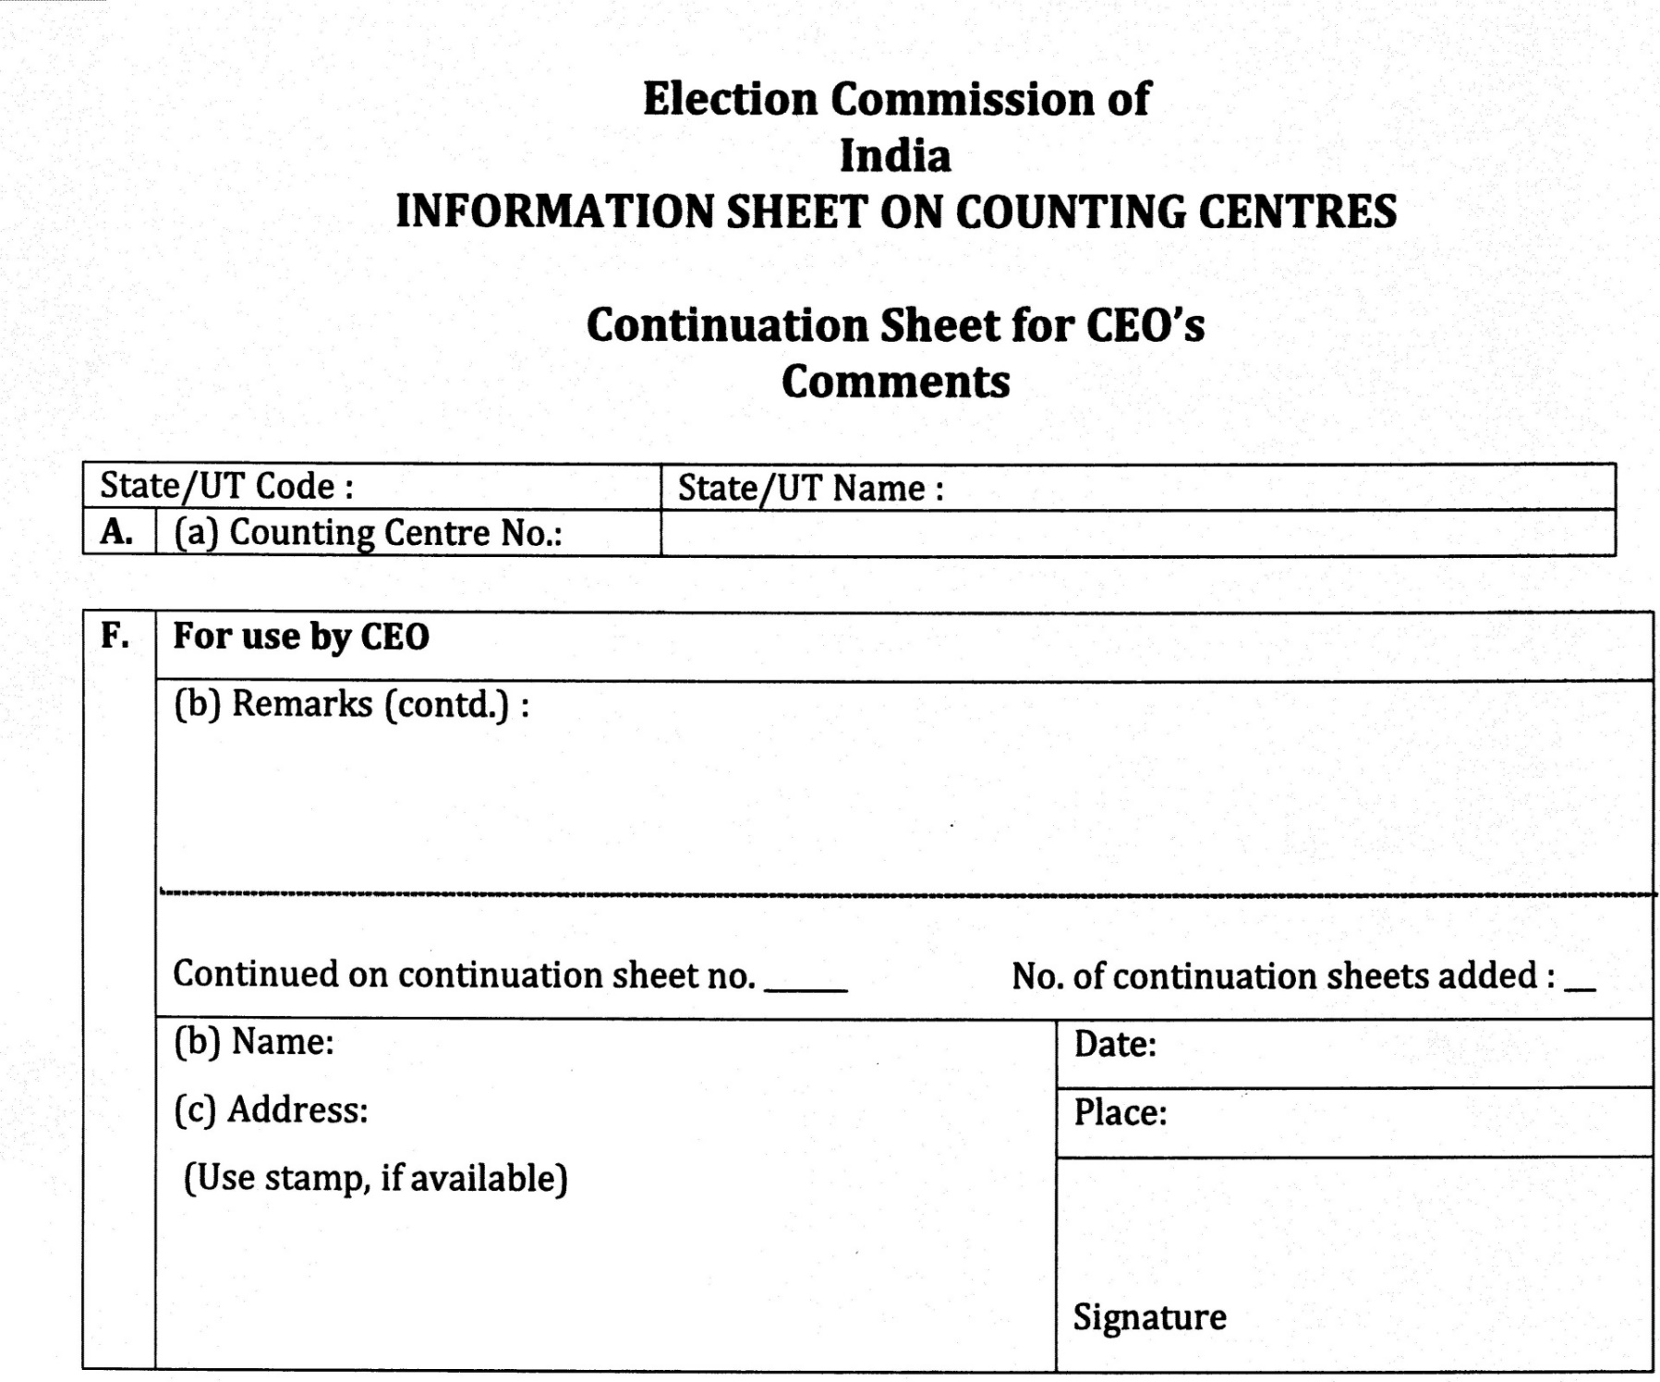

Slide 20
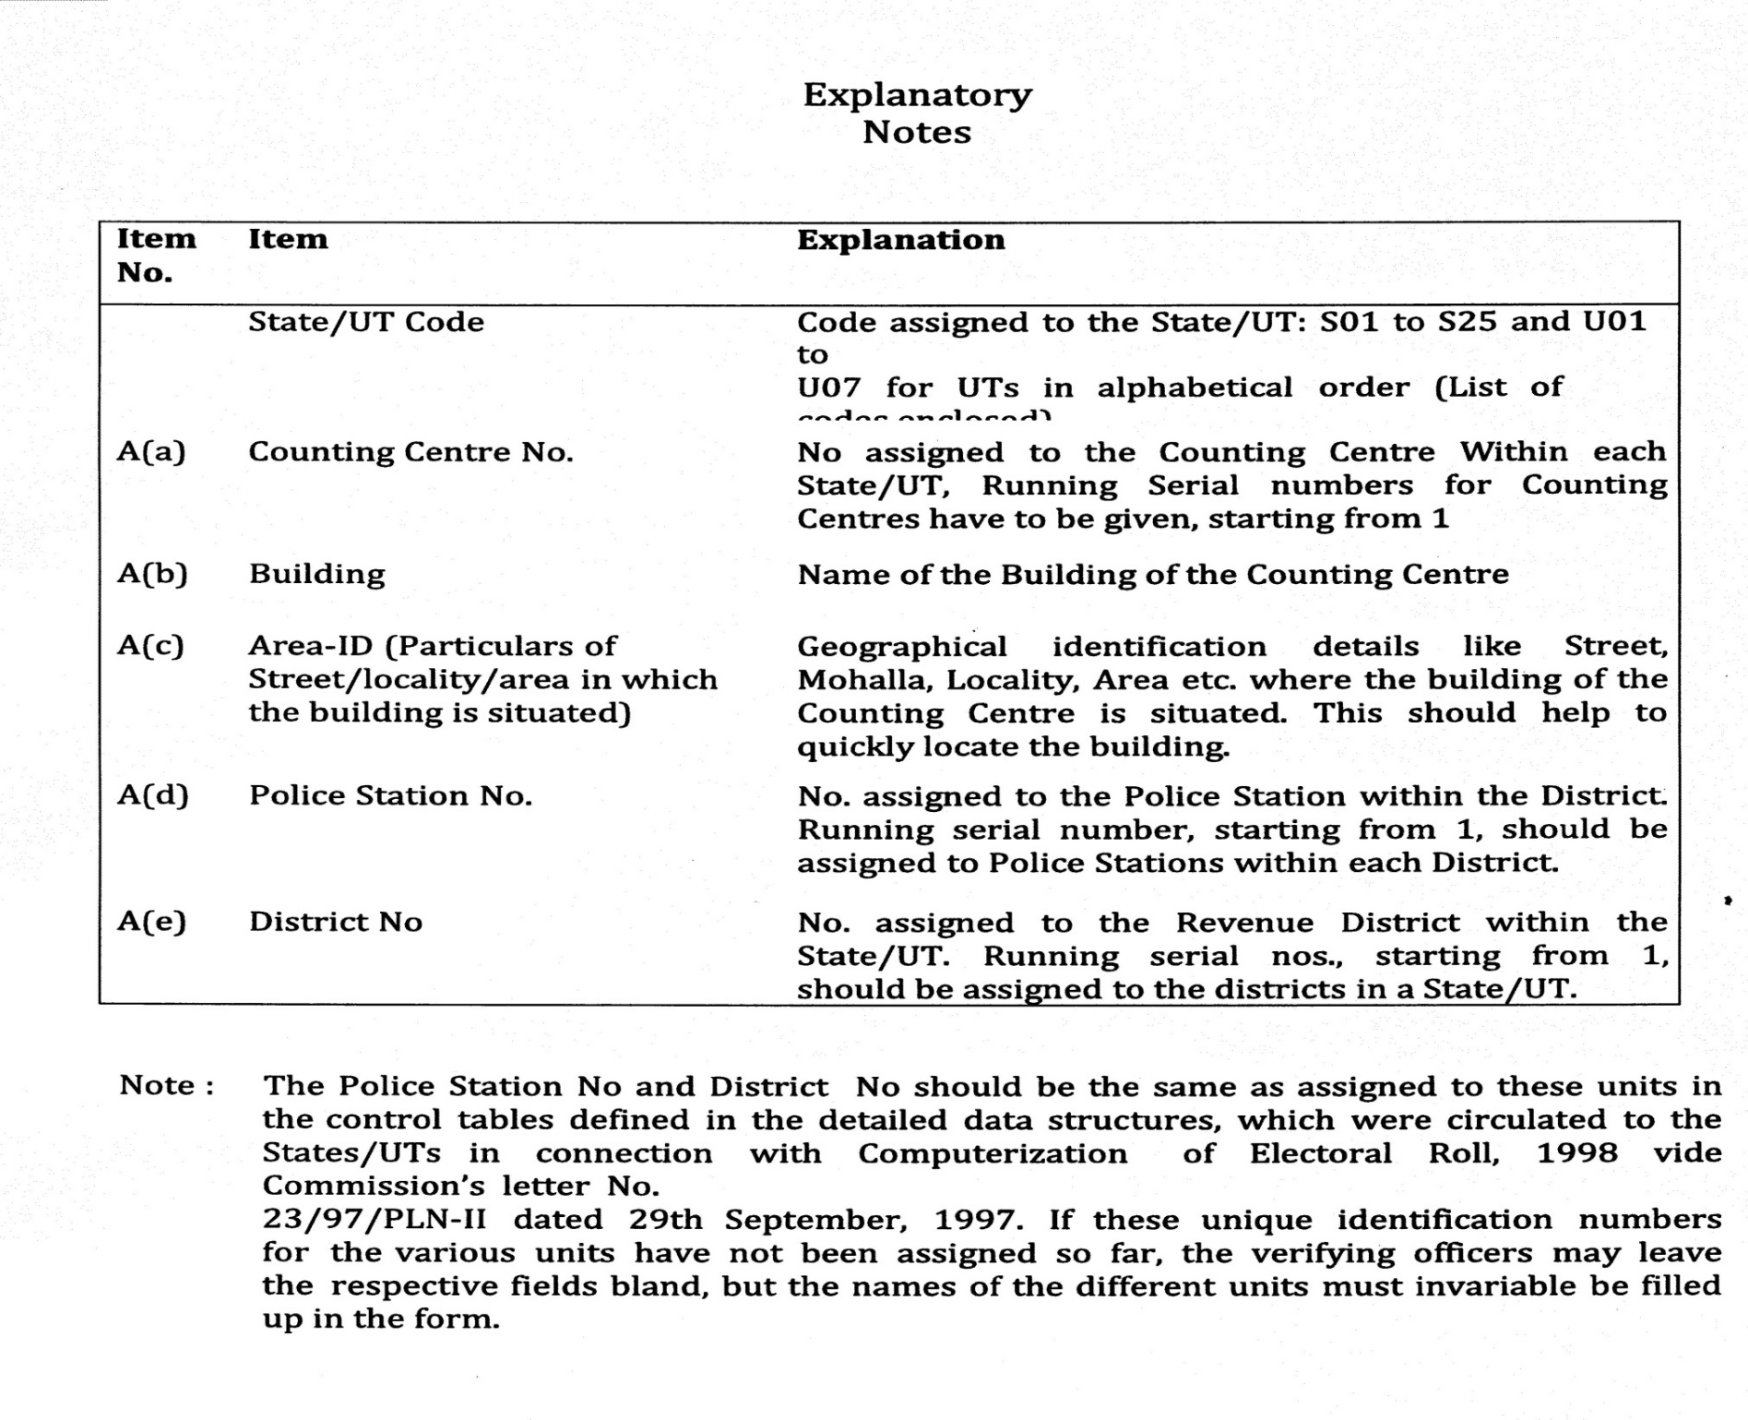

Slide 21
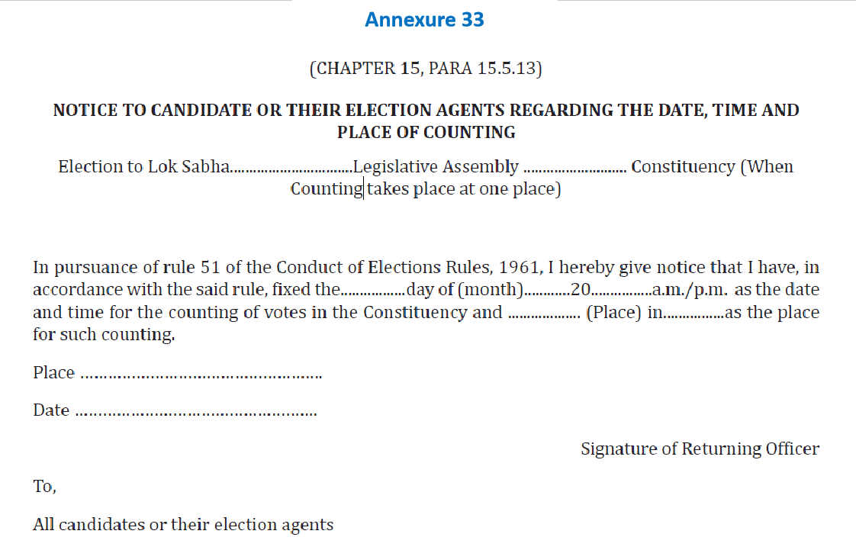
Annexure 34 -when counting takes place in more than 1 place

Slide 22
Should be spacious enough to accommodate infrastructure and officials and agents
Should have adequate lighting with proper standby arrangements (generator, etc.)
Adequate fire extinguishing equipment
Should be a permanent structure.
If unavoidably temporary, take ECI approval
Infrastructure at Counting Centre

Slide 23
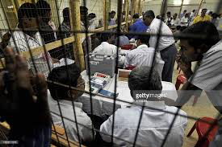


Counting Hall Arrangements
Barricade of woodblock and wire-mesh separating countint tables from counting agents.
Provision for VCB ( VVPAT counting booth)-one of the counting tables in the counting hall where RO sits, to be converted into VCB, covered with wire mesh like Bank cashier’s cabin.
PB counting preferably in same hall.
Tables- RO/ARO and Observer,
PB/ETPBS,
Counting tables
Computation.
Blackboard/ Whiteboard
Provision for Transparent Container (14’*10’*5) & Transparent Pigeon Hole tray ( 6“*4“*4“) for VVPAT counting- as per specification

Slide 24

Emergency light/ Generator
Fire fighting equiments
Public Address System
Photocopier Machine
Videography
Drinking Water
QR code scanner
Provide at every counting table, a blue ballpoint pen, paper knife for breaking open seals, two sheets of paper and Carbon Paper, Part II of Form 17-C, Round wise movement sheet of EVMs, Model proceeding ( table wise & round wise)
Proforma for recording of votes secured by each candidate and NOTA by additional counting staff/ Micro observer.
Sealed power packs of EVMs to be used in case of battery failures.

Slide 25
No. of tables in counting hall depends upon
  No. of polling stations to be counted.
  Space available
  No. of counting agents
  No. of counting staff including micro-observers
  Security concerns
The candidates or their agents will be allowed to sit on ROs Table to watch the counting process.
A table with computer on which computation and compilation of data from each table after each round shall be done, should be alongside of ROs table.
If the tabulation is done at the table other than ROs table then one additional counting agent besides micro observer will be allowed to sit in on the tabulation table.
Adequate barricades using woodblock and wire-mesh for each counting table to prevent agents/candidates/representatives from handling polled EVMs, but agents should be able to view entire process.

Slide 26
Counting Materials / Forms
Tray
Paper Knife
Gala
Matches
Candle
RO metal seal
Section 128
17 C part II
Pigeon hole
Plastic Container
Secret Seal
Common Address Tag
Thread
Tag
Blank Identity card
Envelopes of various size
Battery of CU & VVPAT
Pin
Gems clip (Plastic coated)
Paper weight
Pen
Pencil
Carbon paper
Card board for sealing
Phoron
Sealing cloth
Clip board
Rubber band of different sizes
Self adhesive tape
Glue stick
Stove
Karhai
Big spoon
Chalk –duster
Blank A 4 paper
Blank A 3 paper
Blade
Sponge
Glycerin
Blank proceedings
SLU trunk/stickers
Black envelope
QR code reader

Slide 27
Layout
C.S.
BLACK BOARD
C.S.
4
C.A
7
C.A
M.O.
M.O.
C.S.
3
C.A
C.S.: Counting Supervisor
C.A.: Counting Assistant
M.O.: Micro Observer
C.S.
M.O.
6
C.A
COUNTING AGENTS OF CANDIDATES
COUNTING AGENTS OF CANDIDATES
M.O.
C.S.
2
C.A
M.O.
C.S.
5
C.A
M.O.
C.S.
ARO
RO
OBS
1
C.A
M.O.
CLERKS TO ASSIST RO

Slide 28
PRIORITY IN SEATING IN COUNTING HALL
(subject to seating capacity)
1. Agents of candidates of recognized national parties
2. Agents of candidates of recognized state parties
3. Agents of candidates of recognized state parties of other states permitted to use reserve symbol
4. Agents of candidates of registered unrecognized parties
5. Agents of Independents Candidates

Slide 29
DISCIPLINE & DECORUM IN COUNTING HALL
Agents to keep seated at allotted table.
Agents shouldn’t be allowed to move about hall. However, Candidates/ Election Agents can move around hall.
Only one person – either candidate or agent to be present at a table on behalf of contesting candidate.
If RO doubts any person he can have him/her searched, even if they possess valid authorization letter.
CAPF officials posted at doors of counting hall.
No one can enter or leave hall without RO’s permission.
RO can send anyone out of hall if they disobey RO’s orders.

Slide 30
Videography
(i) The randomization process
(ii) The process of opening of strong room
(iii) Transfer of EVMs from strong room to counting hall
(iv) Counting hall arrangements
(v) Counting – PB & EVM
(vi) Process of tabulation
(vii) Process of counter checking of two EVMs by the observers
(viii) Entire procedure to count paper ballot slips (VVPAT) and sealing
(ix) Security arrangements.
(x) Presence of candidates and their agents
(xi) Process of declaration of result
One Videographer per hall

Slide 31
(xii) Handing over of certificate of Return of Election
(xiii) Sealing of EVMs after counting
Any other significant events of the counting process
The videography should indicate the date and time and the unedited video CDs should be sealed, clearly labeling all the details contained therein, after the counting process is over for future reference. Accordingly, adequate number of video teams may be deployed on the counting day.

Slide 32
Management inside Counting Hall
Candidate and election agent can go to any table from outside the Chicken Mesh.
No person is allowed to enter or leave hall without RO’s permission.
No smoking
There will be no webcasting of the process of counting of votes but CCTV coverage will have to be made.
The connectivity of the cameras should be done through wired connection.
The HD IP Cameras will be used and minimum camera specification can be reduced to 2 Megapixel.
RO shall carry the mobile phone linked with ETPBS for receiving OTP to log into the system.
It will be switched off once the ETPBS system is logged in and kept with the Observer.
No one else other than the Observer can carry mobile phone.

Slide 33

Media Management
Media Pass to be issued in advance.
Media Centre- Separate room, adequate space, telephone, STD, fax, computer, printer, scanner and internet connection. Mobile allowed.
Media Centre to Counting Hall- Guided tour in small groups for small duration.
Inside Counting Hall- No mobile, No recording of actual vote recorded in EVM.
RO in advance should mark a line or fix one string to limit the access inside counting hall.

Slide 34
Design of VVPAT Counting Booth (VCB)
(a) The VCB should have minimum length 6 ft, breadth 6 ft. and height 8 ft.
(b) All four sides and the ceiling should be covered with a narrow wire mesh such that VVPAT- slips cannot come out from the VCB. A circular hole of 5 cm radius at a suitable height for the Counting Agents' transaction may also be made.
(c) CCTV should be installed on the ceiling just above the counting table for monitoring and recording purpose.
(d) VCB should have seating arrangements for at least four personnel.

Slide 35
SECURITY ARRANGEMENTS
At Storage place of polled EVMs-
  TWO tier security arrangements round the clock at the strong rooms having polled EVMs.
  Innermost perimeter by CAPF and outer perimeter by State Armed Police(SAP).
  The candidates representatives to be allowed to stay outside the inner perimeter at a location which enables them to view entry points of the strong room. If no direct view, then CCTV arrangements to be made. So that they can see the gates of strong rooms. In CCTV case, they shall be taken periodically in batches to strong room to see and verify themselves strong room.
  Round the clock control room in an adjacent room with a Gazetted officer.
  A log book shall be maintained by the CAPF to record date, time, duration and names of any one, Including DEO/SP/RO/Observer/Candidates or their agents etc, crossing the 2nd ring.
  The CPF contingent shall be given a camera to record such visits.
  all entry points of strong room should be under constant videography using web cam and laptops. Person deputed to take back up from lap top should be issued a photo- I card and his names etc be intimated to CPF posted there.

Slide 36
DEO shall visit storage campus (up to inner perimeter only) everyday morning and evening, if storage campus is in district HQ. If outside then by the RO, but DEO to visit at least once in 3-4 days.
Round the clock uninterrupted power supply, adequate fire extinguishers etc. to be arranged for.
No vehicle, official or private shall be allowed inside the secured campus.
At Counting centres-
First of all, secure and smooth movement of EVMs from strong room to counting hall and vice versa, has to be ensured.
100 meter perimeter around a counting premise to be demarcated as ‘Pedestrian Zone ‘. Must be duly barricaded with an entry gate to enter into counting premise and no vehicle should be allowed to cross this.
Three tier cordoning system. The 1st and outer cordon to start from pedestrian zone. Must have adequate local police forces with a senior magistrate to check identity of the entrants. Persons with photo I cards issued by ECI or DEO only to be allowed to cross.
2nd cordon will be at the gate of counting premise/campus and will be manned by SAP. Checking of identity and frisking ( only by state police personnel) to be done.
3rd cordon at the door of counting hall where CAPF is to be present. Frisking to ensure that no one enters with mobile and other prohibited items.

Slide 37
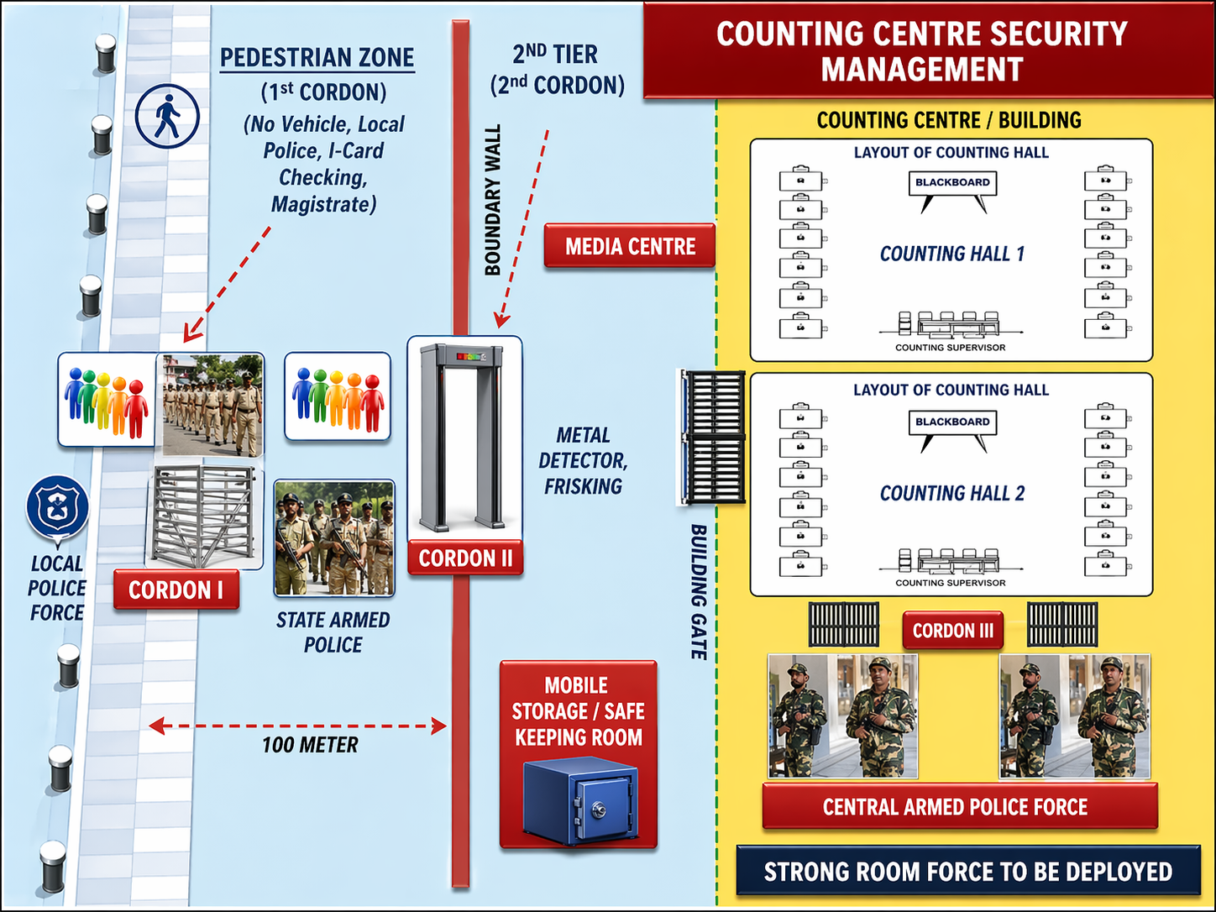

Slide 38
PERSONS ALLOWED INTO COUNTING HALL
Counting supervisors and assistants
Persons authorized by ECI
Public servants on duty in connection with election
Candidates, their election agents and counting agents
Every body inside the counting hall shall have to display his I-card on his/her person.
Sufficient nos. DFMD have to be installed for smooth & timely entry of all.
24

Slide 39
Police personnel, whether in uniform or plain clothed, NOT allowed. Must remain outside and can enter only when called by RO to come to control
Ministers, State Ministers, Dy. Ministers of Union & state unless they are candidates
The above cannot be appointed as election or counting or polling agent of candidate as they require security
Counting agents cannot enter unless/he has submitted 2nd copy of appointment letter after completing and signing declaration
ECI NO. 470/INST/2014-EPS Dated: 13th May, 2014 : Contesting candidates who are SPG protected to be accompanied inside the counting hall with one SPG personnel in plain clothes with "one concealed arms.”

Slide 40
The Commission has directed that General Observer shall visit the Counting Centre 02 days before the day of counting of votes and submit a report in the format (Annexure-ll) to the Commission on the same day. (51/8/7/2019- EMLS dtd 01.01.2020)
Report on Arrangement at Counting Centre
Name of State:
Name of District:
No. & Name of AC:
Address of Counting Centre visited:
I have visited the above mentioned Counting Centre on All necessary arrangements
at the Counting Centre have been made for counting of votes of the ongoing General/ Bye- election…………………………………………………………………………………. It is also submitted that Commissions instructions on the arrangement at counting centre have been complied with. It is further certified that:
S. No. | Particulars | Status | If No, remarks thereon
1. | Whether Counting Hall is spacious to accommodate infrastructure, officials and counting agents? | Yes/No
2. | Whether smooth flow of EVMs/VVPATs from the strong room to counting hall and vice versa has been made? | Yes/No
3. | Whether adequate lighting with proper standby arrangements (generator etc.) has been made? | Yes/No
4. | Whether 100 meter perimeter around the counting centre has been demarcat- ed as ‘Pedestrian Zone’ and barricaded? | Yes/No
5. | Whether 03 (three) cordoning security system has been made? [1st (outer) cor- don to start from pedestrian zone having adequate local police, 2nd (middle) cordon at the gate of counting premises/campus manned by SAP and 3rd (inner) cordon at the door of counting hall manned by CPF] | Yes/No
6. | Whether proper barricade using transparent material/wire mash for each counting table to prevent agents/candidates/counting agents etc. from han- dling polled EVMs has been made? | Yes/No
7. | Whether one of the counting table inside the counting hall has been ear- marked as VVPAT Counting Booth (VCB) for counting of VVPAT paper slips? | Yes/No
8. | Whether VCB has been wire-mashed just like a Bank Cashier Cabin so that no VVPAT slips can be accessed by any unauthorised person? | Yes/No
9. | Whether you have seen the complete mock drill of counting of VVPAT with atleast 500 VVPAT slips? | Yes/No
10 | Whether you are satisfied with arrangements at Counting Centre? | Yes/No

Slide 41
iii. Counting Staff & Counting Agents
      Counting Personnel
      Counting Agent

Slide 42
Counting staff
Counting staff is appointed by the RO concerned.
Format of Appointment letter prescribed in Annexure-35 of HB of RO.
Requirement to be assessed on basis of no. of counting halls and no. of counting tables plus reserve.
For each table:
  One Counting Supervisor (preferably a Gazetted officer of Central / State Govt. or officer of equivalent status of PSUs.
  One Counting Assistant
  One Micro Observer (a Central Govt. official)
  One Group D employee ( For carrying polled machines)
  Additional Counting Assistant for Observer to do parallel counting
  Other personnel are to be appointed in every AC as per following scale:
  i) Strong Room officer (2 nos per Strong Room)
  ii) Sealing Personnel (1+2)
  iii) VVPAT Counting personnel (1 +3) - Separate Counting staff preferably, Cashiers, Central or State
  Bank Cashiers etc. can be appointed for VVPAT slips count.
  iv) Compilation staff (I+2)
  v) RO’s table personnel (2nos) are to be deployed from amongst Govt employees.
  vi) Personnel for scanning as per requirement icw pre-counting of ETPBS
Training in cascaded mode exclusively on counting matters –to be provided to all appointed personnel
At State Level- By CEO Office for the ADM Election & SLMTs
At District Level- By SLMTs for all ROs, AROs, CSs, CAs, CMOs, VCB staff, ETPBS, Postal ballot Counting Staff, Tabulation staff, Encore entry staff, Sealing staff

Slide 43
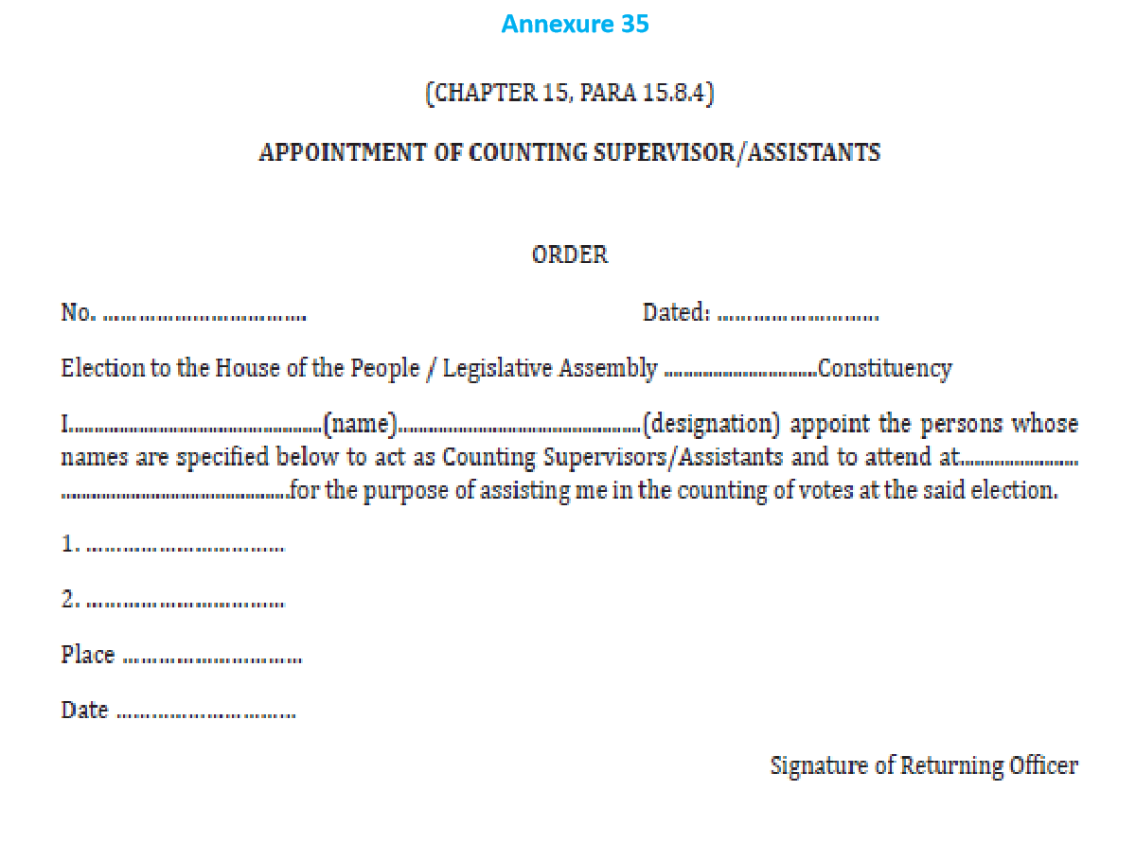

Slide 44
Counting Personnel/Agent at each table
Personnel | Category | EVM Counting | ETPBS/ Postal Ballot Counting
Counting Supervisor | Govt employees in Supervisory cadre | 1 | 1
Counting Assistant | Govt employee | 1 | 2
Micro Observer | Central Govt/Undertaking employee | 1 | 1
Counting Agent | As will be appointed by the Candidate through Form 18 ( above 18 yrs of age) | 1 | 1

Slide 45
Staff for Counting Observer: for each AC
Personnel | Work assigned
One Addl. Counting Staff ( CA) | Random checking of two EVMs per round
Addl. Counting Staff (officers) | VVPAT Counting Booth (VCB)
1st Micro Observer | Keep watch over the data entry in computer
2nd Micro Observer | Re-check the printouts of Form 17C Part II

Slide 46
Randomization of Counting Personnel
Sl No | Randomization | Responsibility | Process | Time frame | Objective | Appointment letter to be issued by
1 | First | DEO | Using computer | One week prior to counting | To segregate 120% counting officials | DEO
2 | Second | DEO + Observer | Using computer | 24 hrs prior to counting | AC wise segregation | RO
3 | Third | DEO + Observer | Computer/ Manual | At 5 am on date of counting (must be completed by 6 am) | Counting Table allocation | RO
Videography
Observers to appoint Micro Observers

Slide 47
Counting Agents
Each Candidate- To appoint counting Agents- all EVM counting tables + RO’s Table + PB/ETPBS Tables + Compilation table.
To be Appointed in Form- 18 (in duplicate).
Declaration to be signed in RO’s presence.
List of Counting Agents in Form 18, with their photos for all contesting candidates by 1700 hrs on 3 days prior to the date of counting.
Counting Photo I-Card to be issued- agents to affix their signature.
The law does not prescribed any specific qualifications for persons to be appointed as counting agents.
Candidates are advised to appoint mature persons who are above 18 years as their counting agents.

Slide 48
The following persons cannot be appointed as Counting Agent of a Candidate during an election:
a.Sitting, Minister either of the Union Government or of the State Government, Member of Parliament or State Legislature
b.Mayor of a Corporation or Chairperson of Municipality/Zila Parishad/Panchayat Union, etc.
c.Chairpersons and Members of Central PSUs/ State PSUs, Govt. Bodies/Corporation.
d.Persons receiving any honorarium from Government or Persons working on part time in any Govt. / Govt. Aided Institutions.
e.Para Medical/ Healthcare staff working in Govt./Govt. Aided institutions, Fair Price Shop dealers, Anganwadi Employees.
f. Person in the service of the Government [This is an offence and Under Section 134-A of the R.P. Act 1951 and such appointees are punishable with imprisonment for a term which may extend to 3 (three) months, or with fine, or with both].

Slide 49
There is no prohibition against appointment of Gram Panchayat Pradhan/ Gram Panchayat Sarpanch / Panchayat members, Councilors or Members of Municipal Corporation or Municipality and local persons, who are residents of the constituency, as Counting Agents of Candidates. There is no prohibition in appointing an NRI who is a citizen of India as Counting Agent.
Any other person having security cover provided by the State (both Union and State Govts.) shall not be allowed to act as Election Agent or Counting Agent of any candidate during an election even if they surrender or decide to relinquish their security. Further, such person cannot enter the Counting Hall along with or without his security personnel.
Appointment of counting agents in Form 18. Revocation in Form 19.
Counting agent should sign on badge immediately.
Any application on plain paper to be rejected. Form 18 to be submitted in duplicate. The RO will keep one copy and return the 2nd copy. On counting day, the agents will sign the declaration part of the Form 18 and give it to the RO.
Issue photo identity cards to such counting agents under your seal and sign. No entry into counting hall without I-card
The Counting agent may carry pen/pencil, Plain paper/note pad and duplicate copy of form 17 C

Slide 50
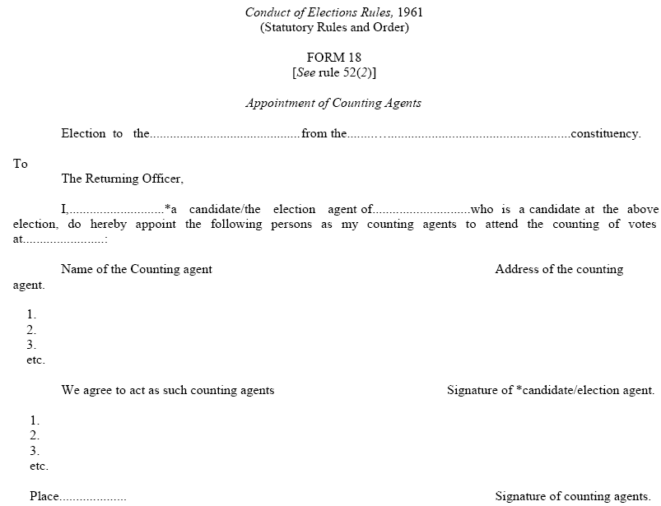
Form 18: Appointment of Counting Agents

Slide 51
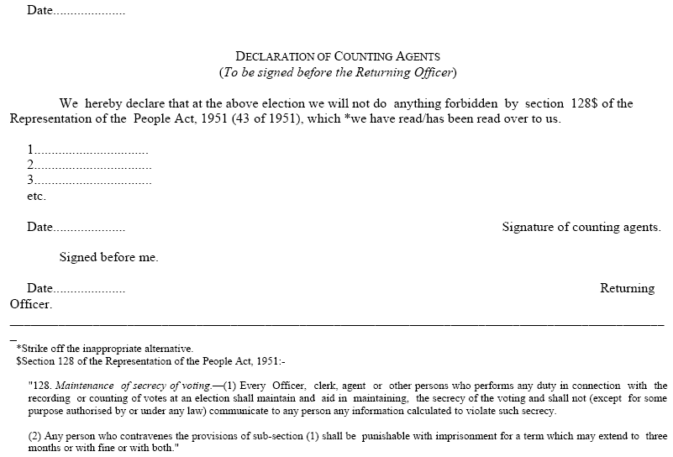
32

Slide 52
2. COUNTING PROCESS
Starting Counting Process
ETPBS
Postal Ballot Counting
CU Counting
VVPAT counting
Special situation
Compilation

Slide 53
Opening of Strong Room
The RO should commence the counting at the hour fixed (8.00am) for the purpose and communicate the time of opening strong room to candidates and observers ( 6.30am).
The strong room should be opened, in the presence of RO/ARO(s), candidates/ election agents and ECI observers.
After making necessary entries in the log book maintained for the purpose, the seal of the lock should be checked and then broken.
Videography.

Slide 54
Counting of votes in Counting Hall
Section 128 of the RP Act, 1951- For maintaining secrecy of vote in the counting hall, RO should read out aloud the provisions of Counting of Postal Ballot to be taken up first.
Counting of postal ballot papers shall be done at RO’s Table.
If there is shortage of space for keeping more than 3 or 4 tables in the hall and the number of Postal Ballot Papers received is very high, the RO can make arrangement of a separate hall adjacent to counting hall for counting of postal ballot papers.
Only such postal ballot papers as are received before the hour fixed for commencement of counting (8 am) shall be counted.
The penultimate (one before the last) round of counting of votes recorded in EVMs shall not commence till the counting of postal ballot is completed in all respects.

Slide 55
ii. Counting of ETPBS

Slide 56
SOP regarding counting of e-Postal Ballot
counting of the e-Postal Ballot received from the Service voters in the RO office on or before 7:59 AM on the day of counting.
There are two stages for ETPB Counting:
A. Pre counting – Scanning of Form 13-C, Form 13-A and Form 13-B
B. Counting (RO should mark scanning as complete before starting Counting of e-PB Votes).
Requirements of Hardware items for pre-counting of E-Postal ballot for each table:
1. One Desktop/ Laptop with windows 7 and above
2. One QR Code Scanner with Manual Trigger Mode
3. Ensure Power Backup and One UPS for each desktop
4. Wired Internet Connectivity of minimum 10 MBPS for each system (make arrangement of two internet lines of different operators)
5. Stationery Items

Slide 57
Points to be taken care of at the time of Pre-Counting of E-Postal Ballot:
1.Only QR Code Scanners are to be used for Pre-Counting. All QR Code Scanner and Computer must be tested on demo site before the day of counting at the counting center on the computer to be used for Pre-Counting. Clear browser history. QR Code Scanner must be in Manual Trigger Mode.
2.Scanning will be enabled at 8:00 AM on the day of counting.
3.Suitable seating arrangements for one agent for each candidate may also be made within the room for them to watch the process of QR Code reading.
4.All RO/Counting Supervisor should login one day before the counting and set their password.
5.The ARO appointed for pre-counting (ETPBS Scanning) should be well trained. The Pre-Counting ARO will check each of the ETPB’s in the INVALID BALLOT tray and mark them accordingly with reason.
6.Scanning to be done in order C-A-B (Form 13-C then Form 13-A and then Form 13-B).
7.The Counting Supervisors and Counting Assistant should be well trained regarding the scanning of 13-C, 13-A and 13-B and should be familiar with all types of scenarios. They only need to do scanning of QR Codes. They will not deal with the validity of any document related to e-postal ballot. The validity of the E-postal ballot will be checked by Counting ARO on the counting table.
8.Scrutiny of the e-PB will be done by the RO/Counting ARO.
9.Keep two separate trays – one for ETPB’s which are to be counted and one for ETPB’s which are not to be counted. Paste the following signs on the tray: VALID BALLOT and INVALID BALLOT. Never mix the ETPB’s of these two trays.
10.After Pre-counting of all ETPB’s is done, transfer the ETPBs in the tray VALID BALLOT to the counting tables.

Slide 58
After completing the scanning of all received e-PB, RO has to login on ETPBMS and mark scanning as completed and along with it enter the total number of e-PB received till 8:00 AM and after 08:00 AM on the day of Counting and total e-PB rejected without Scanning. Note that once scanning is marked as complete, no further scanning can be done. Start counting e-PB only after marking scanning as completed.
Scenario 1: Normal Scenario
Step 1: Scan the outer cover (Form 13-C) which has a QR Code on lower right-hand side. It will be read by the QR Code Reader and necessary valid checks will be performed for possible duplicates and verification of the service voter. A unique serial number will be provided by the computer. The Counting Supervisor will manually write the computer-generated serial number on the envelope being verified.
Step 2: If no duplicate and correct verification is found, then open the outer cover (Form 13C) and take out the two documents which are required to be found inside. The first one is declaration (Form 13-A) and the second one is inner cover (Form 13-B) containing the postal ballot paper.
Step 4: Scan two QR Codes on Form 13-A one by one which is on the lower side of Form 13-A. Note down the computer generated Sl. No. on Form 13-A
Step 5: Scan the QR Code which is on the lower right side on Form 13-B. Note down the computer generated Sl. No. on Form 13-B.
Step 6: If the QR Code reading does not raise any anomaly, keep Form 13-B envelope and Declaration (Form 13-A) back in Form 13-C envelope and keep the envelope in a tray marked as VALID BALLOT.

Slide 59
Scenario 2: If the QR Code available on Form 13-C is damaged and cannot be scanned, then follow the procedure given below.
Scenario 3: If the QR Code available on Form 13-A is damaged and cannot be scanned, then follow the procedure given below.
Scenario 4: If QR code available on Form 13-B is damaged and cannot be scanned, then follow the procedure given below.
Scenario 5: If the declaration Form 13-A or Form 13-B is not found after opening of outer envelope 13-C, then follow the procedure given below.
Scenario 6: If 13-A or 13-B QR code cannot be scanned and 16-digit e-PBID is also not readable, then follow the procedure given below.
Scenario 7: In case duplicate or spurious E-Postal Ballot, then follow the procedure given below.

Slide 60

ETPBS pre-counting
Scanning of QR Codes should be done in sequence as:
  i.Form 13-C should be scanned first
  ii.Then followed by both the QR Code on Form 13-A and
  iii.Then Form 13-B of the same postal ballot
2. Keep two separate tray – one for rejected ballot and one for accepted ballot. Never mix “Rejected/Invalid” ballot with the accepted ballot.

Slide 61
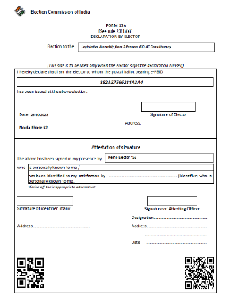
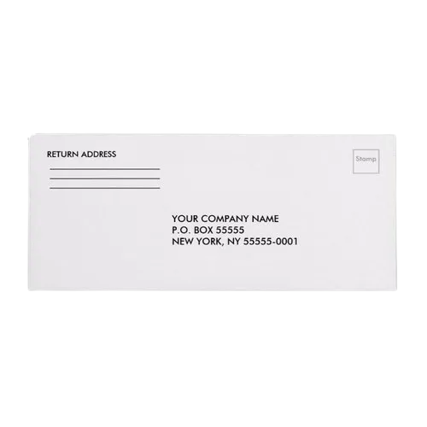
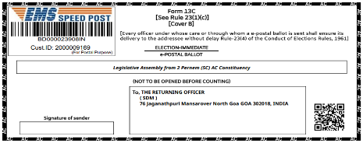
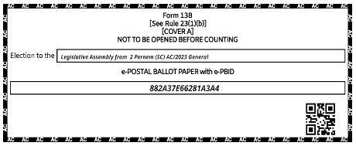
ETPBMS Pre-counting Process
What a Postal Ballot Contains ?
  Form 13C
  This envelope that is received by the post with a pasted form 13C .
  This envelope contains rest of the other documents like Form 13 A, Form 13 C & Postal Ballot.
  Form 13A
  This is the declaration by the elector.
  Present inside the envelope of 13C.
  If the form 13A is missing in the postal ballot, the PB will be marked as invalid.
  Form 13B
  This envelope is kept inside of main envelope.
  Contains the postal ballot and will be opened once it is marked as valid in pre-counting process.
  If missing in the main envelope, the PB will be marked as invalid.

Slide 62
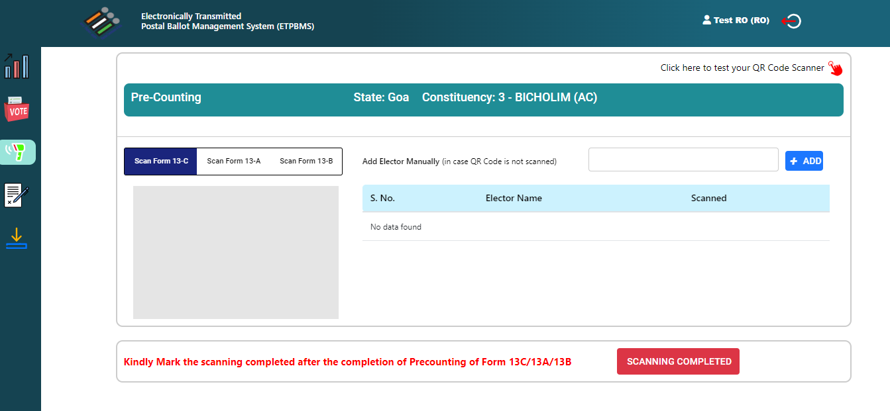
The pre-counting process will gets enabled at 8:00 AM on the day of counting.

Slide 63

Sequence to be followed
in Scanning Process
(C-A-B)
Pre-Counting
Scan
Form 13-C
(Outer Envelope)
Scan
Form 13-A
(Declaration)
Scan
Form 13-B
(Inner Envelope)

Slide 64
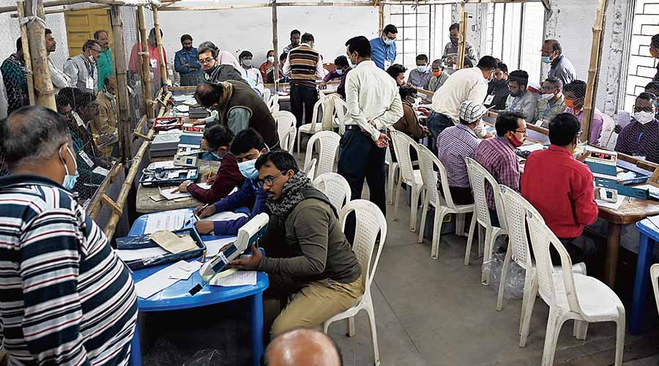
Condition - 1
Process of
Scanning & Valid Marking of e-Postal Ballot…
(In Ideal Condition)

Slide 65

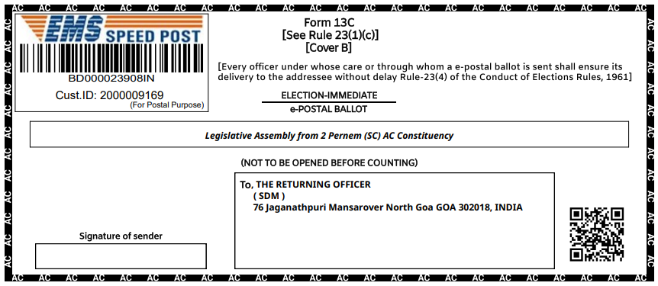
Steps for Scanning & Valid Marking in ideal Condition
Step 1
Scan the QR code of outer envelope i.e. form 13C.
Open the envelope and take out Form 13A and 13B (Inner envelope)

Slide 66
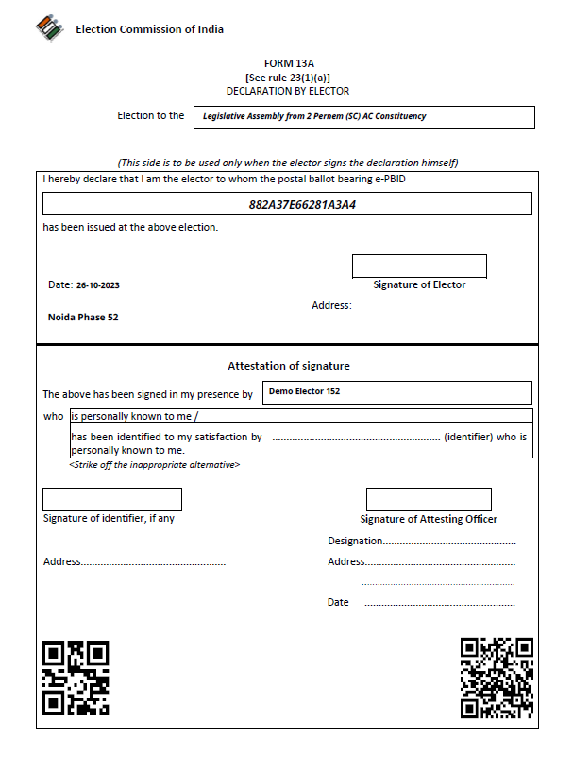
Steps for Scanning & Valid Marking in ideal Condition
Step 2
Scan first QR code of form 13A followed by the scanning of the second QR code.

Slide 67
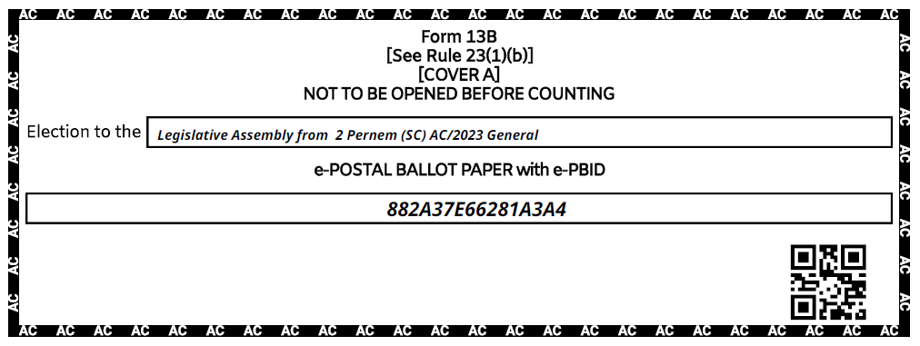
Steps for Scanning & Valid Marking in ideal Condition
Step 3
Scan the QR code of inner envelope i.e. form 13B.

Slide 68


Steps for Scanning & Valid Marking in ideal Condition
After successful scanning of all the forms mark system generated serial number with pencil on form 13A, 13B & 13C (backside) then put form 13B envelope and form 13A inside the outer envelope.
Place in the basket of Valid / Rejected e-PB accordingly.
Rejected ePB
Valid ePB

Slide 69
Condition - 2
Process of
Scanning & Valid Marking of e-Postal Ballot…
(If form-13C is not getting scanned)

Slide 70
Process of
Scanning & Valid Marking of e-Postal Ballot
(If form-13C is not getting scanned)
Step 1
Open the envelope and take out Form 13A and 13B (Inner envelope)
Search the elector by name in the tab of form 13C.

Slide 71
Process of
Scanning & Valid Marking of e-Postal Ballot
(If form-13C is not getting scanned)
Step 2
Search the elector by name in the tab of form 13C.
Once found the elector click on the add button to proceed.

Slide 72
Process of
Scanning & Valid Marking of e-Postal Ballot
(If form-13C is not getting scanned)
Step 3
Scan first QR code of form 13A followed by the scanning of the second QR code.

Slide 73
Process of
Scanning & Valid Marking of e-Postal Ballot
(If form-13C is not getting scanned)
Step 4
Scan the QR code of inner envelope i.e. form 13B.

Slide 74
Process of
Scanning & Valid Marking of e-Postal Ballot
(If form-13C is not getting scanned)
After successful scanning of all the forms mark serial number on form 13A, 13B & 13C than put form 13B envelope and form 13A inside the outer envelope.
Place in the basket of Valid / Rejected e-PB accordingly.
Rejected e-PB
Valid e-PB

Slide 75
Condition - 3
Process of
Scanning & Valid Marking of e-Postal Ballot…
(If form-13A is not getting scanned)

Slide 76
Process of
Scanning & Valid Marking of e-Postal Ballot
(If form-13A is not getting scanned)
Step 1
Scan the QR code of outer envelope i.e. form 13C.
Open the envelope and take out Form 13A and 13B (Inner envelope)

Slide 77
Process of
Scanning & Valid Marking of e-Postal Ballot
(If form-13A is not getting scanned)
Step 2
If any one of the QR code is not getting scanned that copy the 16 alphanumeric ePB ID and start manual entry of ePB.

Slide 78
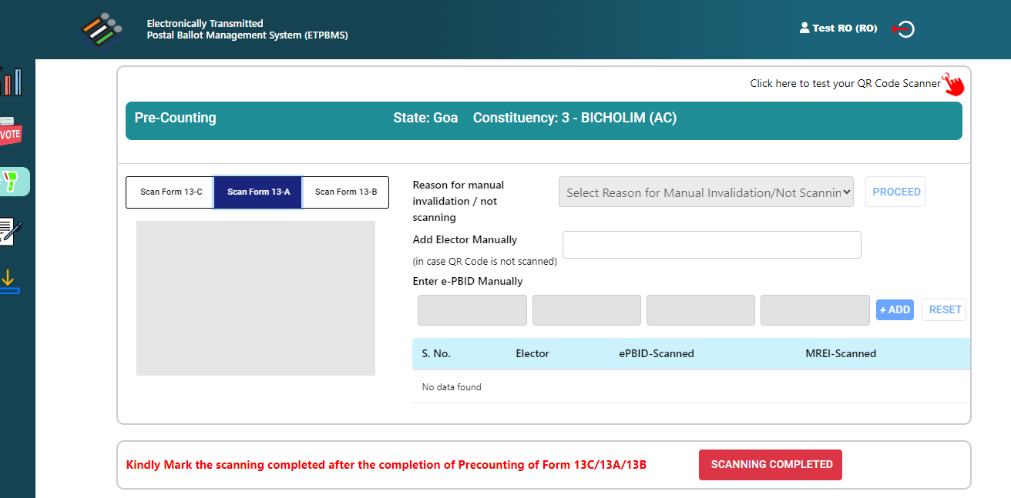
Process of
Scanning & Valid Marking of e-Postal Ballot
(If form-13A is not getting scanned)
Step 3
Start manual entry of ePB ID and add the elector for form 13A marking.
Once the ePB ID entered click on the add button to proceed.

Slide 79
Process of
Scanning & Valid Marking of e-Postal Ballot
(If form-13A is not getting scanned)
Step 4
Scan the QR code of inner envelope i.e. form 13B.

Slide 80
Process of
Scanning & Valid Marking of e-Postal Ballot
(If form-13A is not getting scanned)
After successful scanning of all the forms mark serial number on form 13A, 13B & 13C than put form 13B envelope and form 13A inside the outer envelope.
Place in the basket of Valid / Rejected e-PB accordingly.
Rejected e-PB
Valid e-PB

Slide 81
Condition - 4
Process of
Scanning & Valid Marking of e-Postal Ballot…
(If form-13B is not getting scanned)

Slide 82
Process of
Scanning & Valid Marking of e-Postal Ballot
(If form-13B is not getting scanned)
Step 1
Scan the QR code of outer envelope i.e. form 13C.
Open the envelope and take out Form 13A and 13B (Inner envelope)

Slide 83
Process of
Scanning & Valid Marking of e-Postal Ballot
(If form-13B is not getting scanned)
Step 2
Scan first QR code of form 13A followed by the scanning of the second QR code.

Slide 84
Process of
Scanning & Valid Marking of e-Postal Ballot
(If form-13B is not getting scanned)
Step 3
Scan the QR code of inner envelope i.e. form 13B.

Slide 85
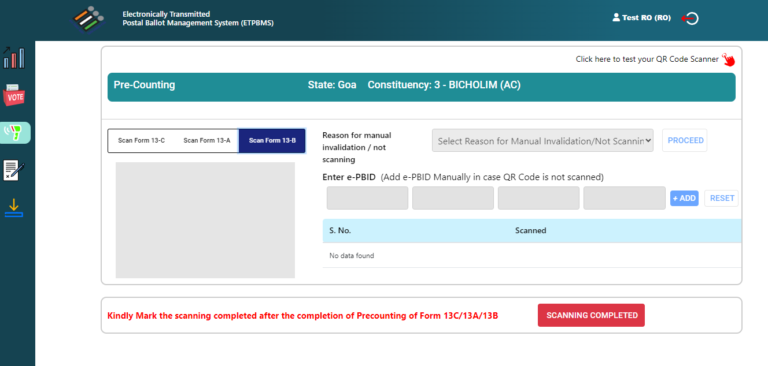
Process of
Scanning & Valid Marking of e-Postal Ballot
(If form-13B is not getting scanned)
Step 4
Start manual entry of ePB ID and add the elector for form 13B marking.
Once the ePB ID entered click on the add button to proceed.

Slide 86
Process of
Scanning & Valid Marking of e-Postal Ballot
(If form-13B is not getting scanned)
After successful scanning of all the forms mark serial number on form 13A, 13B & 13C than put form 13B envelope and form 13A inside the outer envelope.
Place in the basket of Valid / Rejected e-PB accordingly.
Rejected e-PB
Valid e-PB

Slide 87
Condition - 5
Process of
Scanning & Invalid Marking of e-Postal Ballot…
(If form-13A is missing)

Slide 88
Process of
Scanning & Valid Marking of e-Postal Ballot
(If form-13A is missing)
Step 1
Scan the QR code of outer envelope i.e. form 13C.
Open the envelope and take out Form 13A and 13B (Inner envelope)

Slide 89
Process of
Scanning & Valid Marking of e-Postal Ballot
(If form-13A is missing)
Step 2
Mark form 13A missing from the drop down and Reject the e-Postal Ballot.

Slide 90
Condition - 6
Process of
Scanning & Invalid Marking of e-Postal Ballot…
(If form-13B is missing)

Slide 91
Process of
Scanning & Valid Marking of e-Postal Ballot
(If form-13B is missing)
Step 1
Scan the QR code of outer envelope i.e. form 13C.
Open the envelope and take out Form 13A and 13B (Inner envelope)

Slide 92
Process of
Scanning & Valid Marking of e-Postal Ballot
(If form-13B is missing)
Step 2
Scan first QR code of form 13A followed by the scanning of the second QR code.

Slide 93
Process of
Scanning & Valid Marking of e-Postal Ballot
(If form-13B is missing)
Step 3
Mark form 13B missing from the drop down and Reject the e-Postal Ballot.

Slide 94
Condition - 7
Process of
Scanning & Duplicate Marking of e-Postal Ballot…
(If form-13C is Duplicate)

Slide 95
Process of
Scanning & Duplicate Marking of e-Postal Ballot
(If form-13C is Duplicate)
Step 1
The Outer covers (Form 13-C) which is having QR Code on lower right hand side, has to be scanned by the QR Code Reader and necessary valid checks will be performed for possible duplicates and verification of the service voter.
A unique serial number will be provided by the computer. This serial number has to be manually marked by RO on the envelope being verified.

Slide 96
Process of
Scanning & Duplicate Marking of e-Postal Ballot
(If form-13C is Duplicate)
Step 2
If no duplicate and correct verification is found, then only outer envelope (Form 13-C) will be open.
If the system marks it as duplicate, then it will indicate the serial number with which it is duplicate, in this case all the e-PB marked as duplicate has to be tight together and kept in a Invalid Tray.

Slide 97
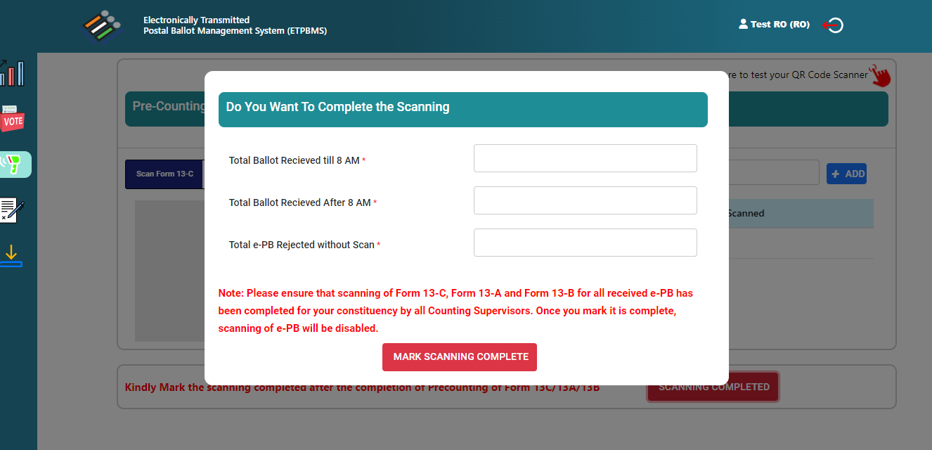
Once the Pre-Counting is completed then RO needs to mark it as Scanning Completed by filling all the necessary details

Slide 98
iii.POSTAL BALLOT COUNTING
      Opening of covers
      Rejection of Postal Ballot
      Rejection of 13 A
      Recording of PB
      Important points

Slide 99
Counting of votes received through Postal ballots
As each cover is opened, take out declaration in Form 13A and inner cover “A” in Form 13B. If declaration in Form 13-A is not found, reject the postal ballot
Scrutinize Declaration
Reject if not duly signed/attested by competent authority
Also reject the PB if substantially defective or Serial Number in Form 13 A and inner cover ‘A’ in 13 B does not match.
Each rejected cover to be endorsed suitably; Such declaration 13 A & inner cover (Form 13B) be put back in cover i.e. Form 13C. Then….

Slide 100
All OK declarations to be kept together in a separate larger cover ‘B’ and sealed so that secrecy of ballot is not violated
All these must be done before cover in Form 13B containing ballot paper is opened
Now open 13 B and scrutinize Postal Ballot Paper and take decisions.
All such covers to be kept separately in an envelope and sealed with particulars i.e. the name of the constituency, the date of counting and brief description noted on top for easy identification

Slide 101
Count valid votes and credit each candidate with votes given to him
Calculate total number of votes received by each candidate
This should be carefully entered in Result Sheet in Form 20 at appropriate column.
Announce the result aloud of the PB round for information of candidates
All valid and rejected PBs to be bundled, packed, sealed with your seal, candidates’ seal if they wish and then ECI Secret seal
Particulars (name of constituency, date of counting, brief description of contents) on sealed packet

Slide 102
All Cover B in Form 13C Containing postal Ballot papers
Open
Form 13 A(Declaration by Elector)
Form 13B
Rejected
Valid
No Declaration found
Declaration is found
No vote recorded
Votes favour of more than one candidate
Spurious ballot papers
Damaged or mutilated ballot paper
if it is not returned in the cover “B”
if the mark indicating the vote is made in such a way that it is doubtful to
make out the candidate to whom the vote has been given
if it bears any mark or writing by which the voter can be identified
Rejected
Scrutinize Declaration
Not Duly Signed by Elector
Not attested by competent authority
Otherwise substantially defective
Serial Number in 13 A and in cover i.e. 13B does not match
Declaration Not Ok
Declaration OK
Kept Separate
All ok declaration to be kept together in a separate envelop and sealed
Then open Form-13B
Rejected
Each rejected cover to be endorsed suitably such 13A and 13-B put back in cover-B (form 13-C)
All such Cover-B

Slide 103
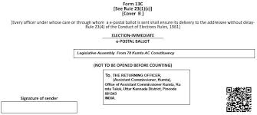

Slide 104
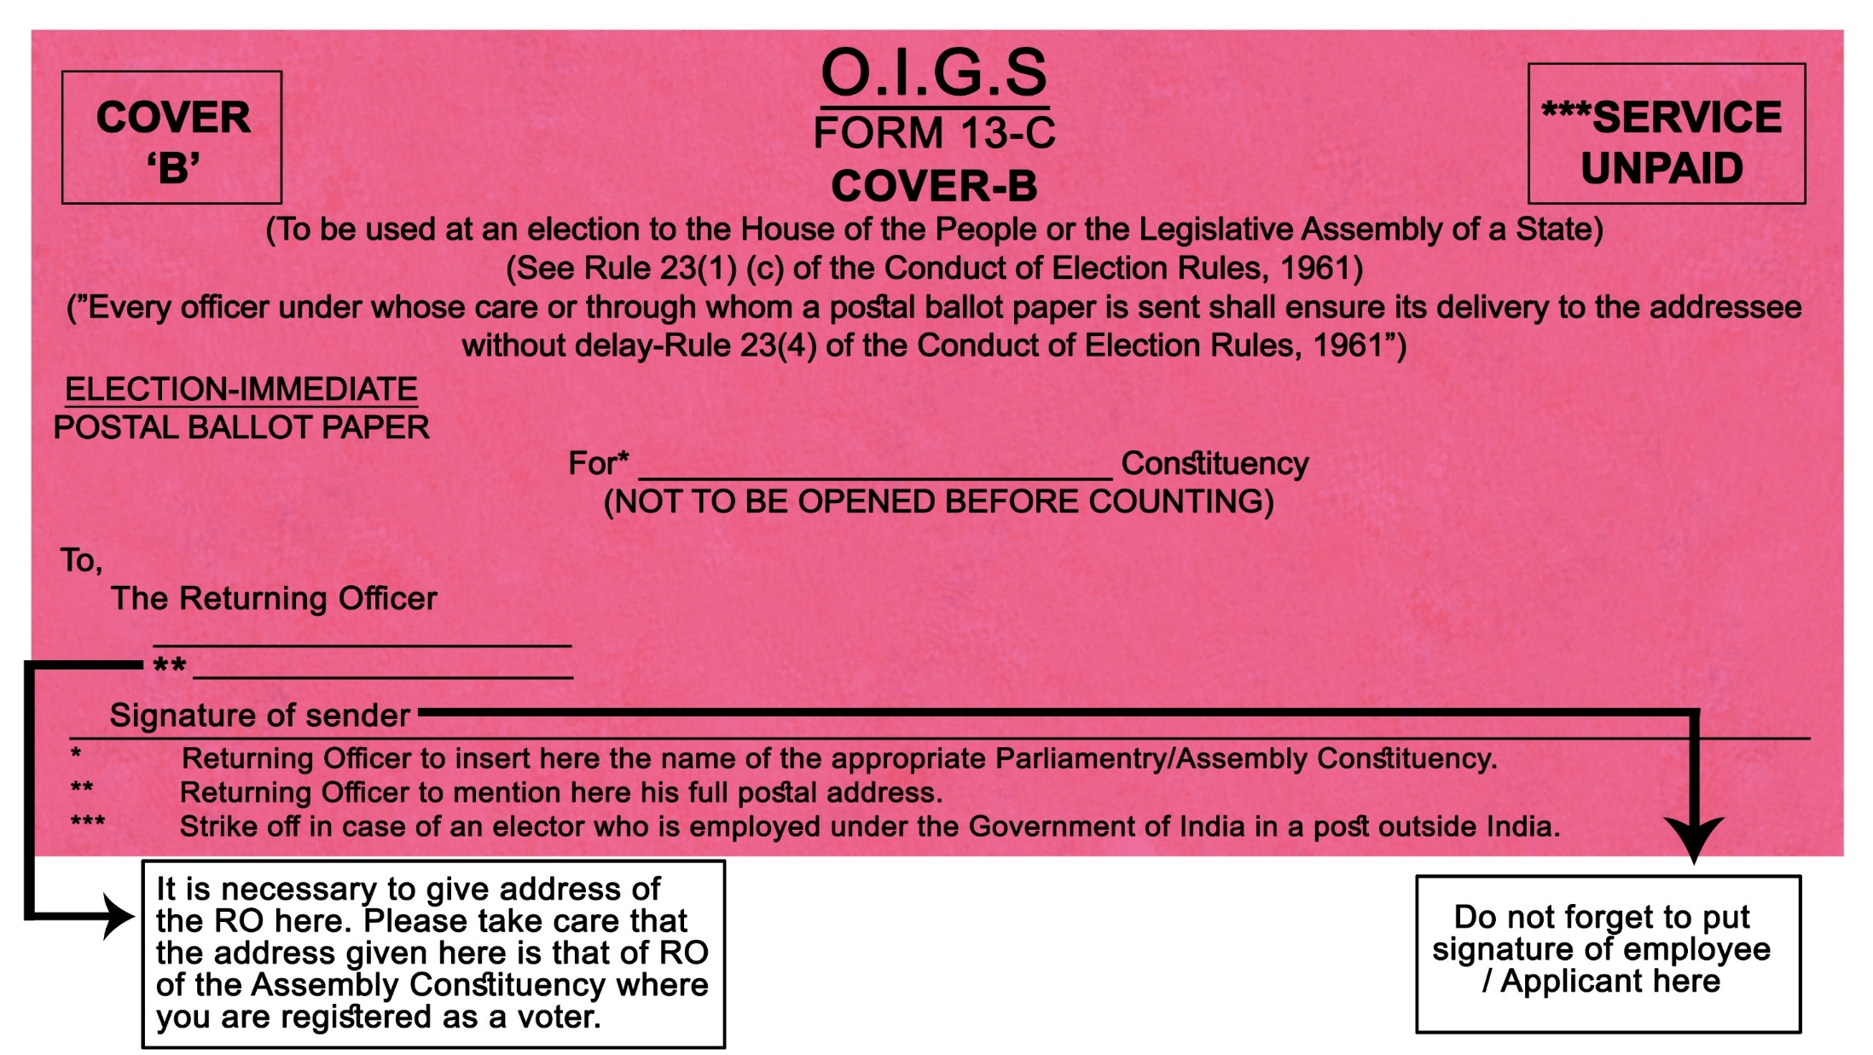
The envelope is white colour for Lok sabha election

Slide 105
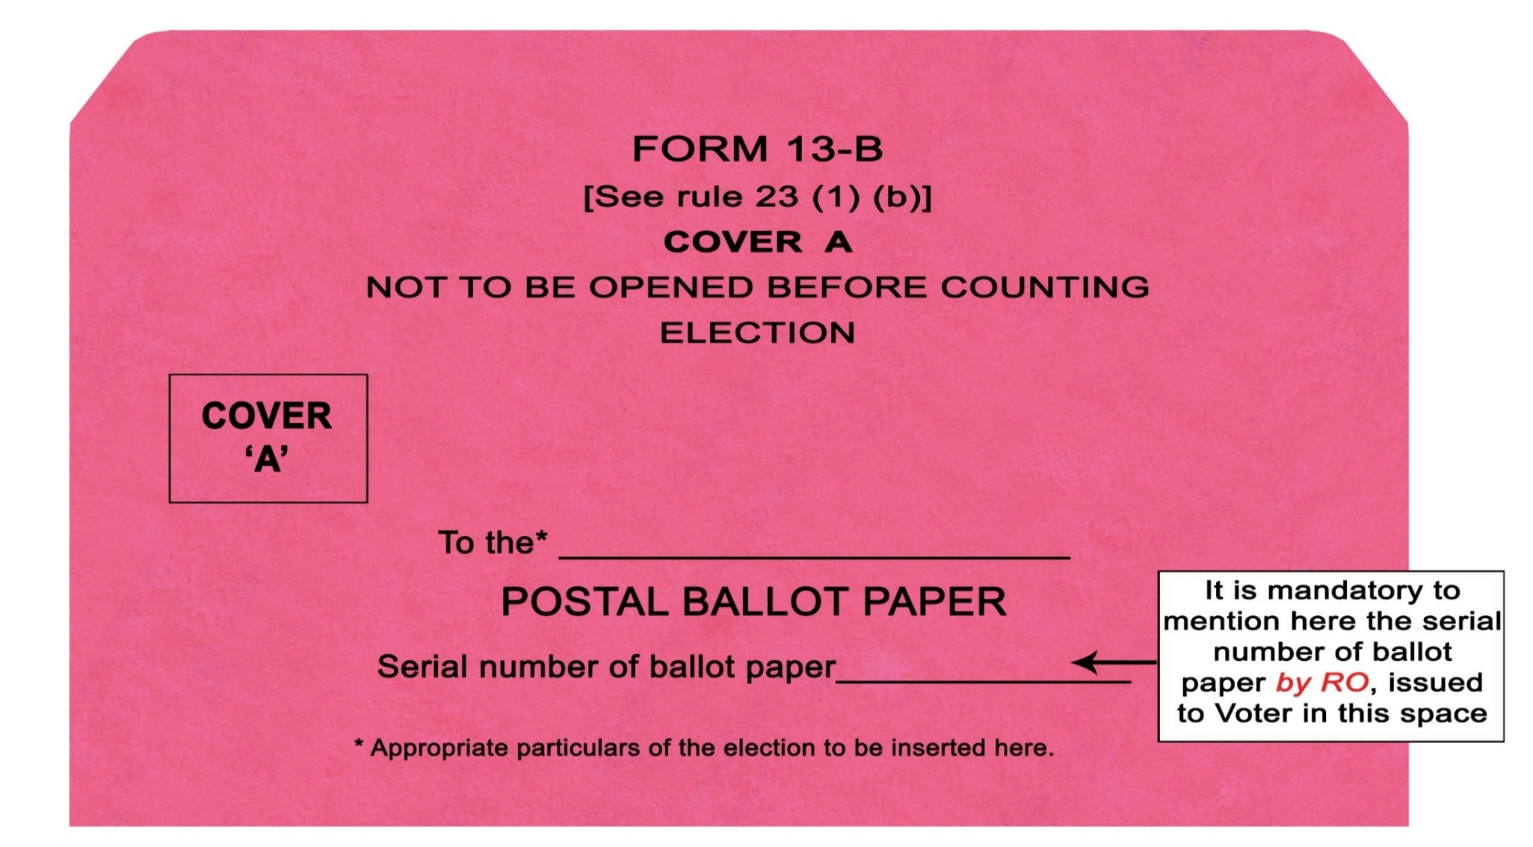
The envelope is white colour for Lok sabha election

Slide 106
Postal Ballot Paper is rejected if:
No vote is recorded
Votes given for more than one candidate
It is spurious ballot paper
It is damaged/ mutilated that its identity as genuine can not be established
Not returned in the cover ‘B’ sent along with it to elector by RO
Marked/ indicated in such a way that it is doubtful for which candidate vote has been given
It bears mark apart from vote or writing by which voter can be identified

Slide 108
Counting of votes received through Postal ballots
  There is no particular mark as per law to be made by voter to record vote on PB
  Any mark is valid if it is clear beyond reasonable doubt in favor of which candidate vote has been given
  It should not be rejected if mark has been made more than once to clarify choice
  PB will not be rejected merely on the ground that the attesting officer has not put his seal on the declaration, if all relevant details of attesting officer have been mentioned
  The PB will also not be rejected on the ground that the sender has not put his signature on the outer cover ‘B’ (Form- 13-C) if the identity of the sender is verifiable on the basis of his declaration in Form -13-A
  Sealing of packets should be done using RO as well as Commission’s secret seal. Candidates also allowed to use their seals.

Slide 109
Defective Declaration in 13 A
If the declaration (Form 13-A) is not found inside the cover “B” in Form 13-C;
If the declaration has not been duly signed by the elector or has not been duly attested by an officer competent to do so or is otherwise substantially defective;
If the serial number of the ballot paper appearing on the declaration in Form 13A is different from the serial number as endorsed on the inner cover “A” in Form 13-B.

Slide 110
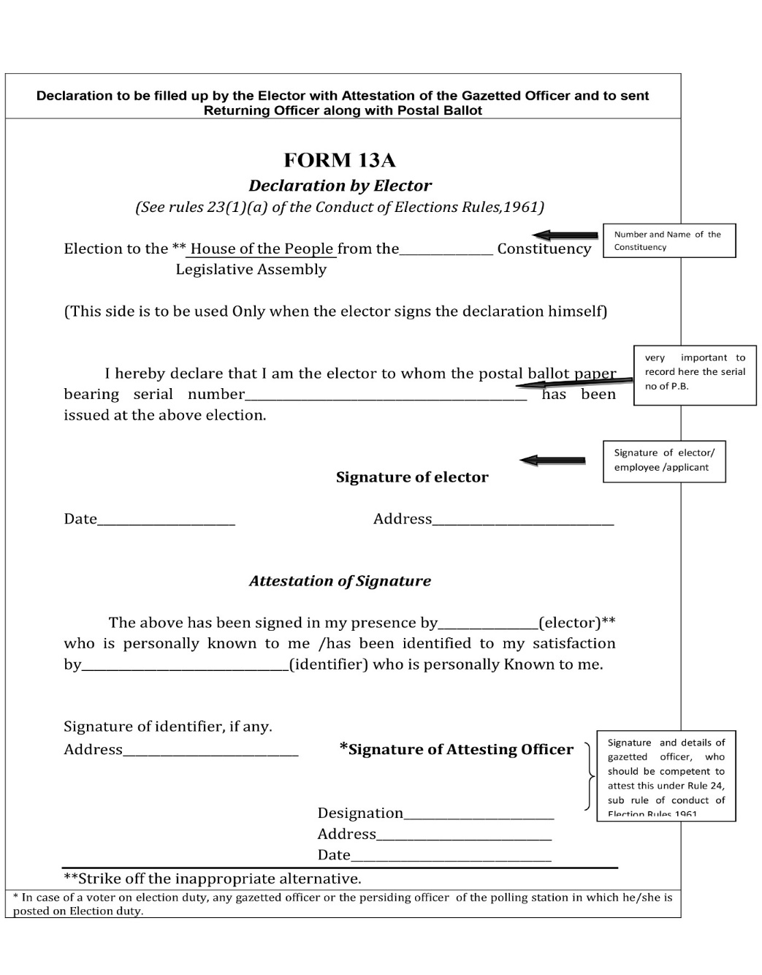

Slide 113
Some Important points
The Commission has decided that where the result of an election is going to be decided by difference of postal ballot received by the first two candidates, then there shall be mandatory and comprehensive recount of postal ballot papers, even though no candidate asks for it. Where the margin of victory is less than the number of PB rejected as invalid, all rejected Ballot papers shall be mandatorily verified.
After 30 minutes of the commencement of postal ballot counting, the EVM counting can start. The EVMs can be brought under escort (agents can accompany) from the strong room to the counting hall even if the postal ballot counting is still going on. However, the penultimate round of EVM counting shall not commence unless the postal ballot counting is over.
The total number of postal votes received by each candidate should be calculated, entered in the Result Sheet in Form 20 in the appropriate place and announced by RO aloud for the information of the candidates.

Slide 114
No Returning Officer shall declare the result without receiving the authorization in the prescribed format from the Observer. It shall be the personal responsibility of the Observer and Returning Officer to ensure fairness of counting of votes and accurate compilation of result.
Where the margin of victory is less than the number of postal ballot papers rejected as invalid, all the rejected postal ballot papers shall be mandatorily reverified by the Returning officer.

Slide 115
iv. COUNTING OF VOTES IN EVM
      Process
      Description through pictures
      17c Part II
      Check by observer
      Result noting

Slide 116
COUNTING PROCESS
EVM counting starts, after commencement of postal ballot counting,
Only CUs and sealed envelopes containing Form 17 C shall be brought to the table as per EVM Movement Sheet,
One senior officer to monitor the movement of CUs from strong Room to Counting Hall, one round after another, then to sealing place.
Only after completion of one round in all respect, CUs of next round will be moved to counting hall.
An account on such distribution of CUs shall be kept and brought to the notice of RO time to time.
Placing of CUs & sealed Form 17 C in counting table as per EVM Movement Sheet.
Remove the seals from carrying case and take out CU.

Slide 117
Allow the counting agents to verify unique numbers of Pink Paper Seal, Outer Paper Seal, Special Tag and Green Paper Seal.
Open the outer cover of the ‘Result’ section.
Check Special Tag and Green Paper Seal.
Switch ‘on’ the control unit,
Ascertaining of result from CUs.
Filling up of Form 17 C part II ( in duplicate) with signatures of Counting Supervisors,
Preparation of Table wise proceeding with signatures of counting agents,
Supply of photocopies of Form 17 C part II to Counting Agents,
Compilation in Form 20 & Trend Sheet from Form 17C Part II,
Parallel counting of two randomly selected EVMs by Addl Counting Staff,
Round wise tabulation with signature of RO & Observer,
Announcement & display of round wise result by RO,
Shifting of CUs for sealing.

Slide 118
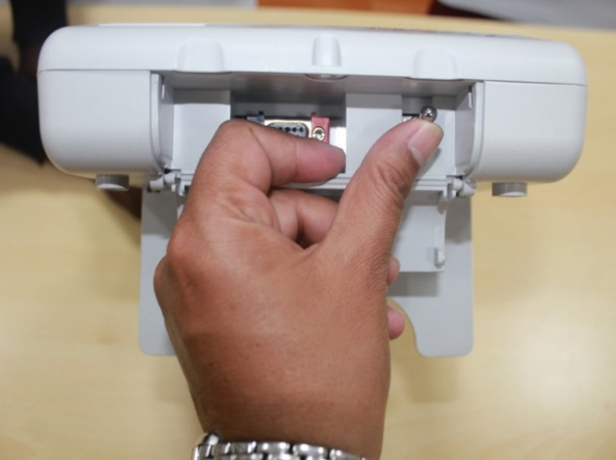
EVM - Counting
Open the bottom compartment of the Control Unit and Switch ON Power
If Voltage of the Power Pack is weak there may not be any display OR display shows “CHANGE BATTERY”. Change the Battery after permission from RO.
Close the bottom compartment

Slide 119
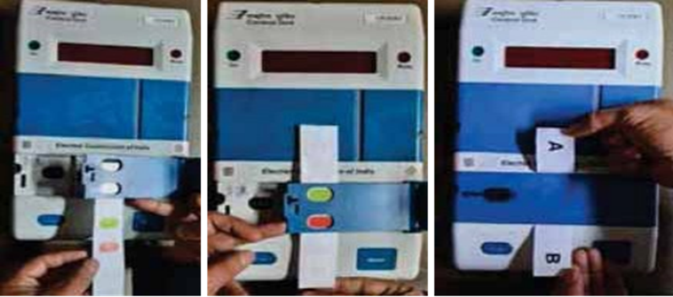
EVM – Counting – Piercing of Paper seal
Pierce the Green Paper seal over RESULT Button to reach RESULT button.
Changed green paper Seal

Slide 120
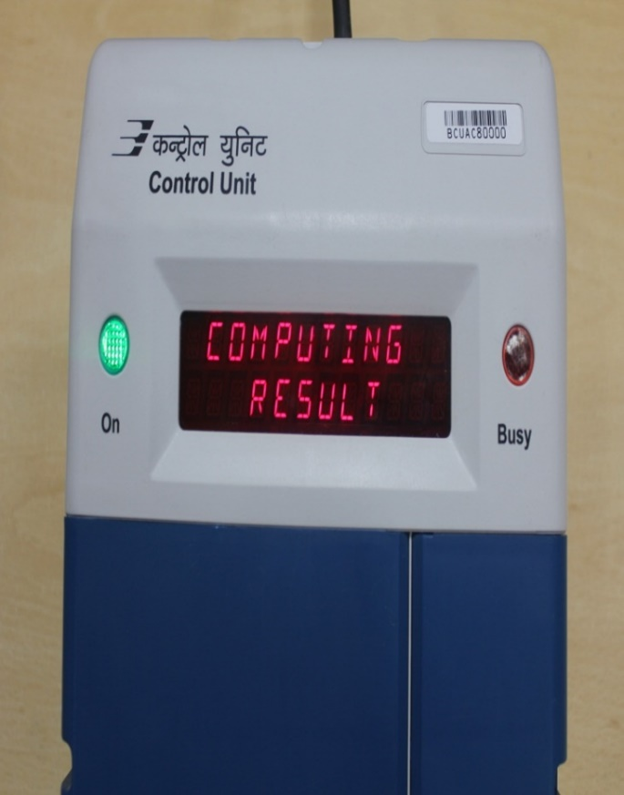
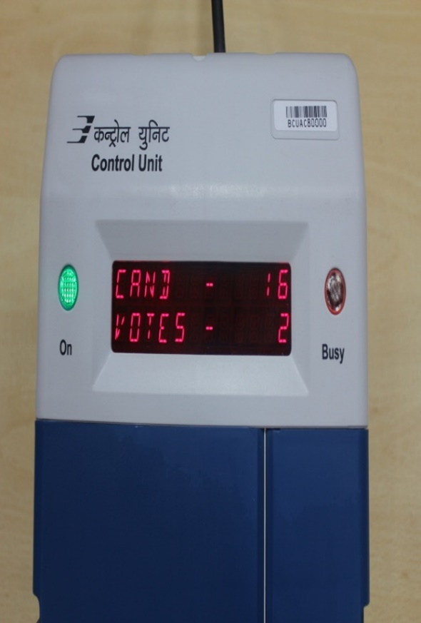
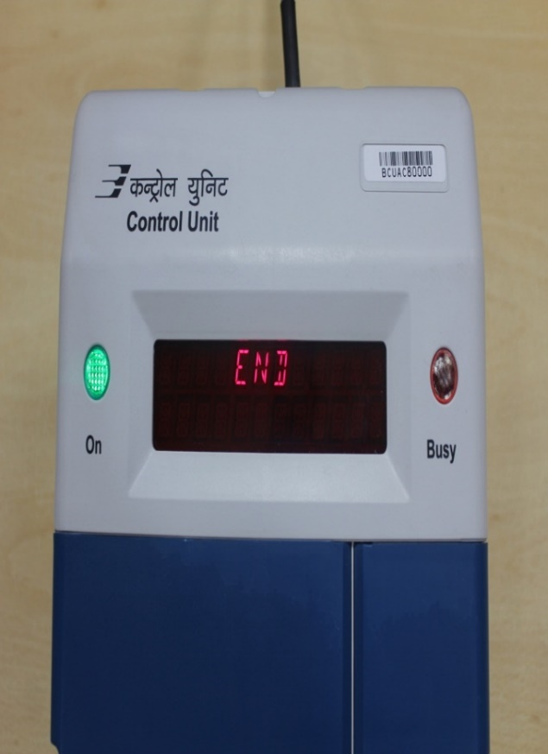
EVM – Counting – Display of RESULT
Press and note down the RESULT in given format
Result

Slide 121

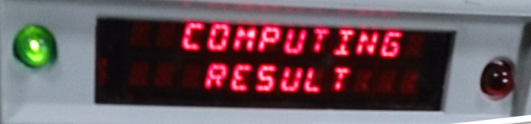
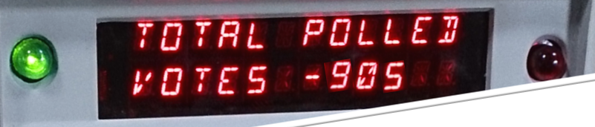

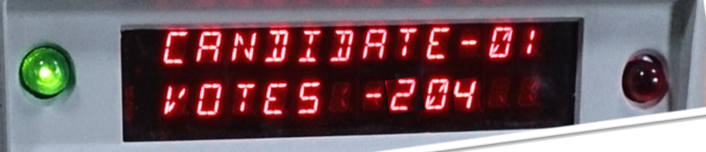
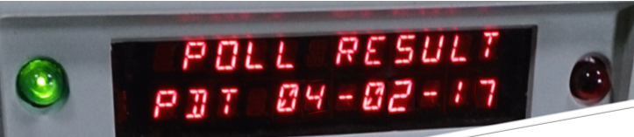
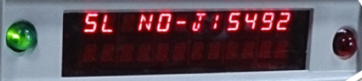
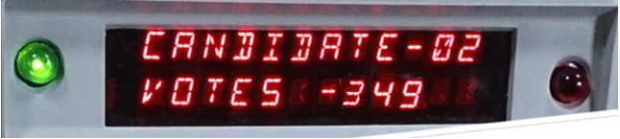
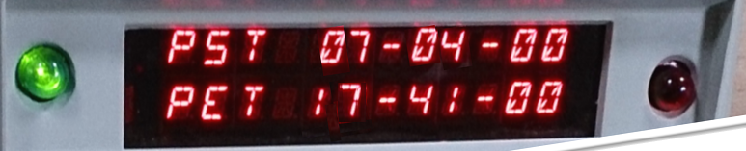
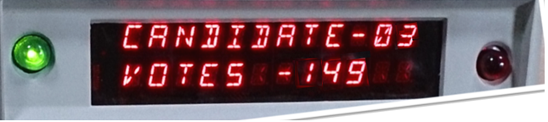
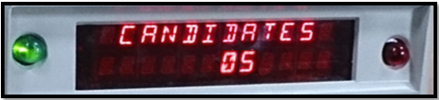
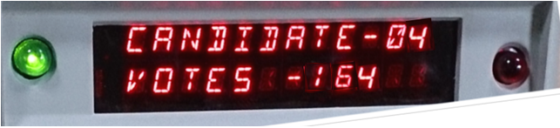
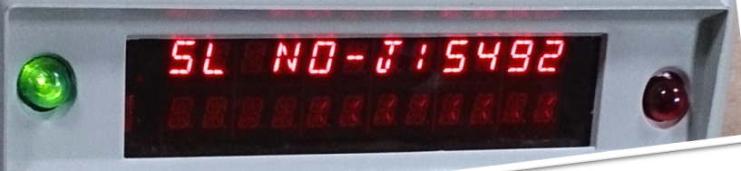
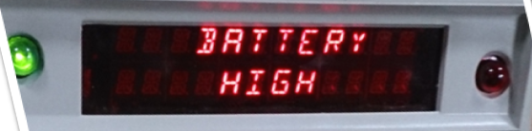
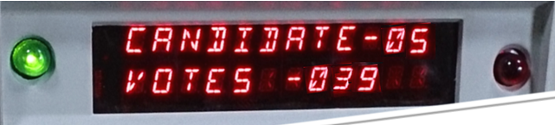
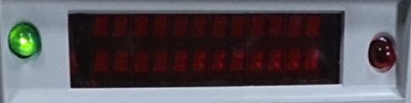
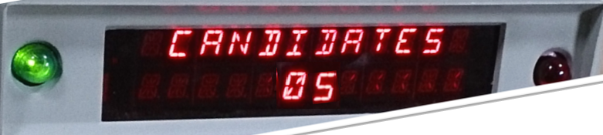
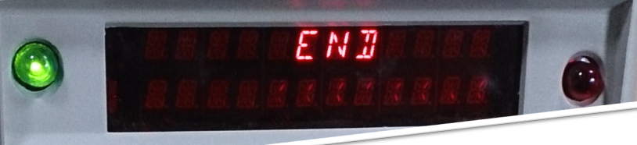

Slide 122
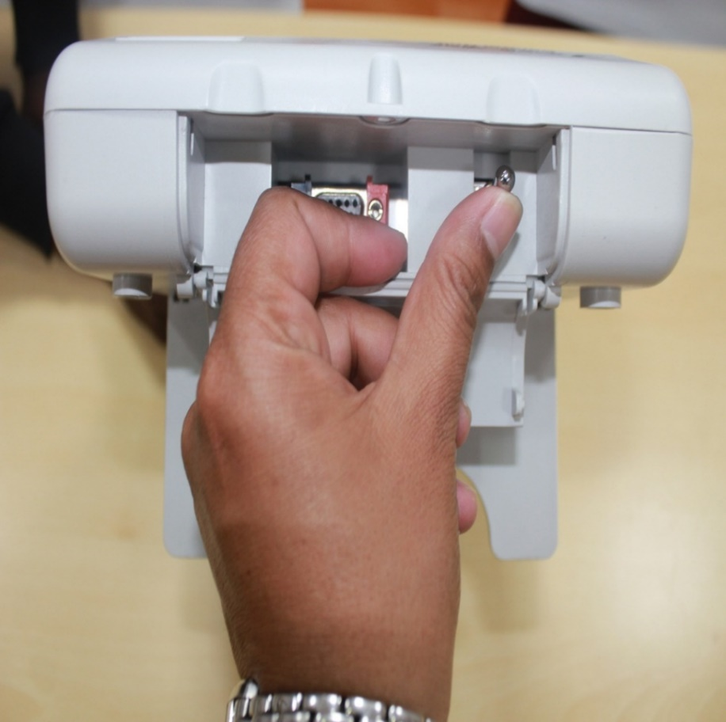
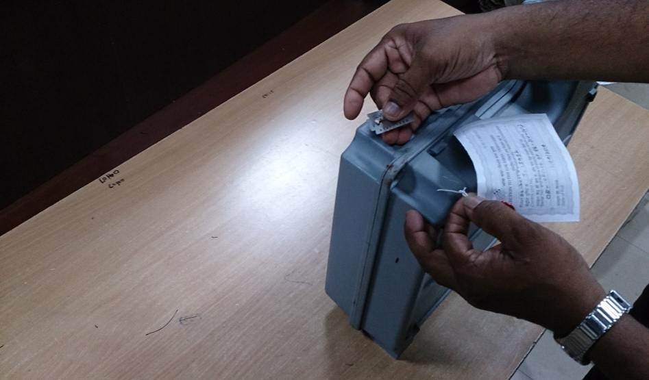
EVM – After the RESULT
After the counting is over Switch OFF the Control Unit
Keep the Control Unit in respective Carrying case and store in Strong Room

Slide 123

evm counting
Switch “ON” Control Unit
Pierce Paper Seal over Result & Press Result
Note down in “Part II-Result of Counting” of 17C-Duplicate using Carbon Paper
Switch “OFF” the Control Unit
Other 17C Part II Photocopy - to all agents
17C Part II to RO/ARO for compilation
Counting Supervisor will keep 2nd Copy of 17C Part II
Put it in envelope & Seal it

Slide 124


Slide 125


Slide 126

Pre printed with candidates names

Slide 127
New 17 c Part II
51/8/7/2019-EMPS dt. 22.05.19
Before taking signatures of candidates/their agents/counting agents in part II of form 17C in the space between Counting Supervisor’s signature and signatures of candidates/their agents/counting agents, write in ink …
‘’ we, hereby, certify that CU No (s) ……..… is/are the same which were used in the polling station no ……..…..”

Slide 128
Cross checking by observer
Observer randomly select 2 EVMs of each round.
Additional counting staff to assist the observer.
If any discrepancy is found –
Result of the round of each table shall be re-verified from the EVM.
Staff will be removed – severe disciplinary action.
Result of such staff in previous rounds would be checked.

Slide 129

Counting of votes recorded in EVMs
Proforma for recording of Votes by Additional Counting Staff
Pre printed with candidates names

Slide 130
Trend Result
Polling Station-wise round-wise Statement.
Both Computer/Manual entry – cross checking.
Both RO and Observer to get satisfied and signed
Thereafter RO should announce the result of the round/display on Blackboard/ Whiteboard.
Copy of Trend Result of each round to – a) All Candidate/Election agents, b)Media Room, c) Communication Room for uploading on Encore d) To the CEO

Slide 131

Counting of votes recorded in EVMs
Round wise statement proforma

Slide 132
v.COUNTING OF VOTES IN VVPAT
      Mock drill
      When to count
      Process of counting
      Annex A, B
      Proceeding

Slide 133
Ballot Slips of VVPAT counting is/may be due to:
If electronic result from the Control Unit of EVM of any polling station can not be retrieved ( No more use of ADU);
2) Mandatory counting of ballot slips of VVPATs of five polling stations for each Assembly Constituency/Segment;
3) Recount of ballot slips of VVPATs of any/all polling station is requested by the candidate/election agent( in due manner) and allowed by the Returning Officer.

Slide 134
COUNTING OF VOTES in VVPATs
Counting of votes shall be done according to rule 56C of the Conduct of Elections Rules, 1961.
After announcement of result sheet entries, any candidate or his election/counting agent may apply in writing to the RO according to rule 56D of the Conduct of Elections Rules, 1961 to count the printed ballot slips of any or all polling stations.
RO shall pass a speaking order, whether the counting of printed paper slips shall be done or not.

Slide 135
While deciding RO will give due consideration to-
a) Whether the total number of votes polled in that polling station is more or less than the margin of votes between winning candidate and candidate making application ;
b) Whether EVM met with any defect and was replaced during poll;
c) Whether there was any complaint about VVPAT not printing the paper slips or complaint under rule 49MA by any voter in that polling station during poll.

Slide 136
Process of VCB counting
White colour paper cards of post card size shall be used for draw of lot.
The no of post card will be equal to polling stations whose result has been displayed in Control unit.
The paper cards shall have pre printed AC/AS no. & name, date of polling on the top, polling station no. in the centre. Each digit of PS no shall be at least 1”× 1” size and printed in black ink.
The paper to be four folded in such a way that polling station number is not visible.
The paper cards shall be kept in big container and must be shaken before picking up 5 slips by RO.

Slide 137



VVPAT Counting
Keep the Ballot Slips in Tray and Count slips to verify with Result of Control Unit.
Cut the seal and Open Ballot Slips Compartment

Slide 138
If RO decides to allow counting of printed ballot slips following procedure shall be followed-
a) VVPAT unit(s) of the respective polling station(s) shall be brought to the VVPAT Counting Booth (VCB) [one table to be earmarked as VCB].
b) VCB shall be enclosed in a wire-mesh just like a Bank Cashier Cabin, so
that no VVPAT paper slip can be accessed by any unauthorised person.
c) Address tag(s) of the drop box of the VVPAT unit(s) shall be cross checked to ascertain that it actually pertains to the same polling station.
d) Address tag(s) of the drop box should be removed and printed paper slips shall be taken out and empty drop box should be shown to all counting agents.

Slide 139
PROCEDURE TO COUNT PAPER BALLOT SLIPS
For keeping VVPAT Paper Slips taken out from the Drop Box of the VVPAT, a sufficiently sized sturdy transparent plastic container with lid, of dimensions 14 inch X 10 inch X 5 inch (length x breadth x height), to easily accommodate around 1400 Printed Paper Slips, shall be kept on the table of VCB.
For keeping VVPAT paper slips of the respective candidates, a Pigeonhole Framework shall be prepared in advance according to the number of candidates including NOTA, with one additional pigeonhole for keeping self-test slips of the VVPAT, and shall be kept on the table of VCB.
The symbol of each contesting candidate as per the Ballot Paper should be affixed on the wall of the pigeonhole allotted to the particular candidates. The symbol should be printed in black and white on a plain paper of minimum size 4inch X 3 inch.

Slide 140
Uncut , partially printed ,self test reports shall be kept as part of record. Can be easily identified as it does not contain sl. no, name, symbol of candidate and larger in length.
Ballot slips shall be put in pigeon holes and prepared for counting in bundles of 25.
Result of the VVPAT paper slips count shall be prepared in the format as per Annexure-VII (of the order of ECI dt. 05.12.2017) and attached to Part-II of Form 17-C.
The result of the count of VVPAT paper slips shall be announced loudly in the counting hall and shown to the counting agents.
If there is any discrepancy between EVM count and paper slip count, the paper slip count shall prevail.
The result sheet will be amended as per the printed paper slips count.

Slide 141

COUNTING OF VVPAT PAPER SLIPS

Slide 142

BALLOT SLIPS FROM VVPAT

Slide 143


Sample Container -14 inch X 10 inch X 5 inch (length X breadth X height)

Slide 144
Annexure - A
Mandatory verification of paper slips of VVPAT of 05 randomly selected Polling Station
(Separate for each polling station - to be sent only to the CEO concerned)
Name of State/UT:……………
No. and Name of Assembly/Parliamentary Constituency :…………………………………
No. and Name of Assembly Segment (in case of PC):……………………………………..
Sl. No. and name of Polling Station:………………………………………………………..
Unique ID of Control Unit:…………………………………………………………………
Unique ID of VVPAT:……………………………………………………………………..
It is certify that mandatory verification of paper slips of VVPAT of randomly selected polling station mentioned above has been conducted as per the instructions of the Commission.
Name of Candidate | No. of Votes Cast |  | Discrepancy if any
 | As per EVM | As per Paper Slips
1.
2.
3.
…
NOTA
Total Votes

Slide 145
Annexure - A
(Present during the mandatory verification of VVPAT Slips count)
Sr. No. | Name of Candidate / Counting Agent | Mention Candidate / Counting Agent | Name of the Party | Signature
Signature of Asst. Returning Officer
Signature of Returning Officer
Signature of ECI Observer

Slide 146
Report on mandatory verification of paper slips of VVPAT of 05 (Five) randomly selected Polling Stations
Annexure - B
Name of State:_______________________
No. and Name of Assembly/Parliamentary Constituency:_______________________
No. and Name of Assembly Segment(in case of PC):___________________________
Sr. No. and Name of Polling Stations.:
1.________________________
2.________________________
3.________________________
4.________________________
5.________________________
It is certify that the entire process of mandatory verification of counting of paper slips of VVPAT of randomly selected 05 Polling Stations has been conducted under my close and direct oversight with strict compliance of the Commission’s instructions.
  Signature
  (Name of ECI Observer)
  Observer Code:

Slide 147
vi. SPECIAL CIRCUMSTANCES
    1. CLOSE not pressed
    2. Result not retrived
    3. Non CRC/Non removal of Mock poll slips

Slide 148
CLOSE button not pressed at the end of the poll
Take the following action during counting of votes, in the presence of candidates/their authorized agents, under videography:
Press ‘TOTAL’ button of the CU to see total votes polled in the CU. If total votes polled in the CU tally with total votes polled in CU mentioned in Form-17C, Counting Supervisor should press the “Close” button of the Control Unit(s) and then press “Result” button for getting result data
If total votes polled in the CU don’t tally with total votes polled in CU mentioned in Form-17C, keep the CU back inside its carrying case and keep under Returning Officer’s custody in the counting hall. Count the votes in other machines as usual. Action shall be taken as mentioned in para 14.5.

Slide 149


Non retrieval of result from Control Unit and as VVPAT is used

Slide 150
Counting of Non eraser/ non removal case/
Mock poll is not erased from the Control Unit but VVPAT paper slips pertaining to mock poll are removed;
Neither mock poll is erased from the Control Unit nor VVPAT paper slips pertaining to mock poll are removed;
Total votes polled in Control Unit during counting do not match with the total number of votes recorded as per EVM as mentioned in Part-I of Form-17C.
(iv) Mock Poll result is erased from Control Unit but mock poll VVPAT paper slips are not removed.
(a)The list of all such polling stations covered under para 2(i) and 2(ii) above shall be shared with the contesting candidates in the counting hall just before the commencement of counting of votes and subsequent at the time of counting and in case of para 2 (iii), during counting of votes, as the case may be.
(b)In all such cases, the CU shall be kept aside i.e. these polling stations will not be taken up for counting during the regular round-wise counting of the Control Units. The Table allocated to such polling stations shall be kept vacant during the relevant round of counting.
(c)After the completion of all regular rounds of counting through Control Units, the VVPAT slips of all such polling station(s), whose Control Units were kept aside, shall be counted at VVPAT Counting Booth (VCB).
(d)In respect of case mentioned at para 2(i) above, the VVPAT slips of the respective polling station shall be counted to arrive at correct count of candidate wise votes polled.

Slide 151
(e)In respect of case mentioned at para 2(ii) above, the VVPAT slips of the respective polling station shall be counted and the candidate-wise votes from mock poll certificate shall be deducted to arrive at correct count of candidate wise votes polled.
(f)In respect of case mentioned at para 2(iii) above, the action may be taken as mentioned at 3(d) or 3(e) above, depending upon whether the VVPAT paper slips pertaining to mock poll are removed or not respectively.
(g)In respect of case mentioned at para 2(iv) above, candidate-wise result may be ascertained from the Control Unit.
(h)Candidate-wise votes obtained from VVPAT slips count of each such polling station shall be treated as a separate round of counting. Candidate-wise votes obtained from VVPAT slips count of all these polling stations shall be added to the candidate-wise tally and the final result compiled.

Slide 152
(iii) Even in cases where VVPAT paper slips pertaining to mock poll have not been taken out from the drop box of the VVPAT, the VVPAT slips shall be counted and the candidate wise votes from mock poll certificate (Pr.O’s report I) shall be deducted to arrive at correct count of candidate wise votes polled.
(iv) The VVPAT slip count result of all these polling stations shall be added to the candidate- wise tally and the final result compiled.

Slide 153
vii.COMPILATION OF RESULTS
        1. Form 20 Preparartion
        2. Announcement
        3. Important notes

Slide 154
Compilation of results from Form 17C Part II
Officer compiling result in Result Sheet in Form 20 will do so strictly as per entries in Part II of Form 17 C.
He will note down no. of tendered votes polled, if any, in Form 20. Take note that these are not be counted.
For AC, Final Result Sheet, You need to prepare only Part I of Form 20 where you mention no. of postal votes received by each candidate.
After all details have entered in Form 20, strike the grand total credited to each candidate, grand total of postal and votes polled at PS
Carefully check entire Form 20 if all entries have been made for every PS and it is not incomplete
Grand total should be struck accurately as discrepancy in the form will affect the result of election and declaration of result. This will invite severe disciplinary action

Slide 155


Slide 156


Slide 157
Compilation of Results
After all rounds are completed and final result sheet in FORM-20 is ready, RO SHOULD NOT immediately sign it.
Before announcing, pause for 2 min during which candidate/agent can ask for recount for PB or for all rounds for some round/s.
Ascertain how long he will take to make an application for recount in writing
If time requested is reasonable, announce exact hour and minute till which you will be waiting

Slide 158
If time requested is reasonable, announce exact hour and minute till which you will be waiting
Consider the grounds urged in application and decide if valid in whole or part. Reject entirely if found unreasonable/frivolous
Reason for accepting or rejecting the application should be recorded in detail
After careful recount, make changes if any in Form 20 and announce the same. Complete and sign Form 20
After observer’s clearance is obtained, announce the result

Slide 159
Important Note
Penultimate round of EVM counting shall not commence unless, POSTAL BALLOT counting is over.
RO’s duty is to accurately count the recorded votes. Hence RO can at any time order the staff to recount the votes.
In case the victory margin is less than total number of Postal Ballot received then re-verification of all postal ballot should be done, even if no candidate/agent has asked for it.
Entire proceeding to be VIDEOGRAPHED and CD of such videography to be kept in a sealed cover for future record.
Under no circumstance actual votes recorded on an EVM or ballot paper is to be photographed or covered by any audio visual coverage.
Take care while doing videography, the focus is on activity and not on the actors.
Media persons are to be taken inside counting hall in batches duly escorted by a senior officer.

Slide 160
3. POST COUNTING ARRANGEMENT
Tabulation & Declaration of results
Sealing of EVM-VVPATs and other papers
Miscellaneous issues

Slide 161
Tabulation & Result Declaration
Form 20 (Final Result Sheet)
Form 21 C/21D
(Declaration of Result )
17 C Part II
Round wise Trend/ Result
Form 21 E (Return of Election )
Signed by RO & Observer
Form 22 (Certificate of Election)
Media Room
CEO (through e-mail)
Announcement of round wise result
Encore
Candidate

Slide 162
Declaration of results
Result declaration after:
  Completing and Signing Form 20
  Obtaining necessary approval from ECI, wherever needed.
  Obtaining No Objection from ECI’s Observer
  Any request for recount, if received, has been duly disposed of by a speaking order of the RO.
Declare the result by loud announcement
56

Slide 163

Declaration of result
RO HB: Observer’s No Objection

Slide 164
Preparation of Form 21C By the Returning Officer
As per the instruction of ECI No. 465/INST/2013-EPS dated: 9.1.2014, the Returning Officer to ensure:
Name of the Constituency is in accordance with the latest delimitation order.
Name & address of the elected candidate is same as in Form 7A
Name of the sponsoring party as per latest notification on political parties and election symbols.
RO to send ink signed Form 21C to CEO.

Slide 165

Form 21 C
59

Slide 166
Declaration of result
Send copies of Form 21C to :
ECI
CEO of state
Union Ministry of Law & Justice (Legislative Department)
State Government
Secretary to State Legislative Assembly

Slide 167

Form 21E: Return of Election
Total number of votes for ‘None of the Above’ (NOTA) will not be calculated in valid votes.
In 21E, serial of candidates is according to the list of contesting candidates (Form 7A).

Slide 168

Form 22: Certificate of Election

Slide 169

Declaration of result
Acknowledgement from returned candidate

Slide 170
Declaration of result
As soon as a candidate is declared elected, you should grant to such candidate, a certificate of election in Form 22.
Only candidate or in his absence, a person duly authorized by the candidate and who is personally known to the RO, can receive the certificate of election from RO.
Only 2 persons can be present excluding the candidate or duly authorized person by the candidate for receiving the certificate of election from RO.
Obtain from candidate an acknowledgement of its receipt duly signed (in any language) by the candidate.
Send this acknowledgement by registered Post with AD.

Slide 171
Declaration of result
If not present, contact immediately and dispatch within a day or two
The acknowledgement of the certificate of return obtained by the RO from the candidate/ his authorized person would be required for oath taking by the returned candidate at Parliament/ Assembly
Certificate to be issued in English or Hindi or in official language of the state
Candidate can sign in any language s/he likes
Where candidate is not present in locality, certificate to be handed over to authorized person and acknowledgement signed by the same person
Certificate to be handed over to candidate and its acknowledgement is obtained immediately if s/he is present at counting

Slide 172
Forms to be submitted to ECI
Form 20 – Final Result Sheet
Fax Message
Form 21C – Declaration of Result (21D for Bye election)
Form 21E – Return of Election
Form 22 – Certificate of Election
Acknowledgement
2 unused EVM ballot paper
Signed by RO in original and stamped properly

Slide 173
Report result of election also to:
ECI by fax/ email (Without any failure)
AIR Station in State HQ
Director, Doordarshan Kendra, New Delhi
Information Officer, PIB, New Delhi
Ministry of Law Govt. of India/ State Govt.
Chief Electoral Officer of State
Secy. Gen. Lok Sabha/ Secretary of State Legislative Assembly
Director of News Services, All India Radio, New Delhi

Slide 174
Sealing of EVM-VVPATs and other important papers
    Sealing of EVM/VVPATs
    Sealing of Statutory Papers
    Proceeding

Slide 175
Sealing of EVM-VVPATs after Counting
After completion of counting of votes, CU and Bus will be kept in strong room. It has to be kept under double lock - one key with DEO and one with Dy. DEO. VVPAT slips have to be taken out from VVPAT. VVPAT slips have to be sealed in black envelop and stored in sealed trunk with statutory papers. VVPAT paper roll compartment will remain sealed till C+10 days for c&V petition. Thereafter VVPAT will be kept in warehouse not in strong room. No sealing of VVPAT is required.
Close the outer cover of the Result Section and reseal it.
The control unit is to be resealed with ROs seal and the seals of such of the candidates or their election agents who may desire to affix their seals thereon.
Keep the control unit so resealed in its carrying case.
Reseal the carrying case.
Put a secret seal of the Commission in addition to ROs own seals

Slide 176
Sealing of other Election Papers
The packets of-
Registers of Voters in Form 17A, including the voter slips.
Unused postal ballot papers with counterfoils attached thereto;
Used postal ballot papers whether valid, or rejected
Counterfoils of used postal ballot papers;
Used and unused tendered ballot papers;
Unused (surplus) ballot papers (printed for display on ballot units and for use as tendered ballot papers);
Marked copies of the electoral roll; and
Declarations by electors and the attestation of their signatures.
These papers should also be sealed with the secret seal of the Commission

Slide 177
Appoint a senior officer to supervise sealing of packets.
These papers are to be sealed with Secret Seal of ECI
All of these are to be put in steel trunk
Each steel trunk locked with two locks and each lock be sealed.
EVMs and election papers thus sealed shall be deposited in safe custody of DEO without delay
DEO should ensure that these are deposited in treasury/sub-treasury under double lock, key of one will be kept with DEO himself.
The envelopes sealed under R 93(1) shall not be opened and their contents inspected by any person/authority except under the order of a competent court under Secret Seal NOT to be put on locks.

Slide 178
Drawing up of Proceedings
After the sealing of the voting machines and election papers at the counting place after the counting of votes, RO should draw up proceedings.
Safe Custody of Election Records by District Election Officer
Existing Strong Room Force should be used to transport EVM and other documents from Strong Room to District Ware house.
Return of Secret Seal of the Commission within 24 hours

Slide 179
Miscellaneous Issues
      Adjournment of Counting
      Battery use/storage

Slide 180
Adjournment/ Stoppage of Counting Process
If RO has to adjourn counting for unavoidable reasons, he should seal and secure all EVMs and election papers outside the strong room using RO’s seal
Allow every candidate/agent to put seal as well as put their own locks on all room including strong room where materials are to be stored
The Observer has the power to stop counting at any time before declaration of result and has power to prevent declaration of result if s/he feels:
Booth capturing has taken place at large no. of PSs
Ballot papers are unlawfully taken out of the custody at any place fixed for poll/counting of votes
Election materials are intentionally/accidentally lost, damaged or destroyed or tampered to such an extent that result can’t be ascertained
RO has no power to order recommencement of counting. This will happen on ECI’s orders only.

Slide 181
REPLACEMENT OF BATTERY AT THE TIME OF COUNTING
ECI No 51/8/7/2014-EMS dt 7.5.2014
In case CU does not display result at the time of counting, battery can be replaced with new one.
New batteries to be available in counting centres.
Removal of Power pack from all CUs after counting
ECI No 51/8/INST/2021-EMS dt 18.1.2021
The power pack of all CUs whether result retrieved from it or not have to be removed and stored outside of strong room after counting is over and certificate in Annexure 1 has to be submitted by RO.

Slide 182
4. REPORTS & DECLARATION OF RESULT
Statutory Reports
Non Statutory Reports
Post Counting Matter

Slide 183
i. Statutory Reports

Slide 184
Sl. | Subject | From | Date | To | Mode of Reporting
1. | Form 20 (Final Result Sheet) | R.O. | On C-Day | C.E.O. / D.E.O. | Both the excel file & the signed pdf is to be sent through e-mail and 2 copies, in original, to C.E.O Office through special messenger preferably by the same day and not later than 11.00 am on the next day.
2. | Report of Result of Election [Fax message] | R.O. | On C-Day | E.C.I. / Chief Secretary/ C.E.O. / D.E.O., Secretary WBLA | Through FAX and the same may also be sent through email and 2 copies, in original, to C.E.O. Office preferably by the same day and not later than 11.00 am on the next day.
3. | Form 21C/21D(Bye election) (Declaration of Result under section 66 of R.P. Act, 1951) | R.O. | On C-Day | C.S. / C.E.O./ D.E.O., Secretary WBLA | The signed pdf is to be sent through e-mail and 3 copies, in original, to C.E.O Office through special messenger preferably by the same day and not later than 11.00 am on the next day

Slide 185
Sl. | Subject | From | Date | To | Mode of Reporting
4. | Form 21E (Return of Election) | R.O. | On C-Day | C.E.O. / D.E.O. | The signed pdf is to be sent through e-mail and 3 copies, in original, to C.E.O Office through special messenger preferably by the same day and not later than 11.00 am on the next day
5. | Form 22 (Certificate of Election) | R.O. | On C-Day | C.E.O. / D.E.O. | The signed pdf is to be sent through e-mail and 2 copies, in original, to C.E.O Office through special messenger preferably by the same day and not later than 11.00 am on the next day
6. | Certificate of Election – Acknowledgement (Signed by the candidate himself and signature duly attested by the RO) | R.O. | On C-Day | C.E.O./ Secretary WBLA | The signed pdf is to be sent through e-mail and 2 copies in original (Attested by R.O), to C.E.O Office through special messenger preferably by the same day and not later than 11.00 am on the next day and another copy, in original, to Secretary WBLA by Registered Post with A/D

Slide 186
7. | Secret Seal | R.O. | On C +1 Day | E.C.I. | Within 24 hours after completion of counting to ECI by Registered Insured Post
8. | 02 (Two) unused Ballot Papers for EVM, marked as “Cancelled for Record in the Election Commission”, on its reverse on each, for each Constituency under signature of RO | R.O. | On C +1 Day | C.E.O. | 2 sets in original to C.E.O Office through special messenger preferably by the same day and not later than 11.00 am on the next day
9. | Index Card | R.O. | On C +2 Day | C.E.O | Online only
10. | Report of the Election by Returning Officer | R.O. | On C +2 Day | C.E.O | 2 copies in original through special messenger

Slide 187


Slide 188

Form 20

Slide 189

Sample part II of Form 20

Slide 190


Slide 191

FORM 22 (See rule 66)
Certificate of Election
I, Returning Officer for the……….…...................Parliamentary/Assembly constituency in the State of..................hereby certify that I have on the…..………..........day of
……………………....20…….......declared Shri/Smt……………………………......………………... of.....………….....1[sponsored by...................(name of the recognised/registered political party)] to have been duly elected by the said constituency 2[in the General Election/Bye- election] to be a member of the House of the People/Legislative Assembly and that in token thereof I have granted to him this certificate of election.
Place ......………
Date ......……….
……………………………..............................
Returning Officer, for
the………………….......................Parliament ary
Assembly constituency.
SEAL

Slide 192
ANNEXURE – XIV
CERTIFICATE OF ELECTION
ACKNOWLEDGEMENT
I ................................................................................................................. acknowledge receipt of the certificate of election in Form 22 in respect of my election to
....................................... from ................................... constituency, declared on
..........................................
Date ................................... Signature of the returned candidate
Attested and forwarded to the Secretary
Returning Officer

Slide 195
VIII. DETAILS OF VOTES POLLED BY EACH CANDIDATE
SI.No. | Names of the Contesting Can- didates (In Block Letters) | Sex (Male/ Female/ Third Gender) | Age (Years) | Category (Gen./SC/ST) | Full name of the Party | Election Symbol Allotted | Valid Votes Polled
 |  |  |  |  |  |  | Counted from EVM | Postal | Total
1
2
3
4
5
6
7
8
9
10
11
12
13
14
15
16
TOTAL
Note: Arrange serially contesting candidates in descending order of valid votes polled.
Certified that the Election Index Card has been checked with Forms 3A, 4, 7A, 20 and 21C or 21 D or 21 E and R.O.’s Report etc. and that there is no discrepancy. Further, it is certified that the Party Affiliations and symbols allotted have been verified from the list of contesting candidates in Form 7 A.
Date Seal Chief Electoral Officer, West Bengal | प्रेसनोटकीतारीख Date of Press Note अधिसूचनाकीतारीख Date of Notification | Signature (Seal) Returning Officer
Note Before printing all fields must be compare with physical card.

Slide 196
Amendment in Index Card (now in online)
(Instruction no. No. 485/LET/ECI/FUNC/EDM/1/IC/2018 dt. 22.01.2018)
Some amendment and addition have been made in the Index Cards of Lok Sabha and Assembly Constituency :-
In entry -V Details of Postal Votes, the Postal Votes counted has been segregated into two categories of voters -
Postal votes counted for service voters under sub-section (8) of Section 20 of R. P. Act. 1950
Postal votes counted for Govt. Servants on election duty (including all police personnel, drivers, conductors, cleaners)
2) In last page of the Index card, an addition has been made between signatures of Chief Electoral Officer and Returning Officer:
Date of Press note
Date of Gazette notification.

Slide 197
ANNEXURE – XVI
REPORT ON THE ELECTION BY THE RETURNING OFFICER
1 | Name of the Constituency:
2 | Date or dates of poll in the constituency:
3 | Number of the polling parties deployed in the Constituency, the composition of each party including police or similar officers employed for maintaining order at the polling station:
4 | Nature of the polling programme, - Single day poll. Constituency divided into zones and polling completed one after another with one/two days interval for transit or single party took up polling in adjacent polling station on successive 2/3 days of alternative days: ... ... ... ... ... ...
5 | Total number of electors in the Constituency- Men Women Number of electors in the part relating to service voters:
6 | Names of candidates nominated and the choice of symbols expressed by each in the nomination paper first delivered by or on his behalf:
7 | Number of nomination papers filed on behalf of each candidate:
8 | Names of candidates whose nomination papers were rejected with brief reasons:
9 | Names of candidates who withdraw their nominations:
10 | Names of contesting candidates together with the description of the symbol allotted to each and party affiliation:
11 | Names of candidates who renounced their party after allotment of symbols:
12 | Names of candidates (independents), subsequent to the last date of withdrawal joined some other party, or some other party, or some party claims that its candidate is contesting the elections as a party candidate:
13 | Number of polling station located- (i) In Government and Quasi-Government buildings: (ii) In private buildings: (iii) In temporary structures Total:
14 | Number of postal ballot paper(S)- ... ... ... ... ... ... ... ... ... ... Issued .. ..... ... ... ... .. ... ... ... .. ... .. ... ... Returned back ... .. ... ... ... ... ... ... ... ... .. ... .. Undelivered in time after prescribed hour: ... ... ... ... ... ... ...

Slide 198
15 | 1-Service voters and their wives: 2-Voters on Election Duty: 3-Special voters and their wives: 4-Electors subjected to preventive detention: Date of issue of Postal Ballot Papers to service voters:
16 | CSVs and Proxy Voters : (a) Total number of CSVs: (b) Number of Proxies who voted:
17 | Names of polling stations, if any, where poll was adjourned and re-poll was ordered and reasons for such adjournment or re-poll:
18 | Number of Ordinary Electors who voted at polling stations:
19 | Number of persons who voted on production of Election Duty Certificate:
20 | Number of blind or infirm voters who voted with the help of companions:
21 | Percentage of votes polled to total electorate:
22 | Date and time of commencement of counting:
23 | Number of valid votes polled by each contesting candidates:
24 | Number of votes rejected: (Postal ballot Papers):
25 | Challenged vote Total: Number allowed: Number rejected: Amount forfeited:
26 | Tendered votes-Total:
27 | Date and time of declaration of result:
28 | Number of Polling Officers recruited locally:
29 | Number of candidates: party wise (also independents and others)
30 | (a) Forfeited deposit: (b) Amount of deposit forfeited:
31 | Number of candidates who were their own election agents:
32 | Number of election agents appointed:
33 | Number of polling agents appointed:
34 | Number of candidates who appointed polling agents:
35 | Number of counting agents appointed by candidates:
36 | Number of voting machines used: (i) Number of Control Units: (ii) Number of Balloting Units: (iii) Number of Voting Machines kept in reserve stock: (a) Number of Control Units: (b) Number of Balloting Units: (iv) Whether any machine from the reserve stock was used: if so, how many control units and how many balloting units:
37 | Number of paper seals used:

Slide 199
38 | Number of indelible ink phials supplied to each polling party:
39 | Number of Electoral Offences with their details – Number of cases of – (a) Disorderly conduct at election meetings (b) Convening, holding or attending public meetings within the constituency on a polling day: (c) Illegal hiring or procuring of conveyances for the transport of voters (d) Canvassing within one hundred meters of a polling station (e) Impersonation of voters (f) Fraudulent defacing, destroying or removal of a list or notice or other document at a polling station (g) Bribing of voters (h) Intimidation of voters (and other persons) (i) Booth capturing
40 | Mistakes and irregularities committed by Presiding Officers
41 | Highest and lowest polling – polling station wise
42 | (a) No. Of votes cast- from 07.00 a.m. to 09.00 am From 09.00 a.m. to 11.00 a.m. From 11.00 a.m. to 01.00 p.m. From 01.00 p.m. to 03.00 p.m. From 03.00 p.m. to 05.00 p.m. (b) Number of slips issued at the closing hour of the poll:
43 | Serious Complaints, if any, made by the candidates
44 | Number of cases of breach of law and order
45 | Recounting of votes- (j) Number of application received for recounting in part or in toto: (k) Number of applications allowed for recounting in part or in toto: (l) Result before recounting and after recounting of votes:
46 | Was the poll interrupted or obstructed by: (1) Riot (2) Open violence (3) Natural calamity (4) Failure of voting machine (5) Any other cause –Please give details of the above
47 | Was the poll vitiated by –(1) Any ballot box used at the polling station having been unlawfully taken out of the custody of the Presiding Officer – a) Accidentally or intentionally destroyed or lost: b) Damaged or tampered with: (2) Booth capturing:
48 | Whether declarations have been made by all the Presiding Officers before the commencement of the poll and at the end of poll as necessary:

Slide 200
ii. Non Statutory Reports

Slide 201
Sl. No. | Subject | From | Date | To | Mode of Reporting
1. | Certificate confirming the readiness of Counting Centre including every counting hall (Annexure – 1A & 1B) | D.E.O. | On C-3 day | C.E.O. | The signed pdf is to be sent through e-mail
2. | Confirmation Report on sending notice to Candidates or their Election Agent regarding the date, time and place of counting (Annexure – 2) | R.O. | On C-3 day | C.E.O. / D.E.O. | The signed pdf is to be sent through e-mail
3. | Commencement of counting (Annexure – 3) | D.E.O. | On C - day by 08.15 A.M. | C.E.O. | The signed pdf is to be sent through e-mail
4. | Tabulating Trends / Result (As per Annexure – I, Commission’s letter no. 470 / INST / 2014 – EPS dated 30.04.2014) | R.O. | On C-day From 09.00 A.M. (Round- wise) | C.E.O. / D.E.O. | The round-wise signed pdf is to be sent through e-mail
5. | Nonfunctioning of EVM (Relevant Annexures – as per Manual of EVM-VVPAT) (table 0) | R.O. | (immediately, if situation arises) | E.C.I. / C.E.O./ D.E.O | The signed pdf is to be sent through e-mail/ fax

Slide 202
Sl. No. | Subject | From | Date | To | Mode of Reporting
6. | Counting of Printed Paper Slips of VVPATs in case of non-retrieval of result from the Control Unit (Commission’s letter No. 51/8/VVPAT/2017-EMS dt. 20.12.2017)(Table 1to 4) | R.O. | (immediately, if situation arises) | E.C.I. / C.E.O./ D.E.O | The signed pdf is to be sent through e-mail/ fax
7. | Report on electors deciding not to vote as per Accounts of Votes recorded (Form – 17C) [Annexure – 4] | R.O. | On C-day | C.E.O. / D.E.O. | Both the excel file & the signed pdf is to be sent through e-mail

Slide 207
Various Forms for Counting of Votes
Sl | Name of forms | Purpose | To be given by | To be Sent on
1 | Form 18 | Appointment of Counting Agents | RO | C-3 day
2 | Form 19 | Revocation of Counting Agents | RO | C-3 day
3 | 17C Part II | Candidate wise Votes from EVM | Counting Supervisor | Counting day
4 | Section 128 | Maintenance of Secrecy of voting | Counting Supervisor | Counting day
5 | Form 13C | Outer Envelope for Postal ballot | Elector | By C day, 8 am
6 | Form 13A | Declaration by Elector for postal ballot | Elector | By C day, 8 am
7 | Form 13B | Inner Envelope to cover Postal Ballot Paper | Elector | By C day, 8 am
8 | Form 13 D | Instruction for Postal Ballot | From elector | Not to be sent
9 | Nil | Format for recording of Tally of Postal Ballot | ARO | Counting day
10 | Nil | Format for recording of Tally of Postal Ballot for Service | ARO | Counting day
11 | Model proceeding | To be signed by Counting Agents at the time of counting EVM/VVPAT | Counting Supervisor | Counting day
12 | Additional Counting | Observer to count 2 / Round EVMs by additional counting staff | Observer | Counting day
13 | Annexure -I | Trend sheet - Roundwise, candidate wise result | ARO/RO | Counting day
14 | CU failure report | Non retrieval of CU result, permission for VVPAT counting | ARO/RO | Counting day
15 | Annexure -25 | Close button not pressed & Total votes tally | ARO/RO | Counting day
16 | Annexure -26 | Close button not pressed & Total votes do not tally, margin is more than than total votes of this machine | RO | Counting day
17 | Annexure -27 | Close button not pressed &Total votes do not tally, margin is less than than total votes of this machine | RO | Counting day
18 | Annexure -29 | 17C Part II for Paper slips counting | RO | Counting day
19 | Annexure -A | Mandatory VVPAT slips counting of 5 PS, Polling station wise | RO | Counting day
20 | Model proceeding | At the time of sealing, to be signed by agents | ARO | Counting day
21 | Annexure -B | Mandatory VVPAT slips counting of 5 PS | Observer | Counting day
22 | Form 20 | Final Result Sheet | RO | Counting day
23 | Form 21 C/21D | Declaration of Result | RO | Counting day
24 | Form 21 E | Return of Election | RO | Counting day
25 | Form 22 | Certificate of Election | RO | Counting day
26 | Table -1 | Details of mandatory slip count | RO | C+1 day
27 | Table 2 | Paper slip counting as per request under rule 56D | RO | C+1 day
28 | Table 3 | Non retrieval of CU result, Counting of VVPAT slips done | ARO/RO | Counting day
29 | Table 4 | Non erase of Mock poll data | RO | C+1 day
30 | Annexure -4 | Report on Voters not to vote | RO | C+1 day
31 | Annexure -VI | Report on Election | RO | C+2 day

Slide 208
iii. Post Counting Matters
        1. Storage of machines
        2.EP case
        3. Candidates’ deposit
        4.Disposal of waste & surplus ballots
        5.Retention of Nomination papers
        6. CCTV recording preserving
        7. Candidates’ Exp account submission
        8. Declaration criminal cases

Slide 209
STORAGE OF EVMs & VVPATs AFTER COUNTING OF VOTES
After completion of counting of votes, CU and BUs will be kept in strong room. It has to be kept under double lock - one key with DEO and one with Dy. DEO. VVPAT slips have to be taken out from VVPAT. VVPAT slips have to be sealed in black envelop and stored in sealed trunk with statutory papers. Paper roll compartment kept intact till C+10 days for C&V. VVPAT will be kept in warehouse not in strong room.
The Strong room shall not be opened till completion of Election Petition (EP) period i.e. till EP list is received from respective High Court.
After completion of Election Petition Period, the exact EP position should be ascertained from High Court concerned before opening the strong room.
Safe custody of election records / EVM-VVPATs after result
Under double lock - one key with DEO and one with Dy. DEO
Disposal of record - After expiry of prescribed period

Slide 210
Disposal of deposits made by candidates (Sec. 158)
The deposit can be refunded only to the person in whose favour it was made in the treasury or his legal representatives if he is dead.
The deposit shall be refunded if the conditions laid down u/s 158 of RP Act, 1951 are fulfilled.
Form of applications for return is given in RO Hand book.
Disposal of surplus and waste ballot papers
Directions of Commission given at Para 13 of Ch. XVIII of RO Hand book shall be followed strictly.
Superintendent Government Press and Collector / District Magistrate of the district, wherein Govt. Press is situated, shall send a report within a week to the CEO certifying that all surplus and waste ballot papers printed have been destroyed in the prescribed manner. Such consolidated report with certificate shall be submitted onwards to the Commission by the CEO.

Slide 211
Period of retention of the Affidavits in Form 26 and the Nomination papers filed by the candidates.
(ECI instruction No 3/ER/ECI/LET/FUNC/JUD/SDR/2016 dated 18th August, 2016)
Nomination Papers and Affidavit (Form 26)- To retain for a period of 06 (six) years after the completion of elections or till disposal of election petition, if any, or any other suit/petition in any court in which any of the declarations made in any of these documents is under challenge.
All the supporting documents filed by the candidates along with their nomination papers shall also be likewise retained for the same period.

Slide 212


Storage of CCTV, video footage

Slide 213
SLU storage (No. 51/8/INST/2024-EMS Dated: 29th April, 2024)
After completion of counting of votes, the SLU containers shall be stored in the respective AC/AS-wise strong room(s) in a steel trunk labelled as `SLUs USED IN AC/AS NO. ' for safe storage and convenience, alongwith polled EVMs under the overall responsibility of the DEO.
i. More than one sealed SLU container may be kept in the steel trunk. As far as possible, it shall be ensured that all the sealed SLU containers of a particular AC/AS are kept in one trunk.
ii. There shall be no inter-mixing of sealed SLU containers of different AC/AS in a steel trunk.
iii. The minimum dimension of the trunk shall be 2 X 1 X 1.5 ft.
iv. The steel trunks having the sealed SLU containers shall be under lock and key.

Slide 214
Action to be taken after completion of Election Petition Period:
i.The Chief Electoral Officer shall immediately ascertain the EP status from the High Court concerned.
No EP filed: The SLUs alongwith their accessories pertaining to the AC/AS, where no EP has been filed shall be sent back to the respective manufacturers. The SLUs may be sent alongwith the non-functional EVMs-VVPATs (Commissioning to Poll) of the district, if any.
iii. EP filed: Where EP has been filed, the Chief Electoral Officer shall ascertain the subject matter of the petition(s).
iv. If EVM/VVPAT is not the subject matter of the petition, an application shall be filed before the Hon'ble High Court concerned to release EVMs and SLUs. Only after getting permission from the Hon'ble High Court concerned, SLUs alongwith their accessories shall also be sent back to the respective manufacturers, on release of EVMs.
v. If EVM/VVPAT is the subject matter of the petition, the SLUs alongwith their accessories shall be sent back to the manufacturer only after final disposal of the Election Petition.
vi. It is clarified that SLUs alongwith their accessories shall be sent only to the respective manufacturers upon completion of the applicable timeframes, i.e. SLUs shall not be sent to any other State/UT or any field units. All the protocols applicable for EVM transportation to the manufacturers shall be applicable, for transportation of SLUs and its accessories to the manufacturers.

Slide 215
Encore

Slide 216
Counting Day Activity
Responsibility at ARO Level
• Data entry of EVM votes for each round.
• After completion of data entry for each table whose votes retrieved, the ARO need to publish the round
• After declaration of all declared round, the ARO will Pre-finalize the EVM votes.
• Finalization of EVM Votes.
Responsibility of ARO Computer Assistant
• Data entry of EVM votes for each round
Responsibility at ROPC Level
• Data entry of Postalof Postal ballot votes
• Finalization of Postal ballot votes
• Result declaration
• Download form 21C
• Upload Signed copy of Form 21 C
Responsibility at CEO Level
• Coordination and monitoring of the activity
Use case to be tested
1. Skip the table entry for faulty machine and publish the round without data entry
2. Correct the EVM votes entry in the current round
3. Correct the EVM votes entry for the previous round.
4. Sequential publish of previous round completed after the edited round.
5. Change of polling station number selected by mistake against any table.
6. Increase/decrease the number of rounds.
7. De-finalization of EVM votes from ROPC login

Slide 217





Counting Module
encore.eci.gov.in

Slide 218





Introduction
The ENCORE counting application is an end-to-end application for returning officers to digitize the votes polled, tabulate the data each round-wise and then take out various statutory reports of counting.
Features of Counting Module:
Table wise entry of EVM Votes
Round wise result dissemination to public portals
Multiple user to make table wise entry
Separate entry of postal votes.
encore.eci.gov.in
Election Commission of India

Slide 219

Prerequisites for RO
Sufficient power backup
Proper internet facility with fixed IP
Dedicated technical resources
Verify Electors data (male, female, others)
Verify Contesting candidates details.
(Candidate’s name, address, party name in English and Hindi both)
Follow complete guidelines

Slide 220
Pre-Counting Process
Round Set up
Account set up
Table Assignment
Enter the number of Rounds Scheduled for AC
Enter number of Polling stations and Counting tables in AC.
Enter details of RO- Computer Assistant.
Activate account and set password and PIN.
Returning officer need to assign tables to all the RO-Computer assistants and himself.

Slide 221
Counting Day Process
Table wise EVM Votes entry
Round Declaration
Enter the Table wise EVM Votes.
Print ‘Table wise Recording of Votes’ (TRV).
Validate TRV and Submit.
Repeat Step 1 & 2 till completion of Round.
Validate RDF (Round Declaration Form) after completion of each round.
Publish Round Result after data verification.
Round wise Trends will be available on Results portal.
01
02
Postal Ballot Votes entry
Results Declaration
03
Enter Postal ballot votes including ETPBS
Postal Ballots votes can be edited any time during counting before finalisation
Enter Rejected Votes.
Verify Data from physical records, and Finalise.
Enter the Winner Name and declare the Result.
Download 21E & 21C and upload signed copy in encore.
04

Slide 222



Dashboard
for
Returning Officer
All the Returning officers need to perform the preparation activity before the counting day.

Slide 223

Dashboard
for
Returning Officer
RO will do user creation, counting center, round schedule for AC and table assignment.

Slide 224
User Creation
By
Returning Officer

Slide 225

User Creation
By
Returning Officer
Here RO will create computer assistant by filling this form.
Maximum 5 computer assistant can be created by RO. Click on “Submit” button.

Slide 226

User Creation
By
Returning Officer
After creating computer assistant, this screen will come with showing list of all created computer assistant.
Here user details will come with “Edit” button.
RO will provide login credentials to computer assistant so that they can login and enter EVM votes.

Slide 227

Editing of User
By
Returning Officer
Click on “Edit” button.
Pop-up screen will come. Here update computer assistant and click on “Update” button.
Computer assistant will be updated successfully.

Slide 228
Counting Center Details
By
Returning Officer

Slide 229

Counting Center Details
By
Returning Officer
Here RO will provide counting center details.
By default, number of polling station will come in particular AC.
RO will enter total number of counting table in counting center.
Number of round will auto calculated and shown.
Click on “Submit” for saving data.
Click on “Next page” for next screen.

Slide 230
Round Schedule for AC
By
Returning Officer

Slide 231

Round Schedule for AC
By
Returning Officer
Here RO will add/update number of rounds schedule for AC.
Click on “Submit” for saving data.
Click on “Next page” for opening next page.

Slide 232
Table Assignment
By
Returning Officer

Slide 233

Table Assignment
By
Returning Officer
Here RO will assign table to counting user.
Select counting user and table from dropdown list and click on “Assign” button.
RO will assign table to him/her and computer assistant.
Only assigned table will be shown to RO and computer assistant at the time entry of EVM votes.
RO can un-assign counting user by clicking on “Un-assign” button.

Slide 234
PS Wise EVM Votes Entry
By
Returning Officer

Slide 235

PS Wise EVM Votes Entry
By
Returning Officer
Here RO will enter EVM votes PS wise.
Here RO will select table number & polling station number.

Slide 236

PS Wise EVM Votes Entry
By
Returning Officer
After selecting polling station, its name will appear next to dropdown list.
Then RO will enter EVM votes to each candidate.
RO can see preview of entry by clicking on “Print preview” button.

Slide 237

PS Wise EVM Votes Entry
By
Returning Officer
In print preview, RO can also change EVM votes by clicking on “Edit” button in case of required.
RO must download and take print-out and verify EVM votes data.
After verify, click on “Submit” button.
Confirmation pop-up will come. Click on “OK” button. EVM votes will be saved.

Slide 238

PS Wise EVM Votes Entry
By
Returning Officer
After submitting table data, this screen will come.
Table number will become green if its data is submitted.
RO must enter EVM votes for all tables for each round in same way.

Slide 239

Quick summary
of
Table Details
RO can see table wise details by clicking on “Quick Summary of Table ” button.
Here RO can see table wise EVM votes details for every candidate.

Slide 240
PS Wise EVM Votes Entry
By
RO Assistant

Slide 241

RO Computer
Assistant Dashboard

Slide 242

RO Computer
Assistant Dashboard

Slide 243

PS Wise EVM Votes Entry
By
RO Assistant
RO Computer Assistant selects table number and polling station number and then enters EVM votes.
Polling Station name will appear next to polling station number.
RO computer assistant can see print preview of EVM votes.

Slide 244

PS Wise EVM Votes Entry
By
RO Assistant
In print preview, RO computer assistant can also change EVM votes by clicking on “Edit” button in case of required.
RO computer assistant must download and take print-out and verify EVM votes data.
After verify, click on “Submit” button.
Confirmation pop-up will come. Click on “OK” button. EVM votes will be saved.

Slide 245

PS Wise EVM Votes Entry
By
RO Assistant
After submitting table data, this screen will come.
Table number will become green if its data is submitted.
RO computer assistant must enter EVM votes for all tables for each round in same way.

Slide 246
Round declaration
By
Returning Officer

Slide 247

Round declaration
By
Returning Officer
RO can publish the round after completion of 1st round of EVM votes.
Click on “Preview & publish” button.

Slide 248

Round declaration
By
Returning Officer

Slide 249

Round declaration
By
Returning Officer
Click on “Download annexure for tabulating trends/Result and RDF report” then verify RDF report.
After verification of RDF, click on “Proceed for publication” button.

Slide 250

Round declaration
By
Returning Officer
After clicking on “Proceed for publication” from published EVM votes, this screen will come.
Here RO will write his/her name on certificate of correctness of round-wise data and click on “Publish” button.

Slide 251

Round declaration
By
Returning Officer
Round is published successfully.
In the same way, RO can publish every round after completion of each round of EVM vote entry.

Slide 252
Editing of Previous Round
By
Returning Officer

Slide 253

Editing of Previous Round
By
Returning Officer
RO can edit previous round voter also.
Click on “Edit previous round votes”.

Slide 254

Editing of Previous Round
By
Returning Officer
Here select round for which EVM votes has to be changed.
Click on “GO” button for updating round.

Slide 255

Editing of Previous Round
By
Returning Officer
After selecting round for updating, page will redirect to selected round page where RO select table number to change EVM votes.

Slide 256

Editing of Previous Round
By
Returning Officer
After doing changes, click on “Print preview”.

Slide 257

Editing of Previous Round
By
Returning Officer
In print preview, RO can also change EVM votes by clicking on “Edit” button in case of required.
RO must download and take print-out and verify EVM votes data.
After verify, click on “Submit” button.
Confirmation pop-up will come. Click on “OK” button. EVM votes will be changed.

Slide 258

Editing of Previous Round
By
Returning Officer
RO need to again publish the edited round.
Click on “Preview & publish” button.

Slide 259

Editing of Previous Round
By
Returning Officer
Here, RO can check all details.
Click on “Download annexure for tabulating trends/Result and RDF report” then verify RDF report.
After verification of RDF, click on “Proceed for publication” button.

Slide 260

Editing of Previous Round
By
Returning Officer
RO will write his/her name before publication.
Here RO will write his/her name on certificate of correctness of round-wise data and click on “Publish” button.

Slide 261

Editing of Previous Round
By
Returning Officer
After the final submission Round will get publish successfully.

Slide 262
Entry of Postal Ballot Votes
By
Returning Officer

Slide 263

Entry of Postal Ballot Votes
By
Returning Officer
RO Dashboard

Slide 264

Entry of Postal Ballot Votes
By
Returning Officer
RO enter postal ballot votes.
Click on “Print preview & publish” button.

Slide 265

Entry of Postal Ballot Votes
By
Returning Officer
RO can do edit, download and print postal ballot and verify.

Slide 266

Entry of Postal Ballot Votes
By
Returning Officer
After verification of postal ballot, click on “Submit”.

Slide 267

Entry of Postal Ballot Votes
By
Returning Officer
In certificate of correctness of postal ballot votes, RO will enter his/her name.
Click on “Publish” button.

Slide 268

Entry of Postal Ballot Votes
By
Returning Officer
Postal votes will be saved.
RO can also finalize postal ballot by clicking on “Finalize postal ballot votes” button.

Slide 269

Finalization of Postal
Ballot Votes
By
Returning Officer
Here RO can verify & finalize postal ballot votes.
Click on “Verify & finalize” button.
Pop-up will come. Check on checkbox & Click on “Verify & finalize” button.

Slide 270

Finalization of Postal
Ballot Votes
By
Returning Officer
Final confirmation of Postal ballot votes entry.

Slide 271
Pre-finalization of EVM Votes
By
Returning Officer

Slide 272

Pre-finalization of EVM Votes
By
Returning Officer
RO need to do Pre-finalization of EVM & Postal Ballot votes after published all round of EVM vote entry.

Slide 273

Pre-finalization of EVM Votes
By
Returning Officer
Here we can see margin of votes between leading and nearest candidates.

Slide 274
Finalization of EVM Votes
By
Returning Officer

Slide 275

Finalization of EVM Votes
By
Returning Officer
Returning officer needs to follow the link and go the finalization page of the EVM Votes.

Slide 276

Finalization of EVM Votes
By
Returning Officer
Here RO can see all candidates votes details with rounds.
Click on “Verify & finalize” button.

Slide 277

Finalization of EVM Votes
By
Returning Officer
Pop-up box will come for declaration alert.
Check on checkbox and click on “Verify & finalize” button.

Slide 278

Finalization of EVM Votes
By
Returning Officer
EVM rounds successfully finalized.

Slide 279
Result Declaration
By
Returning Officer

Slide 280

Result Declaration
By
Returning Officer
Returning officer needs to follow the link and go the result declaration page.

Slide 281

Result Declaration
By
Returning Officer
In result declaration process, RO can see all candidates total votes with leading and trailing status.
RO can download form 21E and form 21 C/D.
Click on “Result declaration” button.

Slide 282

Result Declaration
By
Returning Officer
Here RO will enter winner name in pop-up box.
Click on “Submit” button.

Slide 283

Result Declaration
By
Returning Officer
Result is declared successfully.
RO can download form 21E and form 21 C/D.

Slide 284
Lodging of Accounts of Election Expenses
&
Post Election Activities

Slide 285
Declaration on Criminal Cases ( Ref : ECI order dt 10.10.2018)
Those candidates who having criminal cases against them, shall submit the copies of newspapers in which the declaration on criminal cases was published to the District Election Officers, along with the Election expenses.

Slide 286


Slide 287
Summary of Activities with Candidates/Election Agents after Elections
Training for Candidates/Election Agents and officials- one week before the date of declaration of Result by DEO’s
Account Reconciliation Meeting with candidates/election agents on 26th day from the date of declaration of result by DEOs
Lodging of Candidates’ Account of Election Expenses by 30th day from the day of declaration of result with by DEOs
Preparation of Scrutiny Reports and Summary reports and entry in EEMS (Encore) by DEOs
Submission of reports in respect of Candidates’ Account of Election Expenses to ECI through CEO West Bengal by 38th Day from the day of declaration of result by DEOs

Slide 288
Protocol for Release of Cash
Three Member Committee-
ADM, Zila Parishad/P.D,DRDA-
Nodal Officer of Expenditure Monitoring in District (Convener) and
District Treasury Officer.
All cases of seizure of cash etc., by FS, SST or Police shall immediately be brought to the notice of the Committee
Suo-motu examination by the committee,
Where no FIR/Complaint has been filed against the seizure or where the seizure is not linked with any candidate or political party or any election campaign etc., as per SOP, it shall take immediate step to order release of such cash etc. to such persons from whom the cash was seized after passing a speaking order.

Slide 289
Protocol for Release of Cash
The procedure of appeal against seizure should be mentioned in the seizure document
Maintain a register by the Nodal Officer expenditure monitoring, serially, date wise with the details regarding amount of Cash intercepted/seized and date of release to the person(s) concerned.
If the release of cash is more than Rs. 10 (Ten) Lac, the nodal officer of Income Tax shall be kept informed before the release is effected.
In no case, the matter relating to seized cash/ seized valuables shall be kept pending in malkhana or treasury for more than 7(Seven) days after the date of poll, unless any FIR/Complaint is filed.
It shall be the responsibility of the RO to bring all such cases before the appellate committee

Slide 290
ACCOUNT RECONCILIATION MEETING
Candidate shall be given another opportunity to reconcile the under-stated amount of election expenditure if any, in the account reconciliation meeting to be convened by the DEO on 26th day of declaration of result.
Notice to be issued in writing to each candidate latest by the day of declaration of result.
DEMC after scrutiny shall pass order in writing with reasons, in cases where the account could not be reconciled and serve it on the candidate/agent on the same day.
If the candidate has already lodged his account prior to account reconciliation meeting, he may revise the account within 30 days statutory period for incorporating findings of DEMC.

Slide 291
LODGING OF ACCOUNTS OF ELECTION EXPENSES
Candidates are required to lodge their accounts of election expenses with the DEO within 30 days of declaration of result along with the register of election expenses (U/s. 78 of the RP Act,1951)
Documents required to be filed by candidate:
Abstract Statement : Part-I to Part-IV with Schedule 1 to Schedule 11 duly signed by candidates.
Certified Copy of Bank statement ,
Register of Day-to-day Accounts, Bank register, Cash register
Bills and vouchers in original duly signed,
Copies of expenditure related notices issued by RO and replies to such notices,
Replies to discrepancies pointed out at the time of Inspection.

Slide 292
Scrutiny of accounts…
PROCEDURE OF DEO’S SCRUTINY & SUMMARY REPORT
Candidates to file accounts of Election Expenditure within 30 days from the date of declaration of result.
Abstract Statement needed to be scanned and uploaded in the website of the CEO within 3 days of receipt by DEO.
DEMC shall scrutinize the accounts and in case where differences could not be reconciled shall pass reasoned order in writing and serve it to candidate/agent on same day.

Slide 293
Scrutiny of accounts….
If candidate agrees to he may incorporate the same in his/her account. If he/she does not agree, he/she may lodge account with reason with DEO.
After receipt of final account, same shall be scrutinized by DEMC.
In case of defects such as..
A) Vouchers not signed
B) Duly sworn in affidavit not filed.
C)Day-to-day /bank/ cash register to signed.
D) Abstract Statement not filled up/not signed.
E) Cash Expenditure in excess of Rs. 10000 not incurred through cheque.
F) Expenditure out side the bank account
G) Self Certified copies of bank account not submitted.
I) Bank account is not opened at all
Within 3 days of receipt DEO shall issue notice giving candidate 3 days time to rectify the defects. Reply of the candidate will be examined and forwarded to the Commission along with comments.

Slide 294
Scrutiny of accounts….
In case of delay not exceeding 15 days, DEO shall suo-moto issue notice to candidate for explanation. Reply and DEO’s comments shall be forwarded to the Commission.
DEO shall finalize the candidate-wise summery and scrutiny reports by 37th days from the date of declaration of result and shall forward to CEO by 38th day. DEO’s report shall be forwarded to the Commission by CEO within 45 days.
In case of disagreement persists even after account reconciliation meeting and DEO does not agree that expenses have been correctly reported by candidate, DEO shall enclose copies of relevant documents along with scrutiny reports viz.. Minutes of ARM, notice issued, replies of candidate, rate chart, shadow observation register, expenditure register etc.
DEO shall get data entered into EEMS software within 3 days of finalization of candidate-wise scrutiny report.

Slide 295


After Completion of Elections
To arrange one-day facilitation training programme for all the candidates/ election agents and the personnel engaged for receiving accounts within one week before the last date of submission of the accounts of election expenses.
To issue letter just after declaration of result to candidates for “Account Reconciliation Meeting” on the 26th day of declaration of result and to request them to come prepared with the draft expenditure reports/statements and to arrange the said meeting with Expenditure Observers, Assistant Expenditure Observers, members of Accounting Team, Nodal Officer of Election Expenditure Monitoring of the district.
To issue a letter just after declaration of results to all the candidates for lodging the account within 30 days of declaration of result and mentioning the date of facilitation training in that notice.

Slide 296
After Completion of Elections
If no notice on understatement of items had been issued to the candidate during the election process, the DEO is to issue letter within 15 days of declaration of result to obtain reply of the candidate. Both letter/replies to be considered in Account Reconciliation Meeting first and subsequently shall be informed to the ECI with the recorded views of the District Expenditure Monitoring Committee (DEMC).
If there is any procedural defect in the account of a candidate, the DEO shall issue a notice to defaulting candidate giving him 3 days’ time for rectifying the defect in the account. The reply of the candidate along with copy of the notice shall be forwarded to the Commission by the DEO with his comments.
In cases of delay in filing of accounts, not exceeding 15 days from the due date, the DEO shall suo-motu issue a notice to the candidate calling for explanation for the delay. The reply of the candidate will be examined by the DEO and he shall forward the copy of notice and reply of the candidate, if any, to the Commission, along with his comments.

Slide 297
After Completion of Elections
The DEO shall finalize the candidate wise summary and scrutiny reports in the prescribed format (Annexure-C13) of the Compendium) by the 37th day from the date of declaration of result and shall forward the same to the CEO office preferably by the 38th day.
Scanned copy of the Abstract Statement (Part I to Part IV along with Schedule 1 to 11) of all the candidates along with copies of all notices issued by the RO, if any, and the replies thereto, during election period, must be put on the website of the CEO, positively 345 within 3 days of lodging of account of election expenses by the candidate, for wider dissemination of information to all public.
The scrutiny report of DEO for each candidate is to be entered Encore (Annexure-C17), within 3 days after submission of DEO’s Scrutiny Report.

Slide 298
Checking & Verification of EVMs and VVPATs :
(Post Counting Matter)
[ ECI Ltr. Dtd.-01-06-2024, ECI Ltr. Dtd.-16-07-2024,
ECI Ltr. Dtd.-30-07-2024 & ECI Ltr. Dtd.-17-06-2025]
Within 7 Days of Declaration – If Cand. No-2 or 3 applies for Checking & Verification of EVMs
In presence of the ECIL/BEL Engineers 5% of the Burnt memory/micro controller of the EVMs shall be checked as per Administrative and Technical S.O.Ps
Candidate(s) applying for the C & V shall pay the cost of C & V exercise (Rs. 23660/+GST for 1 set diagnostic check / Rs. 47200/- +GST per set for mock poll test)
In case Candidate(s) want a Mock Poll on EVMs - shall write to ECI – Engineers shall show the recorded Data, the figures shall be noted & signed by ECI Officer, Engineer(s) & Candidate(s)

Slide 299

Recap
Is it mandatory to have names in electoral roll for being eligible for counting agent?
2. Can the Sahakari Sabhadihipati of ZP / Saha Sabhapati of PS be the counting agent?
3. Whether ‘Rejected vote’ mentioned in format for recording of tally of votes of PB will also include ballots not opened out of cover 13 B for various reasons?
4. Whether PS 49 & PS 49A to be counted in same table/ same hall/ adjacent table/same round?
5. After pressing the total button, the CU shows low battery.—what to do?
6. The CAPF will move from counting entre after counting, but the machines will be shifted to strong rooms in permanent Warehouse on C-1 day. How to manage safety security of A+B machines?
7. What to do with non CRC/non removal of ballot slip cases?
8. What are the various proceedings to be prepared during counting?
9. What is the utility of tender votes? – in 17C, Form 20, 21E, it has to be recorded.
10. When to count VVPAT?

Slide 300
11. Two candidates secure highest nos. votes and the votes are equal – what to do?
12. 13 A is attested by HM of Govt aided school. 13 A is attested by Pr. O. Which one to be accepted?
13.In a constituency, Candidate A secures 2 Lakh votes in EVM count and 3000 PB votes. Candidate B secures 1.95 Lakh votes in EVM count and 9000 PB votes. Is recounting of all PB mandatory ? nobody is requesting.
14.In another constituency, Candidate P secures 2.50 lakh votes (EVM+PB), Candidate Q secures 2.49 lakh votes (EVM+PB). Total rejected PB is 500. Is the recounting of rejected PB required. The defeated candidate has requested in writing.
15.The counting Supervisor mistakenly presses on print button piercing GPS instead of Result button. What will happen?
16.Whether different address tags needed for counting ? The tag has only Date of poll, no date of counting.
17.How long the video recordings and CCTV footage to be preserved in ACs where no EP has been filed?
18.Whether to wait for completion of PB Count before the penultimate round of EVM counting?

Slide 301


